Slide 1


John W. Miller II
Chairman/Partner
Georgia Tort Reform Update
AI Innovation vs. Legal Accountability: Balancing Progress and Responsibility in the Digital Age
Notes:
Thank you for having me back

Slide 2


Today’s talk is broken into two sections:
Georgia’s Tort Reform – Version 2025
The Promise and Perils of AI in Healthcare
Notes:
Today’s talk is broken into two sections:

Slide 3
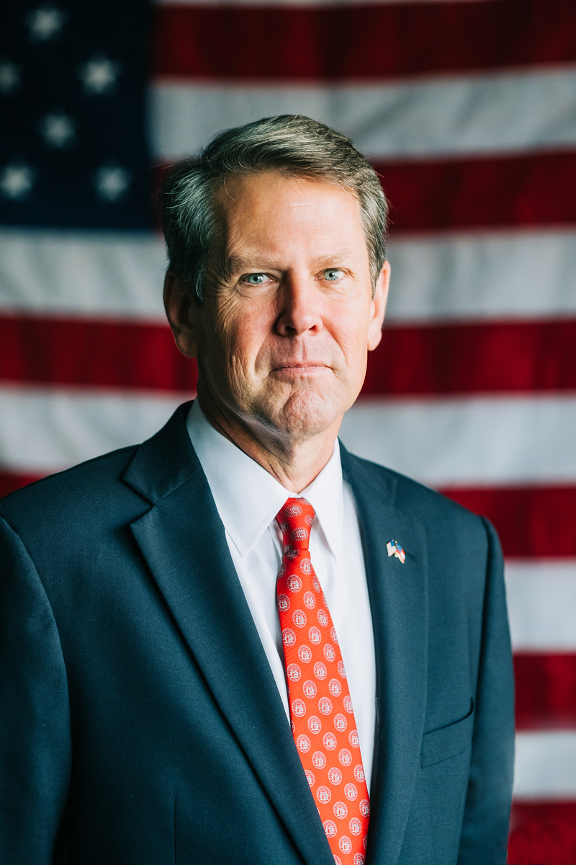
Tort Reform
“As we look ahead, I believe one of the biggest threats to Georgia’s future, is our state’s legal environment.”
“It’s abundantly clear that the status quo isn’t working and a failure to act on meaningful tort reform will continue to put Georgians and their livelihoods in serious jeopardy.”
“These stories highlight a legal environment that leads to fewer options for Georgians seeking care, higher costs, and ultimately worse health outcomes for our people.”
“But I know this issue is complicated and will not be easy to fix. There are many different stakeholders, with competing ideas about how to move forward. However, doing nothing is no longer an option.”
“But I also want to be very clear: there is always room for compromise, but there will be no room for excuses, half-measures, or failure. Whether it’s this legislative session, or a second one later this year, we will achieve meaningful, impactful tort reform.”
Notes:
After several years of Kemp talking a good game…..you saw his rhetoric ramp up in the final few months of last year leading into this year’s legislative session

Slide 4
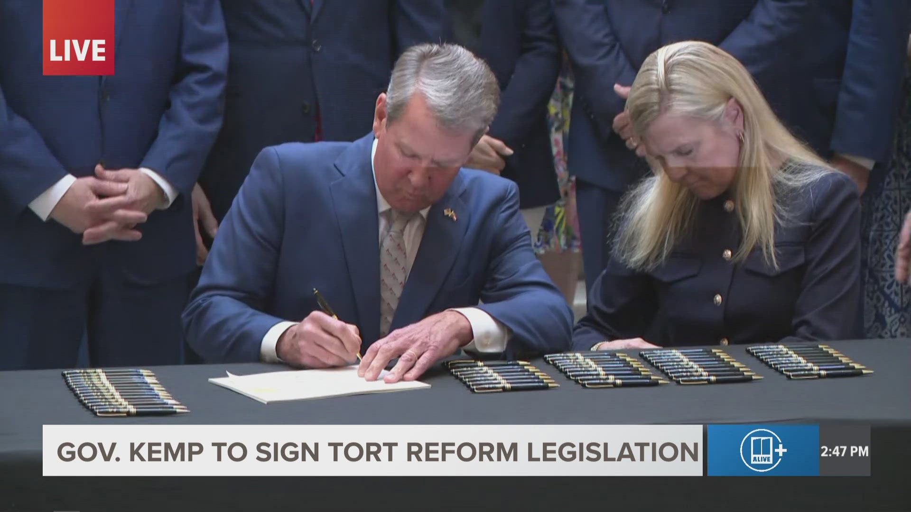

GA Senate Bill 68
Sponsors (26 Republican Senators)
John F. Kennedy (Primary Sponsor) | District 18 | Macon area
Bill Cowsert | District 46 | Athens area
Clint Dixon | District 45 | Gwinnett County
Greg Dolezal | District 27 | Forsyth County and parts Fulton)
Steve Gooch | District 51 | Dahlonega area
Marty Harbin | District 16 | Fayette
Billy Hickman | District 4 | Statesboro area
Chuck Hufstetler | District 52 | Rome area
Burt Jones | District 25 | Jackson area
Kay Kirkpatrick | District 32 | Marietta area
Max Burns | District 23 | Sylvania area
Mike Dugan | District 30 | Carrollton area
Randy Robertson | District 29 | Columbus area
Brian Strickland | District 17 | McDonough area
Blake Tillery | District 19 | Vidalia area
Larry Walker III | District 20 | Perry area
Ben Watson | District 1 | Savannah area
Shawn Still | District 48 | Johns Creek area
Carden Summers | District 13 | Cordele area
Matt Brass | District 28 | Newnan area
Jason Anavitarte | District 31 | Dallas area
Lee Anderson | District 24 | Grovetown area
Russ Goodman | District 8 | Valdosta area
Rick Jeffares | District 47 | Conyers area
Bo Hatchett | District 50 | Cornelia area
Sam Watson | District 11 | Moultrie area
Timeline
Introduced by the GA Senate (January 29th, 2025)
Passed the Senate Judiciary Committee (February 10th, 2025)
Passed the Georgia Senate (February 21st, 2025)
  Mostly along party lines (one Republican/one Democrat)
Passed Georgia House – w/ amendments (March 20th, 2025)
  Razor-thin margin with some Republicans and Democrats breaking party lines
  Immediate transmission back to Senate (approved by vote)
Passed Georgia Senate w/ House’s amended version (March 21st, 2025)
April 21, 2025

Slide 5


Summary of Key Georgia Tort Reform Provisions

Slide 6
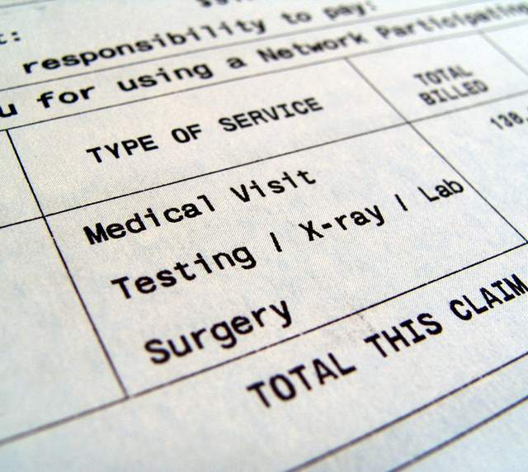
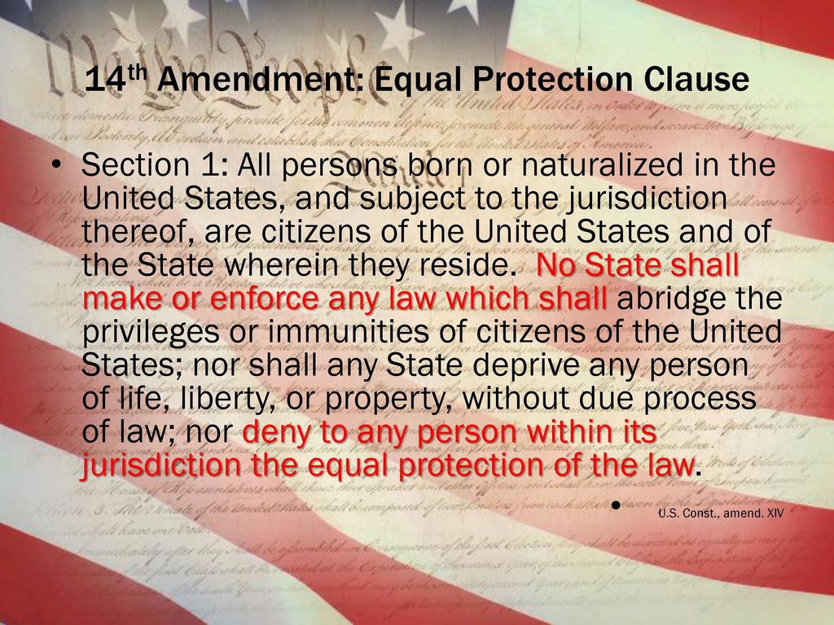
“Truth in Damages”
(Phantom Damages)
What changes?
  Special damages for medical expenses are limited to the “reasonable value of medically necessary care” and are determined by the jury at trial.
  Relevant to the determination of the “reasonable value” of medically necessary care is both:
  (1) the amounts charged for past, present, and future medical expenses and
  (2) the amount actually necessary to satisfy such charges pursuant to an insurance agreement or worker’s compensation program, regardless of whether the plaintiff actually used, is using, or will use such insurance to satisfy such charges.
Letters of protection are discoverable
But let’s not celebrate yet…..we’ve got a fight ahead….
The plaintiff bar is going argue that these reforms violate the Equal Protection Clause by arbitrarily disadvantaging injured plaintiffs compared to other tort victims. They will argue this creates an unequal class of plaintiffs:
Those with insurance or negotiated discounts recover less than uninsured plaintiffs or those without such discounts, despite suffering the same injuries and incurring the same billed charges.
This differential treatment, they contend, lacks a rational basis and unfairly burdens certain plaintiffs, potentially violating equal protection principles.

Slide 7
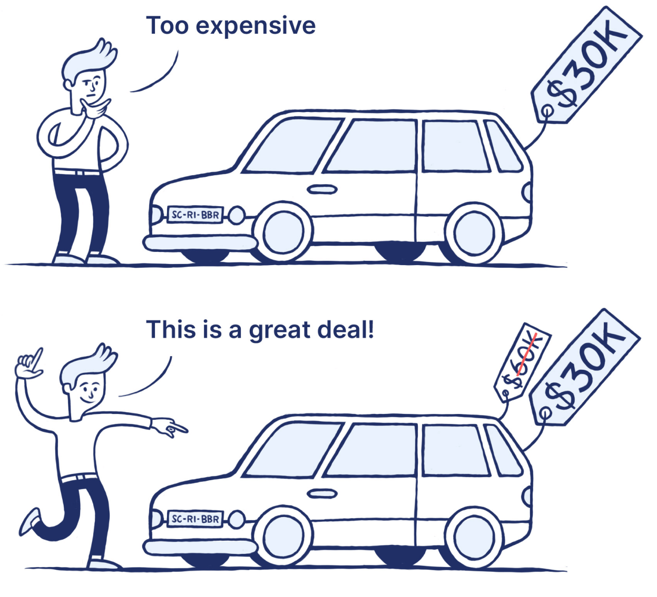

Anchoring
Defining Damages & Limiting Arguments of Counsel
A Plaintiffs’ lawyer is not allowed to elicit any testimony going to the dollar value of noneconomic damages at any point. But, in the closing argument phase, the Plaintiffs’ counsel may “argue” non-economic damages, provided he or she specifically states the dollar amount the Plaintiff is seeking in the introductory or opening phase of the closing argument, then sticks to that number in the final or rebuttal phase of closing argument. The critical role for Courts will be making sure any argument offered to the jury has a “rational connection” to the evidence. This will ban references to things like major league baseball player salaries or the value of a military fighter jet, which have no rational connection to an ordinary citizen’s tort claim.

Slide 8
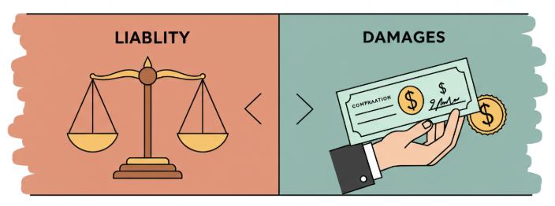
Trial Bifurcation
(Liability/Damages)
2ND Phase
Determine
DAMAGES
1st Phase
The jury (or trier of fact) shall determine the fault of each defendant
If the jury finds any defense at fault, the jury shall further determine through an appropriate jury form the percentages of those who contributed to the injuries
Evidence and arguments of counsel are limited to the issues of liability
2nd Phase
If a defendant is liable, the trial shall be immediately recommenced with the same judge and jury to determine all compensatory damages to be awarded
Evidence and arguments of counsel are limited to the issues of damages
Key Points
A motion must be made to bifurcate
A judge can reject and order a concurrent trial of liability and damages only upon motion by any party opposing and upon the court’s determination that:
  The plaintiff was injured by an alleged sexual offense (Psychological harm from testifying more than once)
  The amount in controversy is less than $150K

Slide 9

Double Recovery of Attorney’s Fees
SB 68 creates O.C.G.A. § 9-15-16, which prohibits “double recovery” of attorney’s fees, costs, and expenses. Essentially, this new Code section prohibits a party from recovering attorney’s fees, court costs, or expenses more than once pursuant to multiple statutes authorizing such awards, unless the statute specifically authorizes the recovery of duplicate attorney’s fees, costs, and expenses.

Slide 10
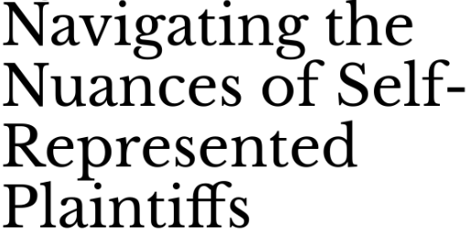

Civil Procedure Rule Changes
Key Changes:
Relevant in healthcare, if you receive illegible and pro se complaints, the Act removes the requirement that a defendant attempt to respond to ambiguous or vague complaints before a defendant can move for a more definite statement. A motion for more definite statement requires the plaintiff to rewrite their complaint to be less ambiguous and/or vague.
Now prohibits plaintiffs from dismissing a case without prejudice after a defendant files an answer or summary judgment motion unless all parties consent or the court approves. This prevents a plaintiff from “cherry-picking” venues by dismissing a case during trial and refiling in a more favorable jurisdiction after the defendant has racked up costs of preparing for trial.

Slide 11
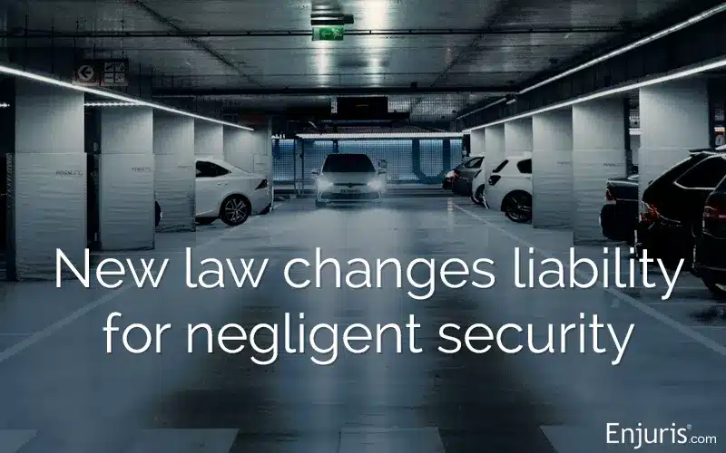

Other Areas of Focus
Standard for Negligent Security Liability (“Premises Liability”)
Allowing a Jury to Know Whether the Plaintiff Wore Their Seatbelt (“Admissible Seatbelt Evidence”)

Slide 12


Senate Bill 69

Slide 13
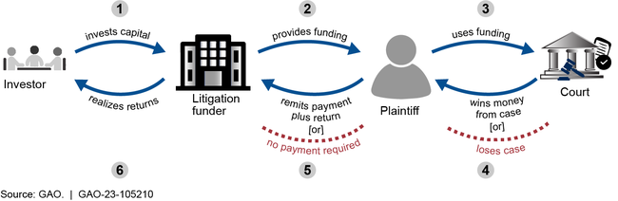

Regulating Litigation Financing
Key Provisions
Disclosure Requirements:
Plaintiffs must disclose any third-party litigation financing agreement to all parties, their attorneys, and the court within 30 days of signing the agreement or filing the lawsuit, whichever is later.
The disclosure must include the full agreement, identifying the funder, the amount advanced, and the terms of repayment, ensuring transparency about external financial involvement.
Interest Rate Caps:
Limits the annual interest rate that litigation funders can charge plaintiffs to 18%, calculated on the amount advanced, to prevent exploitative lending practices.
Prohibits compounding interest or additional fees that exceed this cap, protecting plaintiffs from ballooning debt that could consume their recovery.
Prohibition on Funder Influence:
Bars litigation funders from making decisions about the case, including whether to settle, how to litigate, or which attorney to hire, preserving the plaintiff’s and attorney’s autonomy.
Prevents funders from receiving case updates or legal documents directly from attorneys unless explicitly allowed by the plaintiff, reinforcing attorney-client privilege.
The Act also: creates criminal liability for any person who
willfully violates the requirements of the Act.

Slide 14
Regulating Litigation Financing
Key Provisions
Discoverability and Admissibility:
Makes financing agreements discoverable by all parties during litigation, allowing defendants to request and review them as part of the discovery process.
Permits courts to admit these agreements as evidence if relevant to issues like bias, credibility, or settlement pressures, giving defendants tools to challenge funded claims.
Attorney Protections:
Prohibits attorneys from splitting legal fees with litigation funders or paying them referral fees, aligning with Georgia’s Rules of Professional Conduct to avoid conflicts of interest.
Ensures attorneys owe their primary duty to the client, not the funder, even if the funder is covering litigation costs.
Enforcement and Penalties:
Noncompliance with disclosure or interest rate rules can result in the financing agreement being deemed unenforceable by the court, nullifying the funder’s claim to repayment.
Authorizes civil penalties, including fines up to $10,000 per violation, and allows courts to award attorney’s fees to prevailing parties in disputes over funding violations.

Slide 15
Regulating Litigation Financing
Key Provisions
Scope and Exemptions:
Applies to all civil actions in Georgia involving third-party funding, including personal injury, medical malpractice, and commercial litigation, but excludes class actions and contingent-fee arrangements with attorneys.
Does not regulate funding for defendants or pre-litigation advances (e.g., medical loans), focusing solely on litigation-specific financing.
Effective Date:
Takes effect upon Kemp’s signature for all new and pending cases as of that date, with no retroactive application to agreements predating enactment, ensuring a clear implementation timeline.

Slide 16

AI in Oncology
Exploring the Current State and Future Trends of Artificial Intelligence in Healthcare
John W. Miller II
Chairman/Partner

Slide 17


Disclosure
I have no financial interest in any of the AI tools in this deck…
Nor am I endorsing any of the tools
I take no credit for the images in this slide deck….all were AI generated
Picture source: https://labs.google/fx/tools/image-fx

Slide 18

01
Ripped from the Headlines –
The Patient’s Perspective

Slide 19
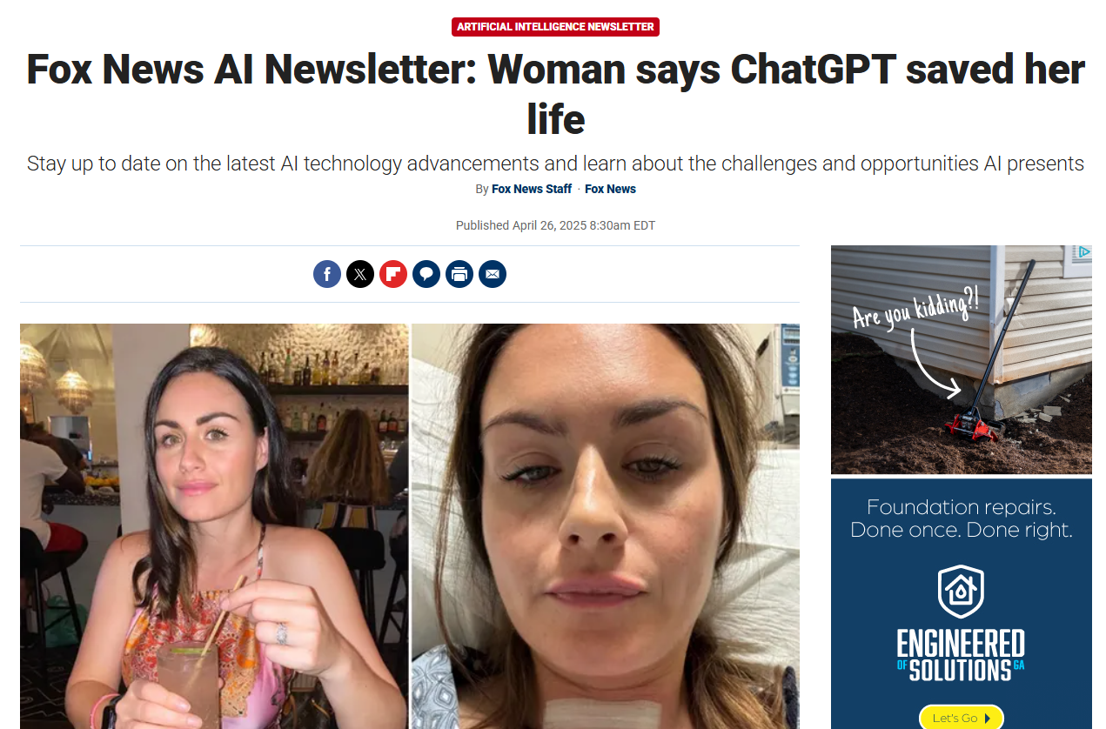
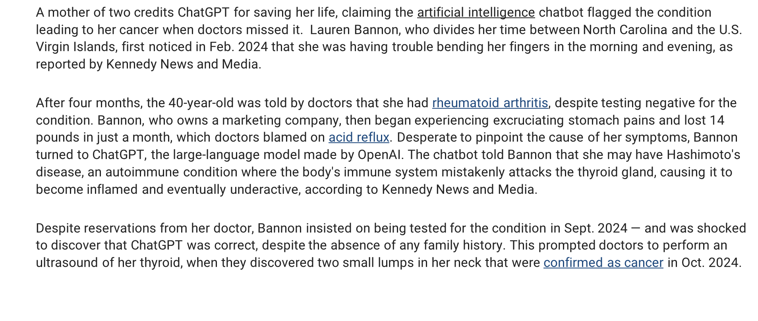
Notes:
Story from two weeks ago
Trouble bending fingers
Diag with rheumatoid arthritis then acid reflux
Went to ChatGPT and entered her symptoms
Hashimoto’s disease
Forced her provider to run additional tests
SECOND POPUP

Slide 20
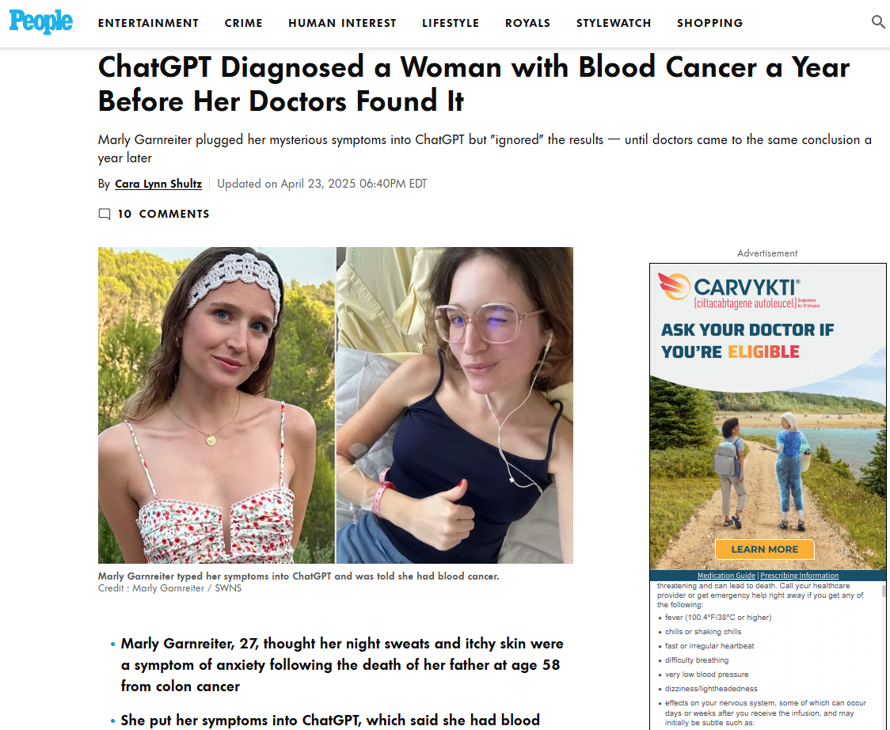
Marly Garnreiter, 27, was struggling with night sweats and itchy skin, but initially chalked her symptoms up to lingering anxiety and grief after her father, Victor, died at age 58 from colon cancer in January 2024.
When she saw her doctor, all her tests came back normal. So Garnreiter decided, on a lark, to put her symptoms into the AI chatbot, ChatGPT. “It said I had blood cancer,” Garnreiter, who hails from Paris, said, according to The Daily Mail. “My friends were skeptical when I told them, and said I should only consult real doctors.”
Months later, Garnreiter returned to the doctor when she started to feel “something was wrong," she explained. “I had a pain in my chest and I was tired all the time,” she said.
Scans showed a “big mass” on her left lung, and tests showed she had Hodgkin lymphoma. As the Cleveland Clinic explains, it’s a type of blood cancer that starts in the white blood cells.
Chat GPT — which had diagnosed it a year earlier — was right.
Notes:
Story April
Patient was having night sweats and itchy skin…wen to her physician was tested and test results were normal
Put her symptoms ion ChatGPT and it said she had blood cancer
Ultimately diagnosed with Hodgkin lymphoma

Slide 21

02
The Current Landscape of AI in Healthcare

Slide 22
Where We Stand Today:
Healthcare AI market expected to reach $188 billion by 2030
Rapid evolution of machine learning, natural language processing, and computer vision
Increasing regulatory frameworks (FDA AI/ML regulatory pathways)
Growing integration with electronic health records
Shift from experimental to practical applications

Slide 23

03
Do we need to be concerned about AI’s impact on our profession in the future?

Slide 24
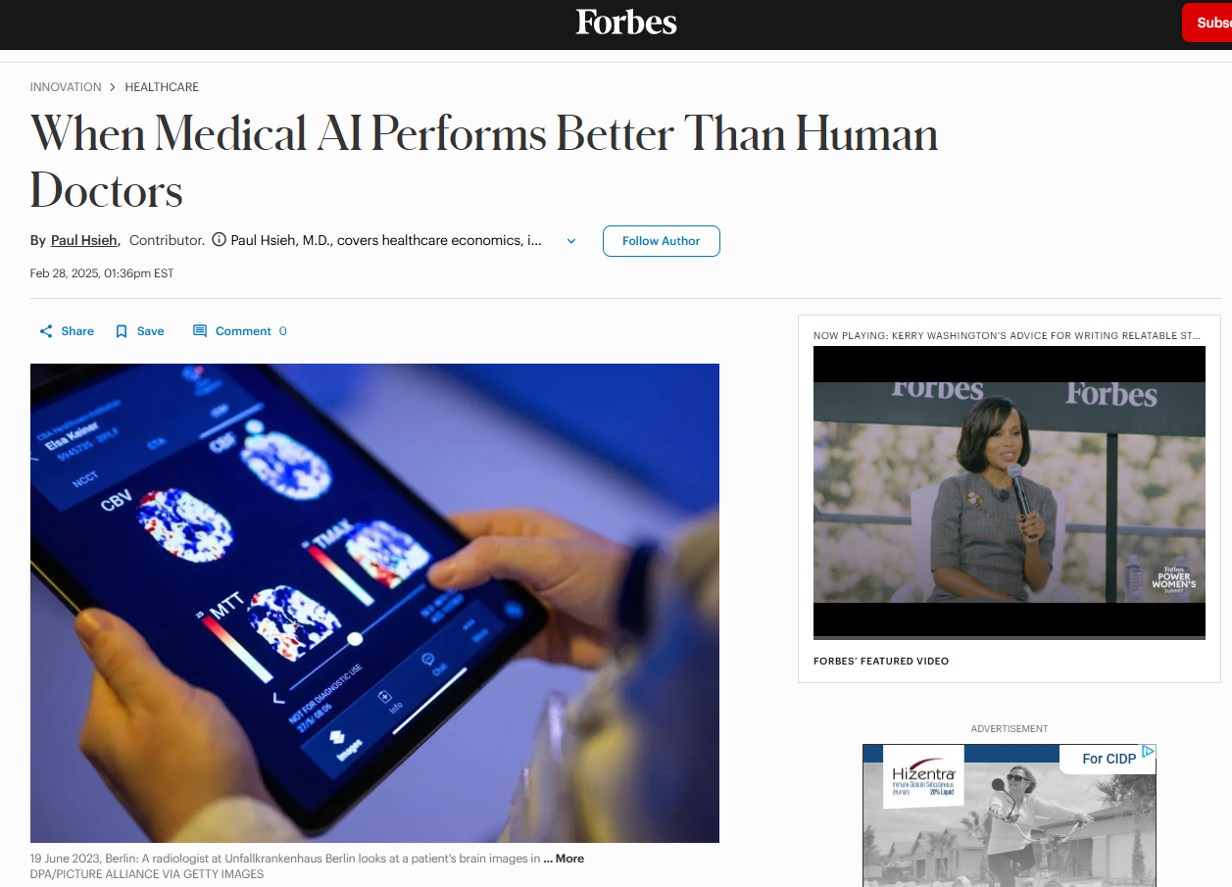
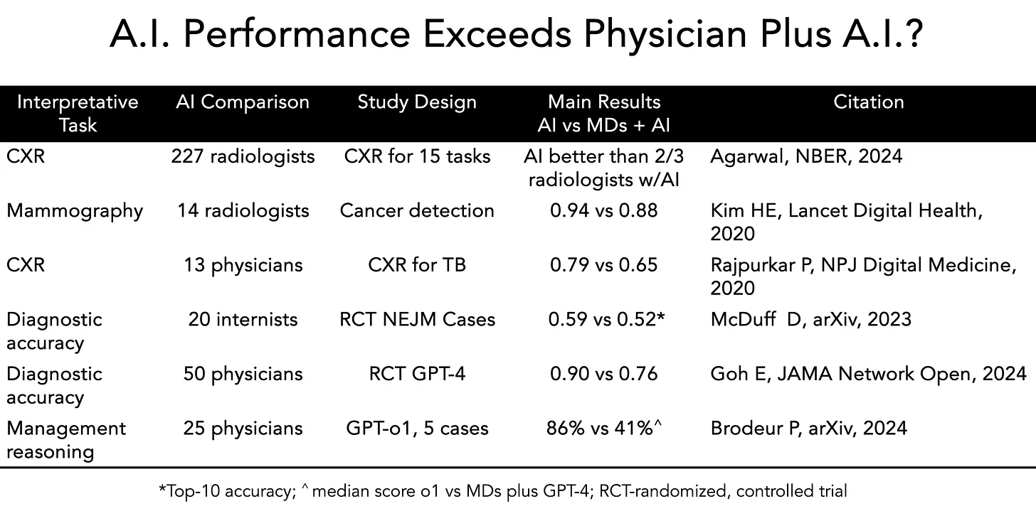
Dr. Eric Topol and Dr. Pranav Rajpurkar recently published an editorial reviewing several studies in which the AI alone performed better than either humans alone or humans-plus-AI. For instance, in one randomized clinical trial on medical reasoning, they noted: “When A.I. worked independently to diagnose patients, it achieved 92 percent accuracy, while physicians using A.I. assistance were only 76 percent accurate—barely better than the 74 percent they achieved without A.I.”
Notes:
Here’s an editorial in Forbes from February of this year
Bias against AI
Two click additional popups
First – commentary
Second - data

Slide 25
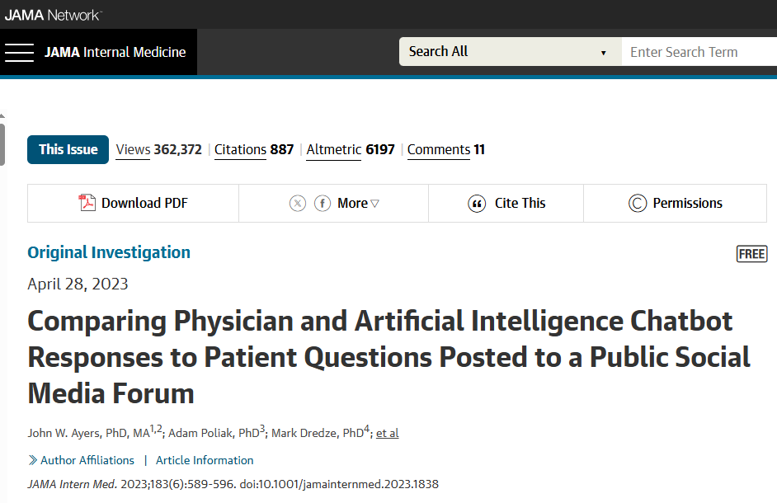
How good are chatbots at delivering answers to patients?
Notes:
This was a study of Reddit answers
Verified human answers
Ran them thru ChatGPT
Reviewed by healthcare professionals

Slide 26
How good are chatbots at delivering answers to patients?
Hypothesis Can an artificial intelligence chatbot assistant, provide responses to patient questions that are of comparable quality and empathy to those written by physicians?
Objective To evaluate the ability of an AI chatbot assistant (ChatGPT), released in November 2022, to provide quality and empathetic responses to patient questions.
Design, Setting, and Participants In this cross-sectional study, a public and nonidentifiable database of questions from a public social media forum (Reddit’s r/AskDocs) was used to randomly draw 195 exchanges from October 2022 where a verified physician responded to a public question. Chatbot responses were generated by entering the original question into a fresh session (without prior questions having been asked in the session) on December 22 and 23, 2022. The original question along with anonymized and randomly ordered physician and chatbot responses were evaluated in triplicate by a team of licensed health care professionals. Evaluators chose “which response was better” and judged both “the quality of information provided” (very poor, poor, acceptable, good, or very good) and “the empathy or bedside manner provided” (not empathetic, slightly empathetic, moderately empathetic, empathetic, and very empathetic). Mean outcomes were ordered on a 1 to 5 scale and compared between chatbot and physicians.

Slide 27
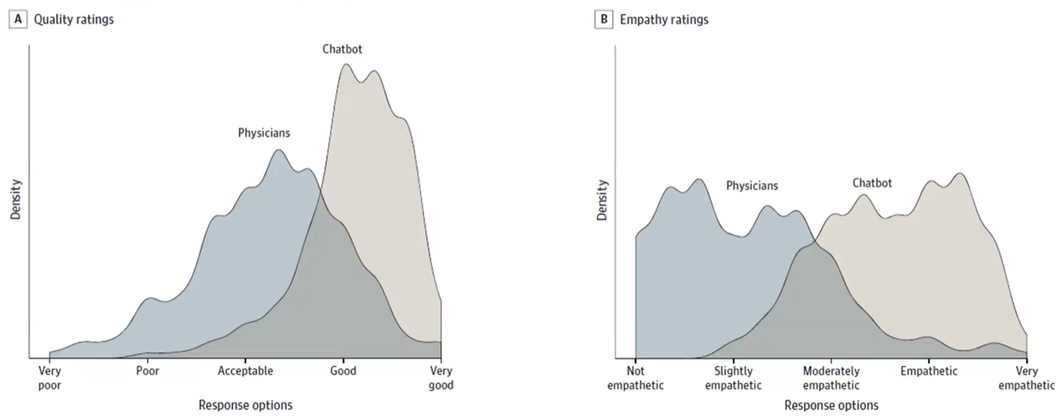
How good are chatbots at delivering answers to patients?
Results Of the 195 questions and responses, evaluators preferred chatbot responses to physician responses in 78.6% (95% CI, 75.0%-81.8%) of the 585 evaluations. Mean (IQR) physician responses were significantly shorter than chatbot responses (52 [17-62] words vs 211 [168-245] words; t = 25.4; P < .001). Chatbot responses were rated of significantly higher quality than physician responses (t = 13.3; P < .001). The proportion of responses rated as good or very good quality (≥ 4), for instance, was higher for chatbot than physicians (chatbot: 78.5%, 95% CI, 72.3%-84.1%; physicians: 22.1%, 95% CI, 16.4%-28.2%;). This amounted to 3.6 times higher prevalence of good or very good quality responses for the chatbot. Chatbot responses were also rated significantly more empathetic than physician responses (t = 18.9; P < .001). The proportion of responses rated empathetic or very empathetic (≥4) was higher for chatbot than for physicians (physicians: 4.6%, 95% CI, 2.1%-7.7%; chatbot: 45.1%, 95% CI, 38.5%-51.8%; physicians: 4.6%, 95% CI, 2.1%-7.7%). This amounted to 9.8 times higher prevalence of empathetic or very empathetic responses for the chatbot.
Notes:
POPUP

Slide 28
Key Points to Consider as Respects AI Diagnostic Accuracy In The Future
1) A.I. ‘thinks’ differently from humans — and will make different kinds of mistakes
2) We are at a tricky inflection point when we should sometimes trust the AI over the humans — but not always.
3) Patients will be increasingly willing to trust A.I. diagnoses over their regular doctors, and physicians should be prepared to accept that.

Slide 29

04
Crash Legal Briefing – “Learned Intermediary Doctrine”

Slide 30
Learned Intermediary Doctrine
The learned intermediary doctrine, a legal principle primarily used in product liability cases involving prescription drugs and medical devices, states that a manufacturer's duty to warn is fulfilled when it adequately warns the prescribing physician (the "learned intermediary") about potential risks, rather than directly warning the patient.

Slide 31
Learned Intermediary Doctrine Exception Examples
Vaccines Administered in Mass Clinics
Contraceptive Medications and Devices
Direct-to-Consumer Advertising
Mandated Direct Warnings

Slide 32
Learned Intermediary Doctrine
Under products liability, the manufacturer also has a duty to adequately warn the consumer—or in the medical context, the patient—about the risks of the product. Given how onerous this could be in the medical setting, many courts accept the learned intermediary rule, which asserts that once the physician has received adequate warning of the products risks, it is then her duty to convey that warning to the patient.
However, there are two exceptions to this rule:
if the manufacturer engages in direct consumer marketing, then the learned intermediary rule cannot be used as a defense
the more interesting of the two—is that if the physician is not playing an “active role” with regard to the product and patient, then the manufacturer cannot make use of the learned intermediary defense

Slide 33
Learned Intermediary Doctrine
This second exception is interesting because it may very well bear on the design and development of AI systems used by physicians. For instance, if such a diagnostic system is designed to make the diagnosis, and then present it to the physician who acts merely as a messenger between the system and the patient, then it would seem that the physician is playing a relatively passive role in this provision of treatment. If a faulty diagnosis is made resulting in patient harm, and the patient was not adequately warned regarding this risk, the physician’s relatively passive role could end up insulating her from liability, because it could eliminate the manufacturer’s ability to utilize the learned intermediary defense. Manufacturers might therefore be more likely to design their AI systems to actively engage the physician not only because they believe it will increase the likelihood of physician and hospital adoption, but also because it may provide the manufacturer shelter from liability by enabling them to use the learned intermediary defense.

Slide 34
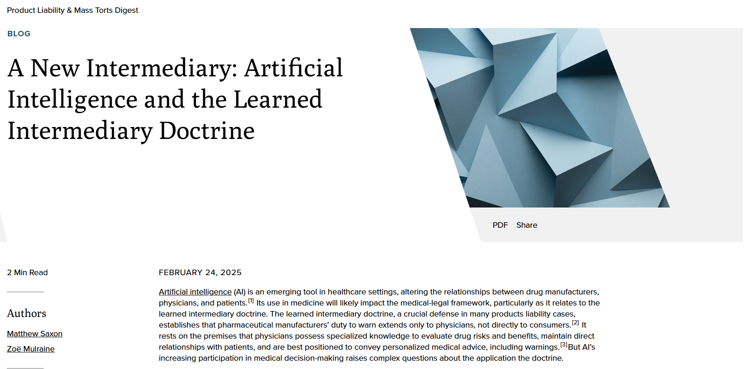
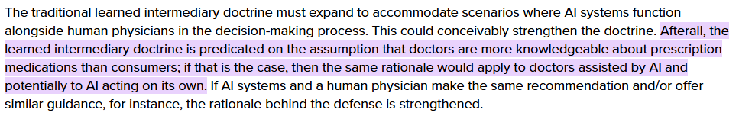
Learned Intermediary Doctrine
Notes:
Article from last month
Advocating for the expansion of the Learned Intermediary Doctrine

Slide 35

04
Back to Basics

Slide 36
Introduction to AI in Medicine...the lingo
Artificial Intelligence: Replication of human intelligence in computers
Machine Learning: Ability of a machine to learn using large data sets instead of hard coded rules; Gives computers the ability to learn without being explicitly programmed
Deep Learning: A type of ML, where we train an AI to predict outputs, given a set of inputs. Deep-learning software attempts to mimic the activity in layers of neurons in the neocortex, where thinking occurs. The software learns, in a very real sense, to recognize patterns in digital representations of sounds, images, and other data.
Neural Network: A computer system modeled on the human brain and nervous system.
At its core, AI leverages algorithms, particularly machine learning and deep learning, to process vast datasets, identify trends, and generate actionable insights often beyond the speed or scope of human analysis. In medical practice, this translates to tools like predictive models for patient outcomes, automated imaging analysis, and even robotic assistance in surgery.
HITL - “Human in the Loop”

Slide 37
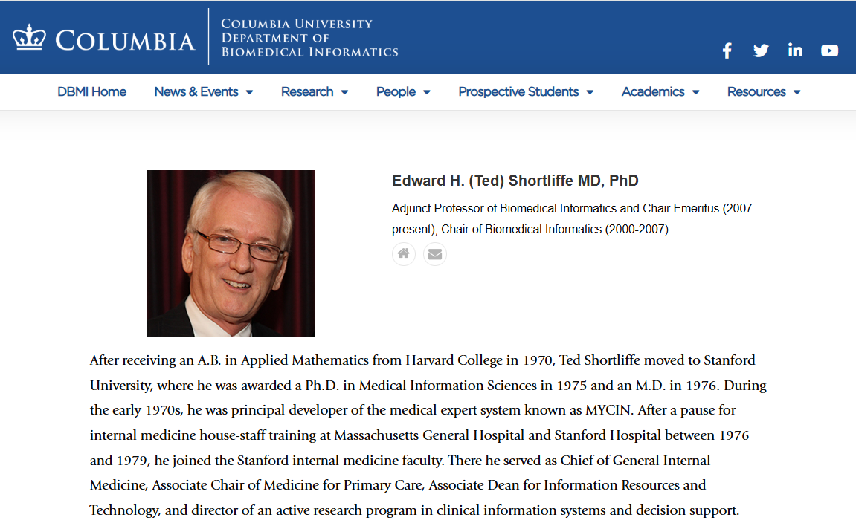
This is Not New
The integration of AI into medicine is not new—early expert systems like MYCIN for antibiotic recommendations date back to the 1970s—
Notes:
Data Scientists have been at solving problems with computers for decades….
Tried to find the grandfather ….. You may know of others
Dr. Shortliffe HARVARD and STANFORD grad who developed a program to make antibiotic recommendations back in the early 1970s

Slide 38
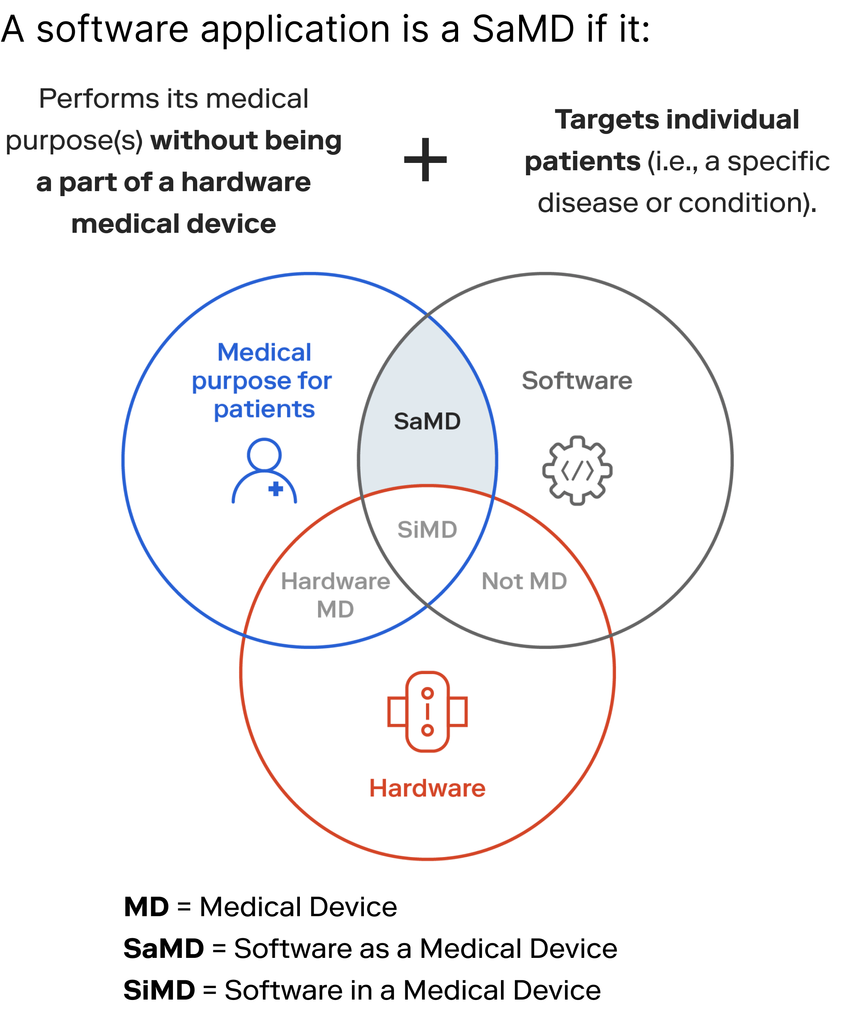
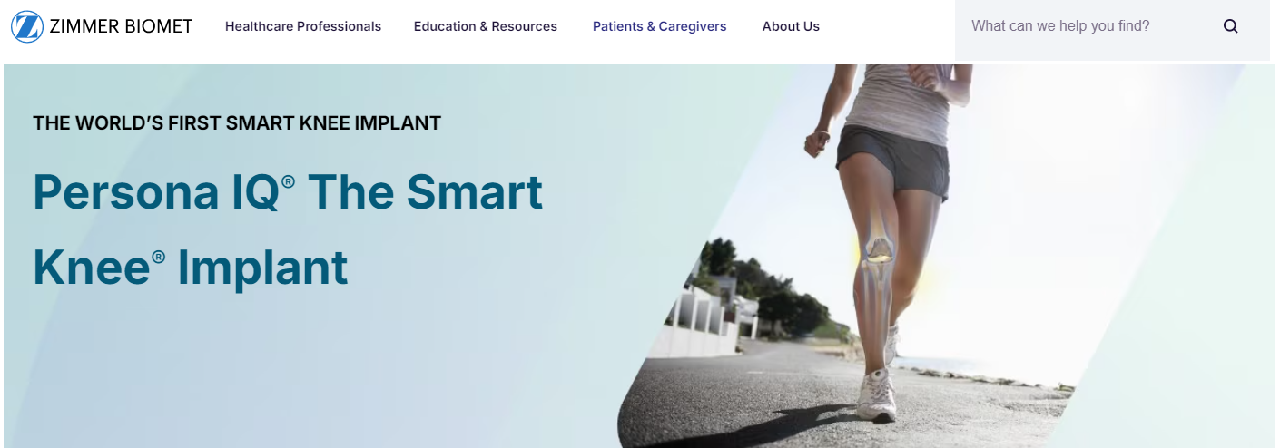
Examples of SaMD
Diagnostic applications that interpret imaging data to detect cancer.
Decision support software that analyzes patient data to recommend medication dosages.
Health monitoring apps that measure and track blood glucose levels, issuing warnings when readings are abnormal.
Examples of SiMD
Firmware that controls the dosage and timing settings in an infusion pump.
Software within an ultrasound machine that processes and enhances images in real time.
The operating system within a blood analysis device that manages tests and interprets the data.
Notes:
Important to understand where AI falls in an ever expanding technological landscape..
Software as a medical device
Another talk on Software in medical devices….hasn’t quite made it to pediatrics yet but it will….

Slide 39

05
The Promise of AI

Slide 40
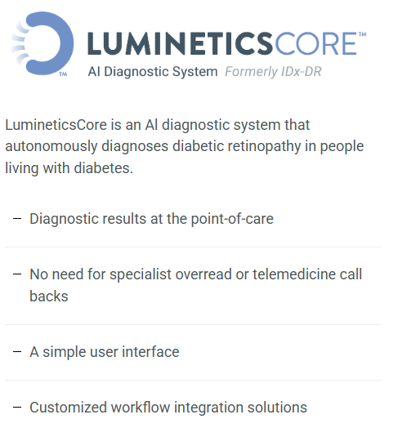
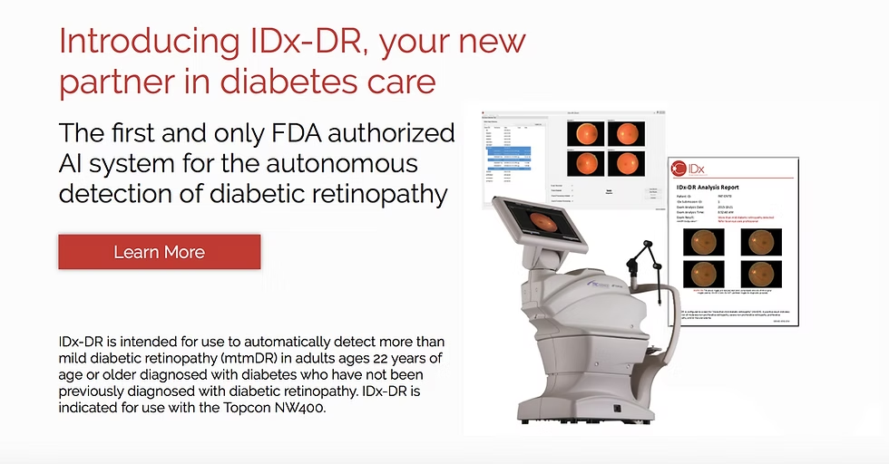
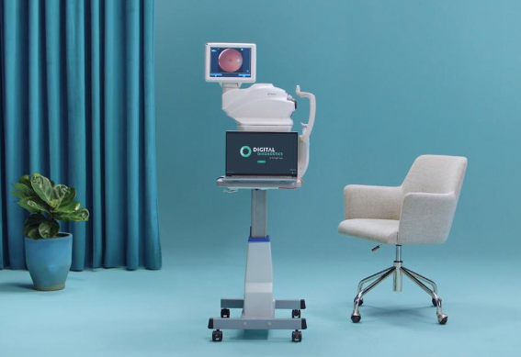
The Promise of AI
AI offers transformative potential in healthcare by enhancing efficiency, accuracy, and personalization. Its promises include:
Improved Diagnostic Accuracy
Notes:
The dream is autonomous diagnosis
An example of an FDA approved device that diagnoses diabetic retinopathy
AI system that diagnoses referable diabetic retinopathy using a single image from each eye, taken with a portable or tabletop retinal camera
Human in the Loop

Slide 41
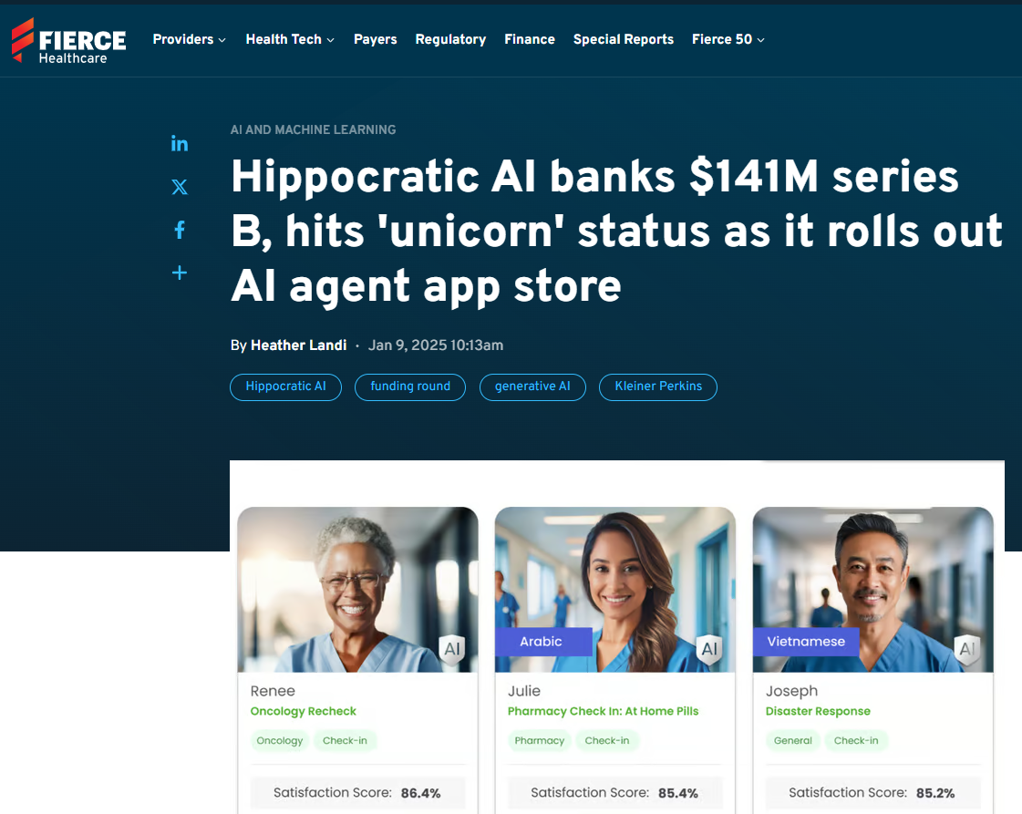
The Promise of AI
AI offers transformative potential in healthcare by enhancing efficiency, accuracy, and personalization. Its promises include:
2. Efficiency and Workflow Optimization
Notes:
Patient engagement

Slide 42


Hippocratic AI Focus
Notes:
Preop and post op patient engagement
With Human in the Loop at present

Slide 43
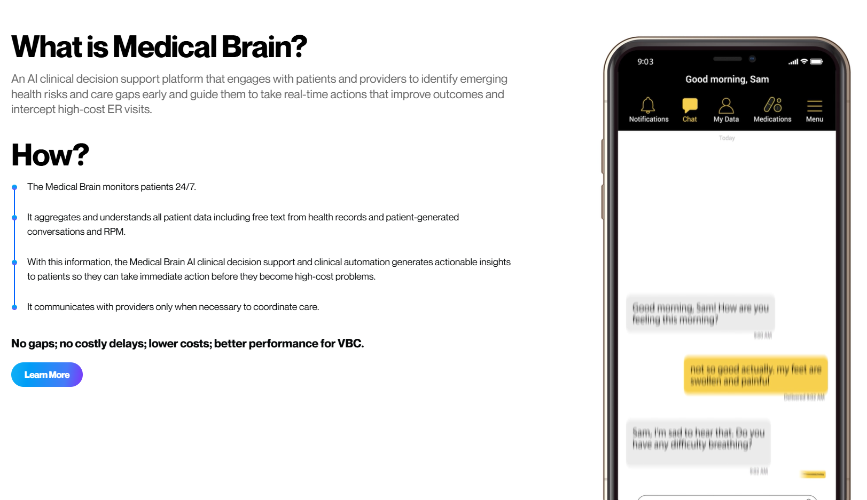
The Promise of AI
AI offers transformative potential in healthcare by enhancing efficiency, accuracy, and personalization. Its promises include:
2. Increased Connectivity / Medical Advice on Demand
Notes:
WebMD – Advice in your pocket

Slide 44
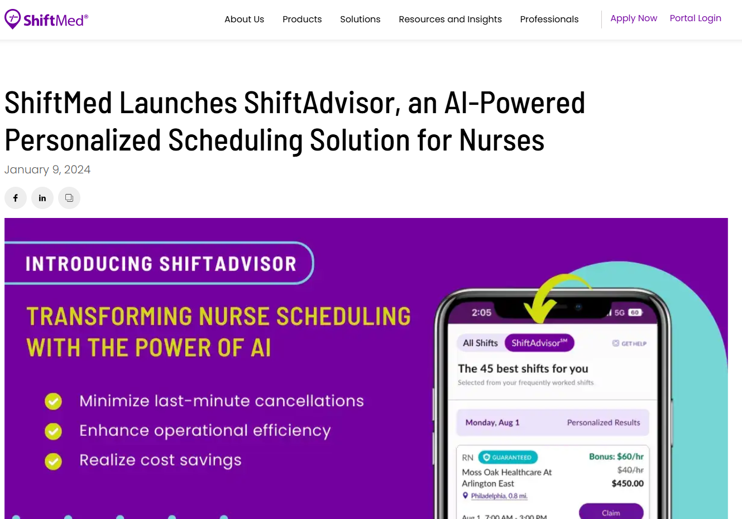
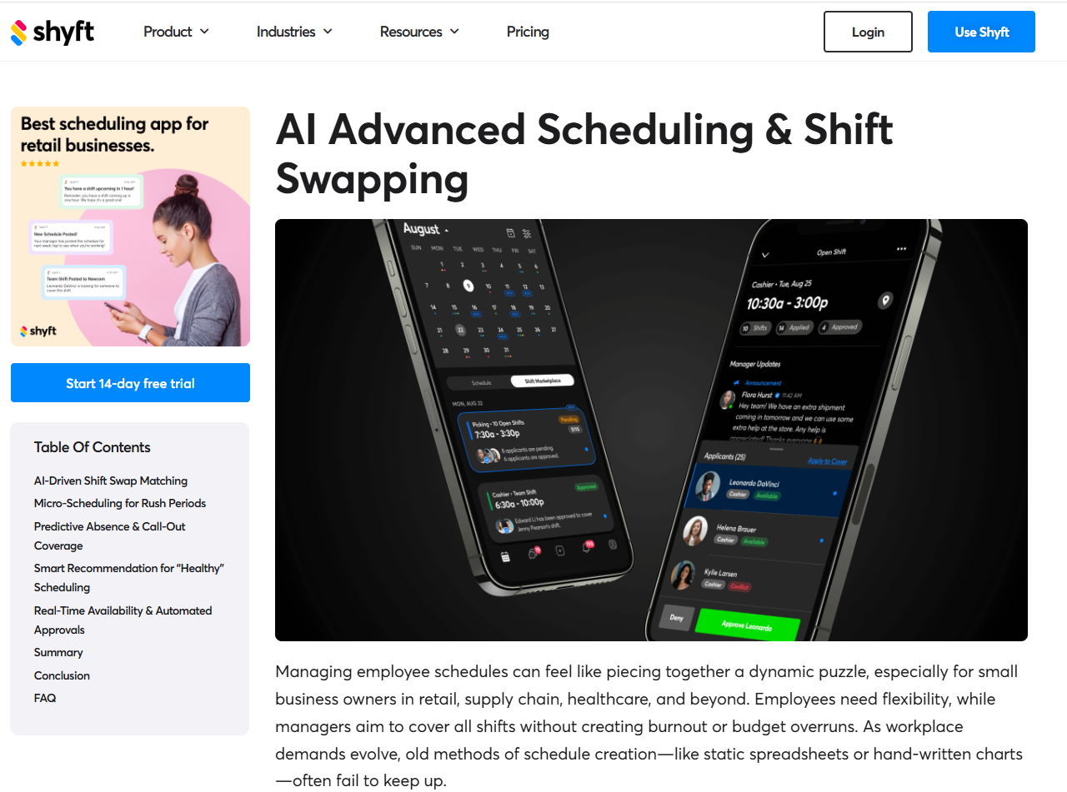
The Promise of AI
AI offers transformative potential in healthcare by enhancing efficiency, accuracy, and personalization. Its promises include:
2. Efficiency and Workflow Optimization
Notes:
More for hospitals than practices…but AI is going to allow for seamless scheduling of …
Not unlike the airline industry…at least one expert says there will be workforce solutions for bidding of shifts

Slide 45
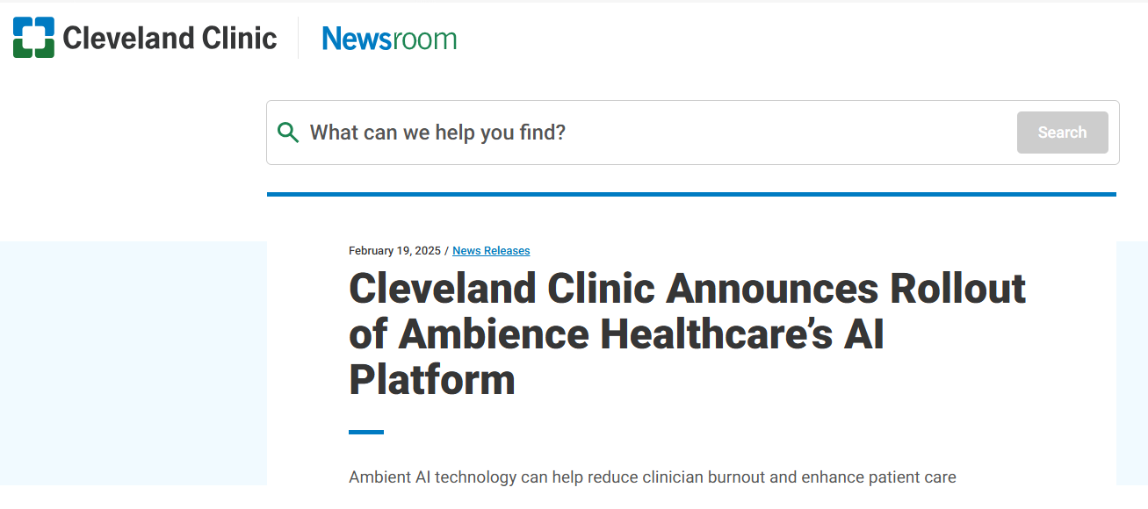
The Promise of AI
AI offers transformative potential in healthcare by enhancing efficiency, accuracy, and personalization. Its promises include:
2. Efficiency and Workflow Optimization
Later this month, Cleveland Clinic clinicians will have access to AI documentation software that records patient appointments and generates comprehensive medical notes. The notes are then reviewed and approved by the provider and uploaded to the patient’s medical record. This technology also generates customized after-visit summaries for patients, their families, and caregivers.
Notes:
From February of this year
More in a minute on this but ambient listening is the biggest game changer for private practices IMO…..

Slide 46
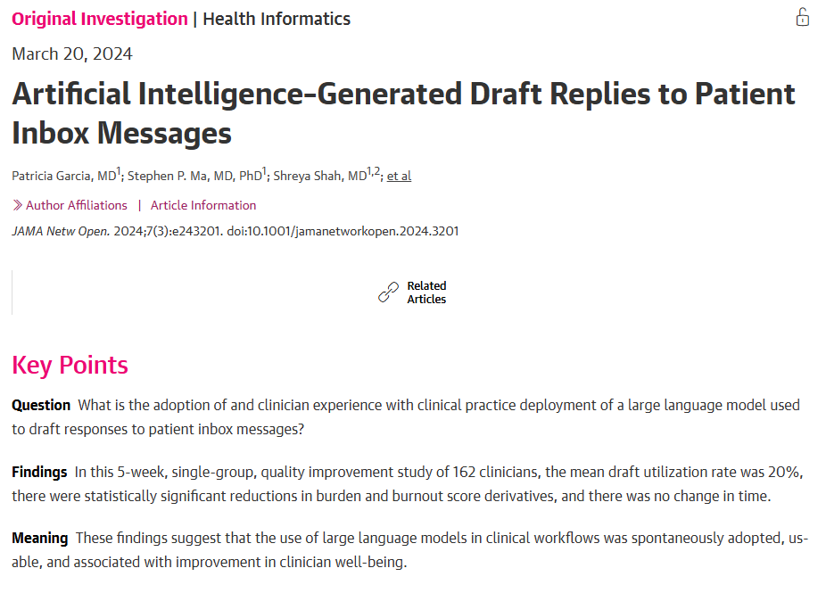
The Promise of AI
AI offers transformative potential in healthcare by enhancing efficiency, accuracy, and personalization. Its promises include:
2. Efficiency and Workflow Optimization
Notes:
Editing will make your life better…prepared and organized data so you can review and bless in short order

Slide 47
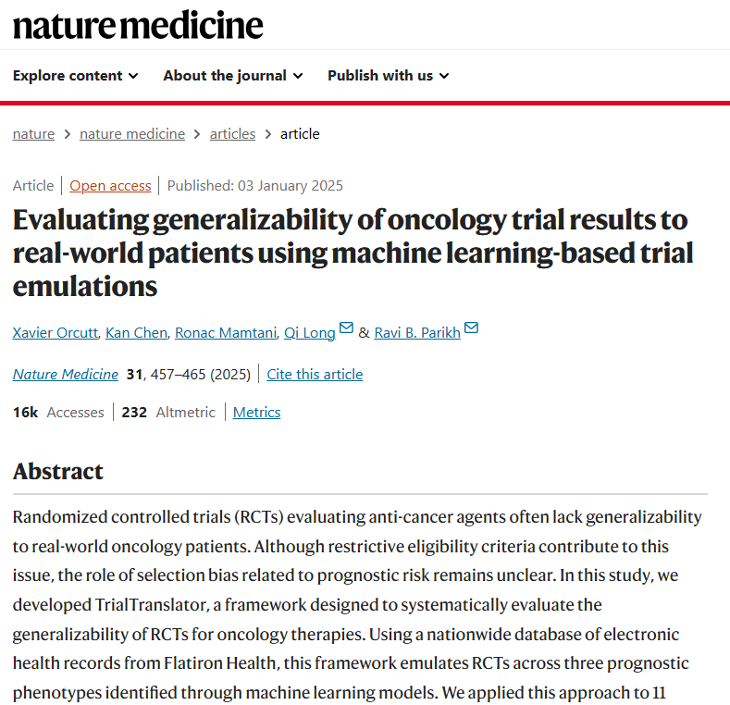
The Promise of AI
AI offers transformative potential in healthcare by enhancing efficiency, accuracy, and personalization. Its promises include:
3. Personalized Medicine
Notes:
This is an article from published in January from research out lead by Dr. Ravi Parikh at Emory
TrialTranslator is a framework that uses machine learning models to risk stratify real-world oncology patients into distinct prognostic phenotypes before emulating landmark phase 3 trials to assess the result generalizability
to translate oncology randomized controlled trials results to individual patients.

Slide 48
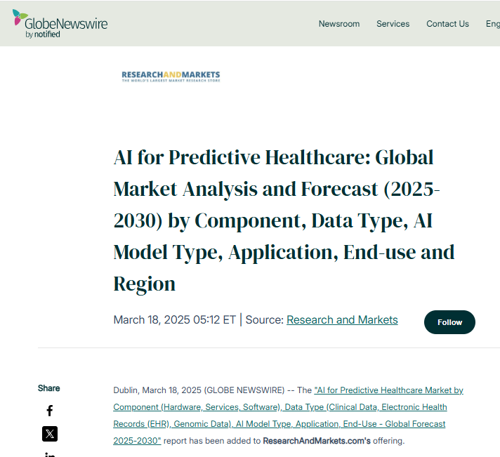
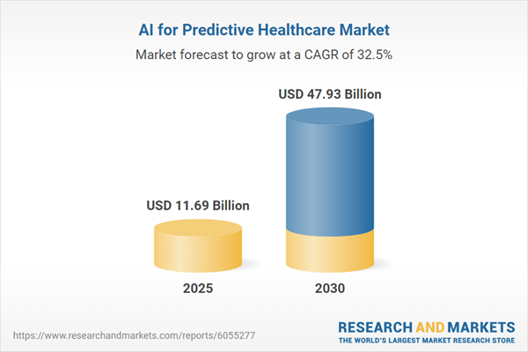
The Promise of AI
AI offers transformative potential in healthcare by enhancing efficiency, accuracy, and personalization. Its promises include:
4. Predictive AI
Notes:
Follow the money

Slide 49
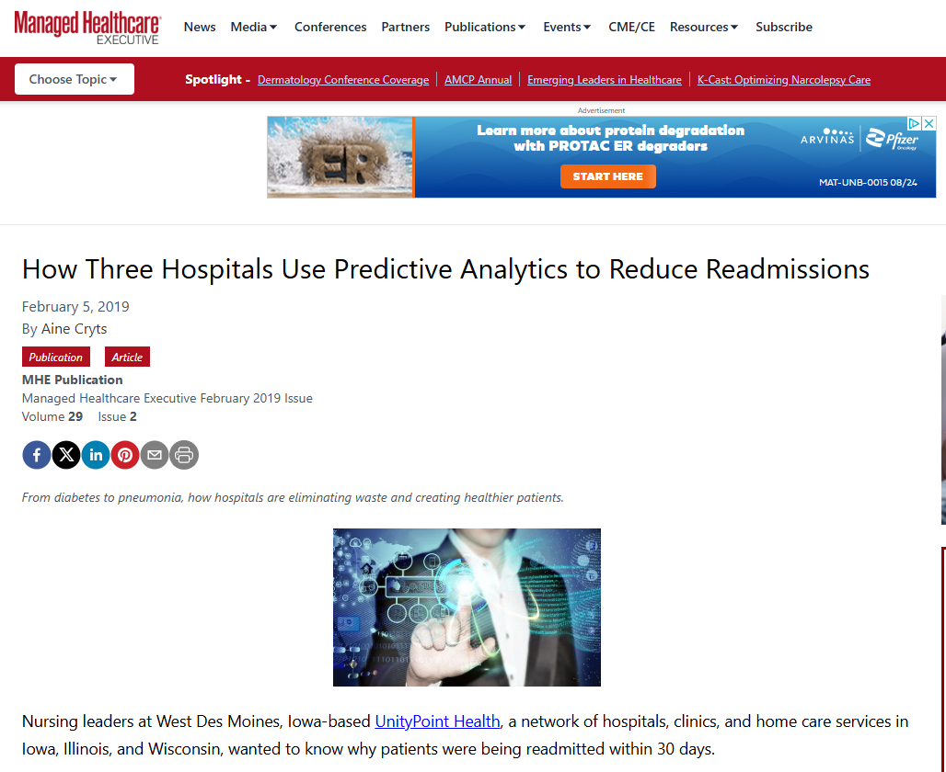
The Promise of AI
AI offers transformative potential in healthcare by enhancing efficiency, accuracy, and personalization. Its promises include:
4. Predictive AI
Once physicians realize that access to this information can help their patients, they embrace this tool, she says. In fact, Newland considers the readmission risk score as the “fifth vital sign” in her patients’ follow-up care.
Notes:
POP UP

Slide 50
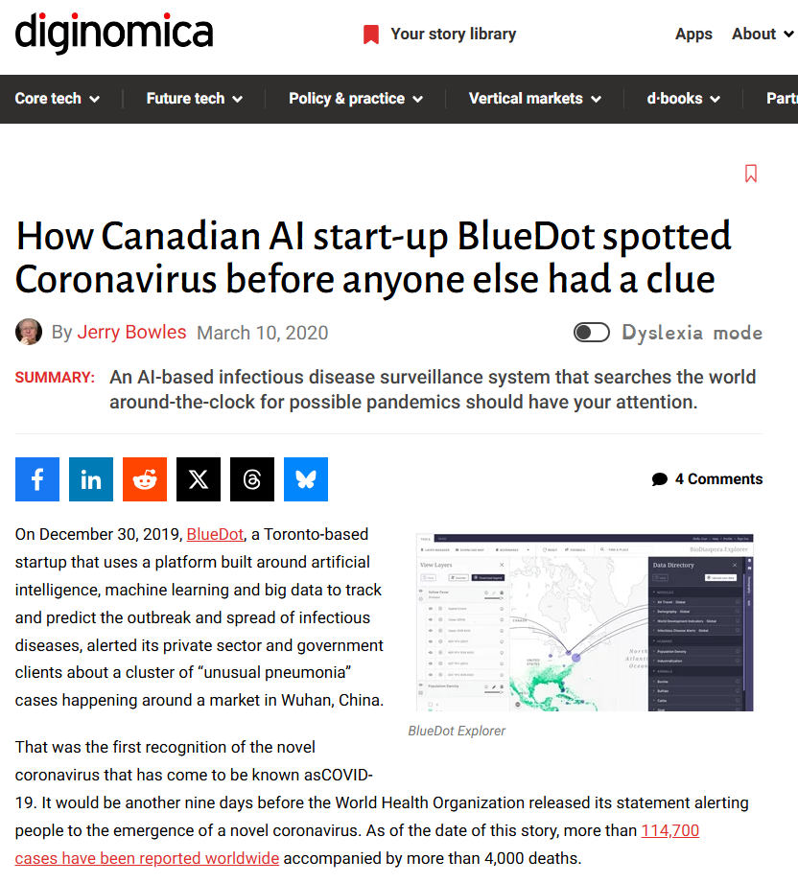
The Promise of AI
AI offers transformative potential in healthcare by enhancing efficiency, accuracy, and personalization. Its promises include:
5. Population Health

Slide 51
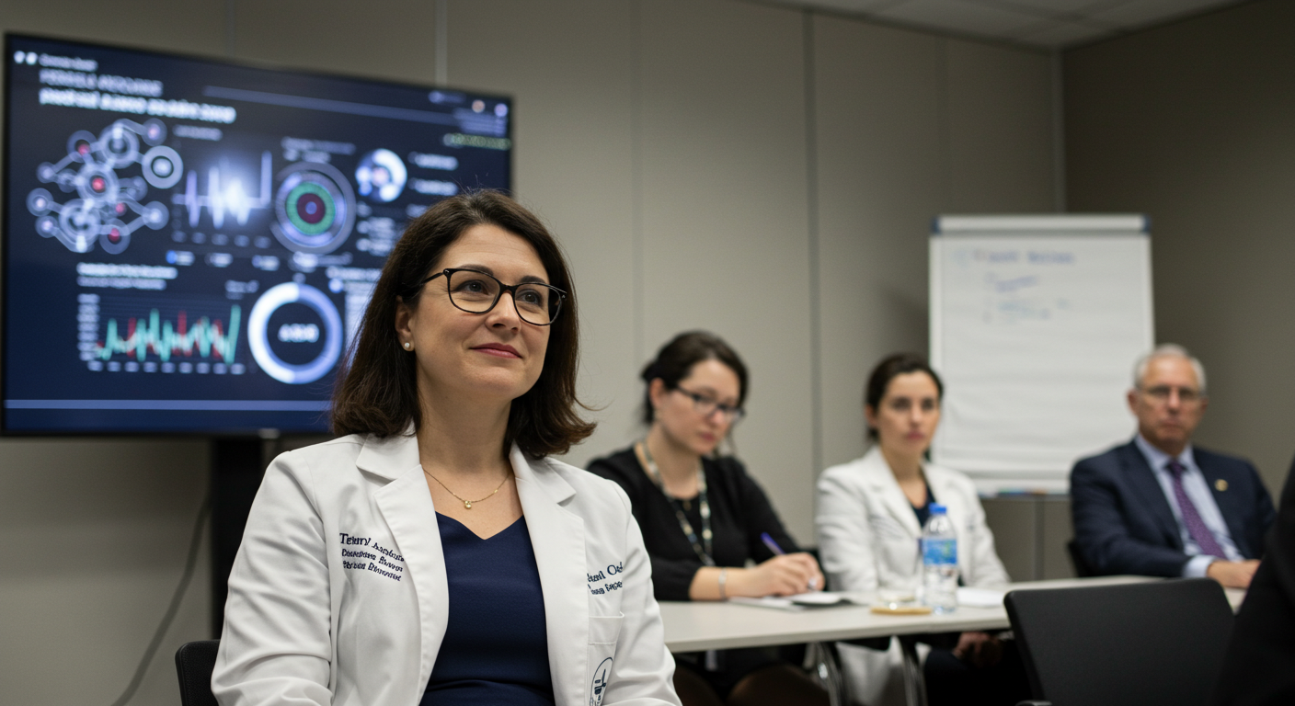
06
Oncology Specific AI
Notes:
Frankly there are some folks in this room probably better credentialed to talk about some of the Oncology Specific AL….and the universe of investment is far too large to tackle so I’m going to give you the categories of AI applications and a few examples that have made their way through the FDA in the last 90 days

Slide 52
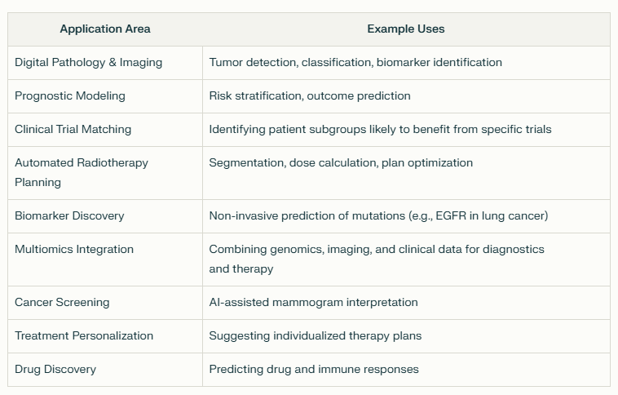
Key AI Applications in Clinical Oncology

Slide 53
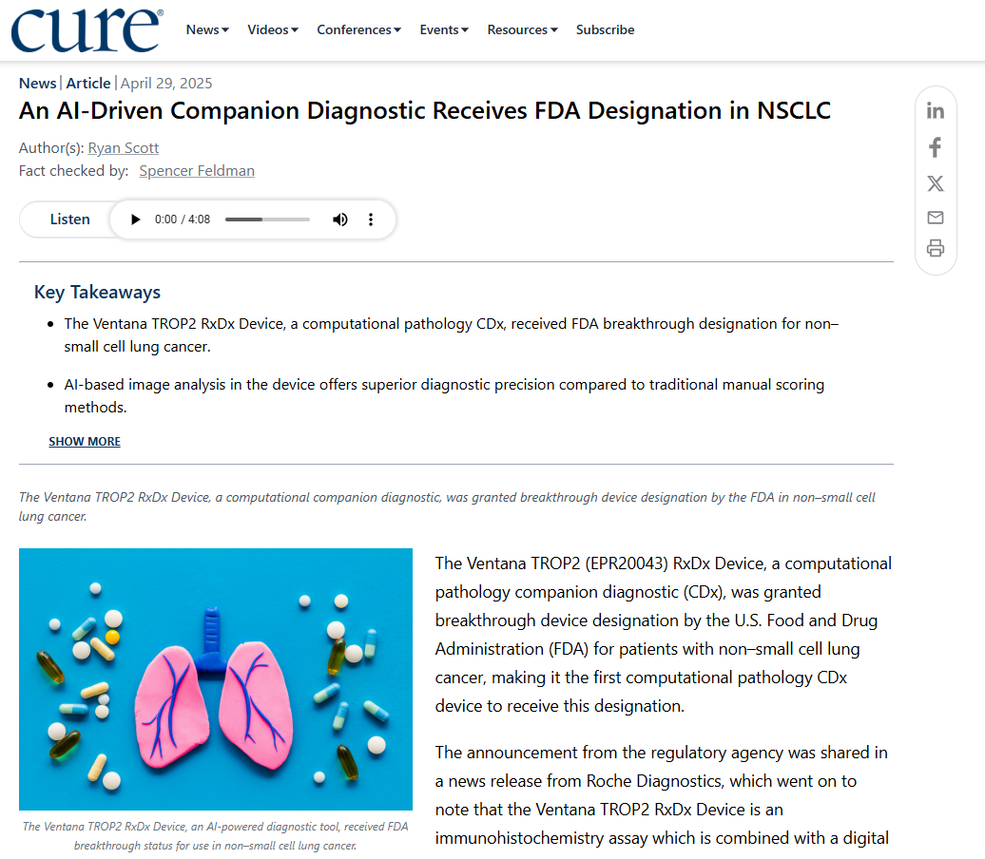
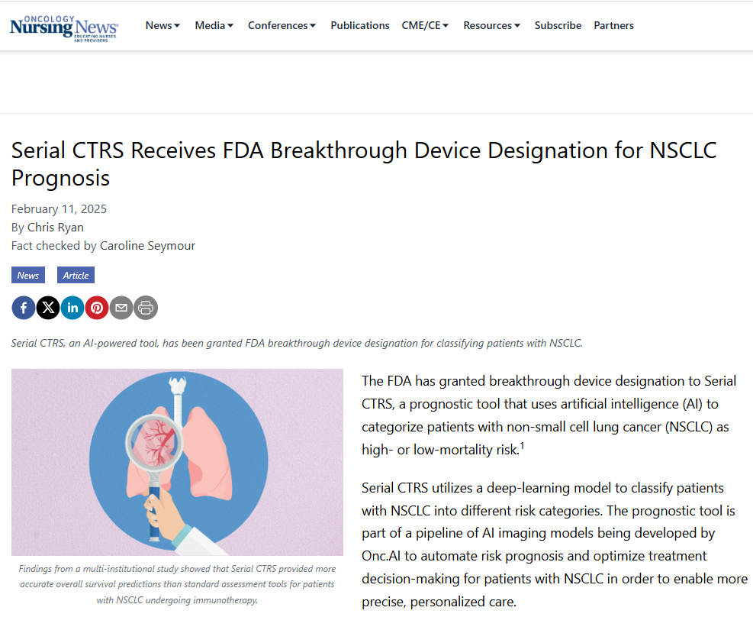
Key AI Applications Moving through the FDA in the Last 90 Days
Notes:
A couple of breakthrough device designations from the FDA two weeks ago and in Feburary to assist in the diagnosis and prognosis of non–small cell lung cancer
#1 Ventana TROP2 - First computational pathology companion diagnostic device
And
#2 Serial CTRS - The prognostic tool is part of a pipeline of AI imaging models being developed by Onc.AI to automate risk prognosis and optimize treatment decision-making for patients with non–small cell lung cancer in order to enable more precise, personalized care.

Slide 54
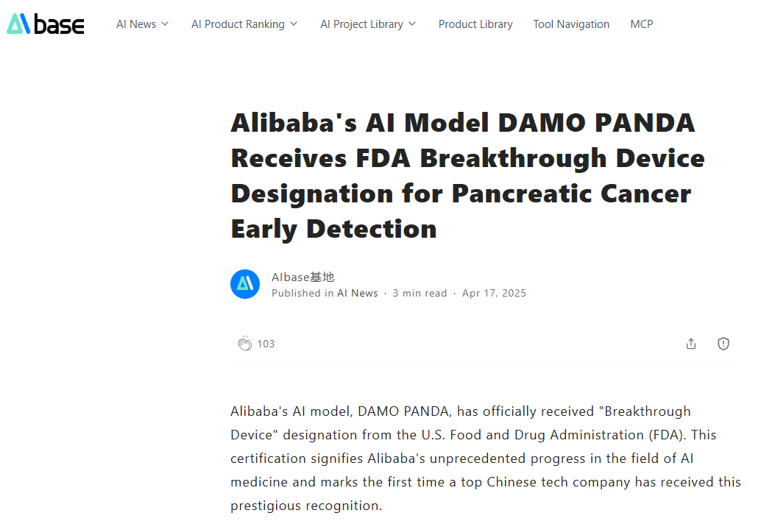
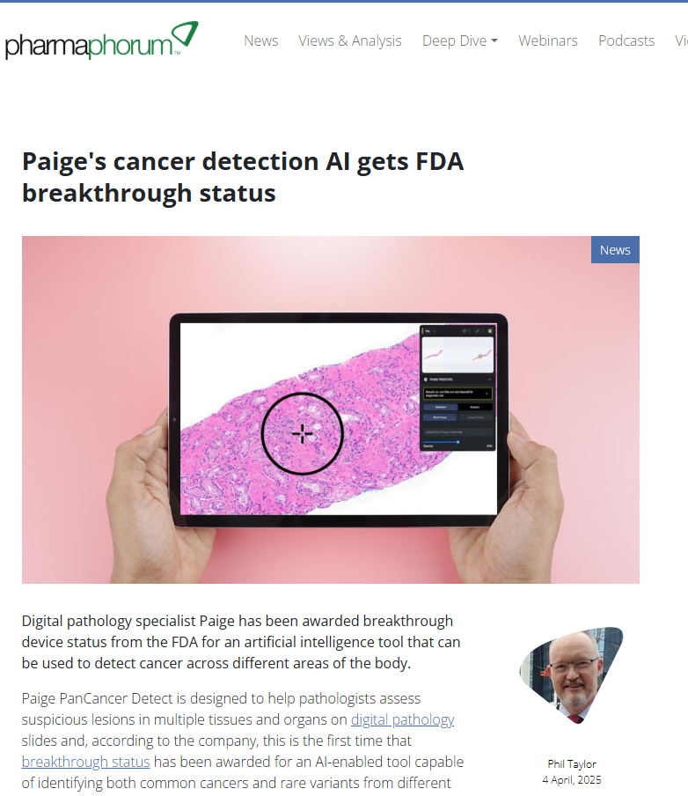
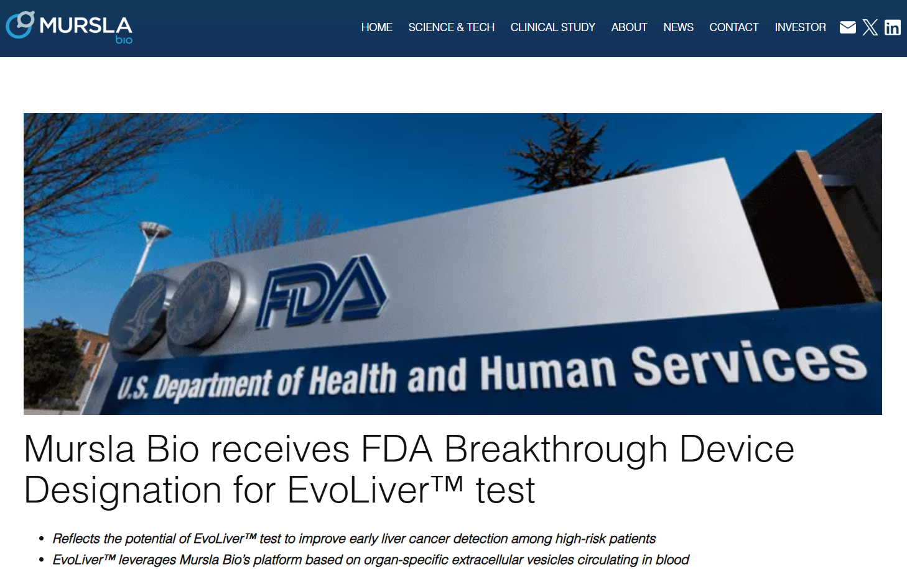
Key AI Applications Moving through the FDA in the Last 90 Days
Notes:
In April both:
#1 Paige PanCancer Detect, this is the first time that breakthrough status has been awarded for an AI-enabled tool capable of identifying both common cancers and rare variants from different anatomic sites.
#2 DAMO PANDA - a pancreatic cancer detection AI model aimed at early detection of pancreatic cancer through precise analysis of subtle lesions in CT imaging.
#3 EvoLiver test - gained this designation for hepatocellular carcinoma surveillance in high-risk cirrhosis patients.

Slide 55

07
General AI Applications

Slide 56





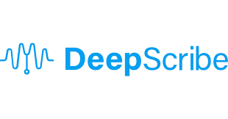







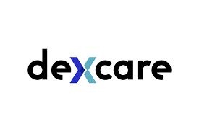

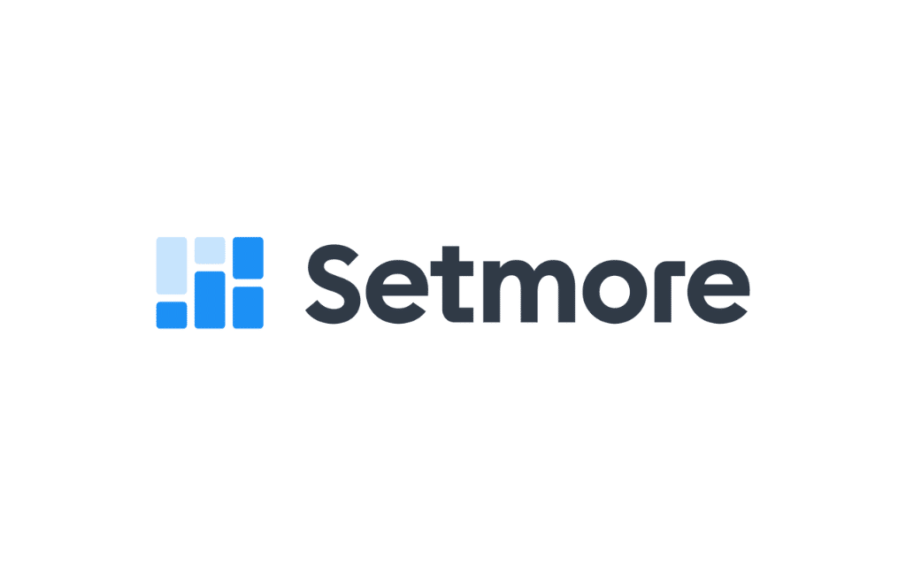

General AI Applications
Ambient listening documentation and care coordination efficiency e.g.
Appointment scheduling and a patient flow e.g.

Slide 57
While we’re on ambient listening devices – Consent is Important
Best Practices for Informed Consent:
Development Process:
Create age-stratified disclosure forms (parent/guardian, adolescent, child-friendly visual explanation)
Have forms reviewed by:
  Legal counsel with healthcare AI expertise
  Ethics committee or consultant
  Parent/family advisory council (especially important for diverse feedback)
  Adolescent advisory group (for teen-specific forms)
  Health literacy experts (aim for 6th-7th grade reading level for parent forms, 4th-5th grade for adolescent forms)
Implementation Strategy:
Train all staff on explaining AI use with consistent messaging
Create supporting materials:
  2-3 minute explainer video for waiting room
  FAQ document addressing common questions
  Age-appropriate visual aids for younger children
Develop process for documenting verbal explanations in addition to signed forms
Create script for discussing AI with families of different cultural backgrounds
Establish clear protocol for handling consent refusals or limitations
Special Considerations:
For split custody situations, obtain consent from all legal guardians
For adolescent-sensitive services, follow state-specific minor consent laws
For emergency situations, define when consent can be deferred
For limited English proficiency, provide professionally translated forms
For children with cognitive impairments, develop simplified explanations and assessment of understanding
For telehealth visits, implement electronic consent with verification questions
Ongoing Management:
Review and update forms annually or when adding new AI applications
Track consent metrics (refusal rates, questions asked, time to explain)
Conduct periodic patient/family surveys on comfort with AI use
Create clear process for consent withdrawal and documentation
Georgia is a one-party consent state when it comes to recording conversations.
This means that in Georgia, you can legally record a conversation, whether it's in-person or over the phone, as long as you are a party to the conversation. You don't need the consent of the other person involved in the conversation to record it.
Important caveats:
Video Recording: Georgia law requires the consent of all parties involved for video recording in private places. So, while you can secretly record audio conversations, video recording someone without their consent is generally illegal.
Federal Law: It's also important to be aware of federal wiretapping law, which also follows a one-party consent rule. If you are recording a conversation where the other party is in a different state, it's best practice to obtain consent from all parties involved, regardless of whether the other state is a one-party or two-party consent state

Slide 58
Sample Consent
CONSENT TO USE AI SCRIBE DURING ENCOUNTERS
Patient Name_____________________ Date of Birth_________________
We are committed to providing the best possible care for you, and as part of this commitment, we are continually looking for ways to enhance our services. We would like to inform you about a new technology that we are using called <SCRIBE>. <SCRIBE> is an artificial intelligence (AI tool that assists us during patient encounters by generating clinical notes based on our conversations. This tool allows us to focus more on you, the patient, and less on computer documentation. The AI tool does not interact with you directly. It merely listens to the conversation and creates a summary. <SCRIBE> is a tool that listens to the conversation during the consultation and generates a written summary or “note” based on that conversation. This note is then reviewed and approved by your practitioner. We want to assure you that your privacy is our utmost priority. The AI tool adheres strictly to Health Insurance Portability and Accountability Act (HIPPA) compliance guidelines to endure your data is secured and protected. Only the healthcare professionals involved in your care will have access to these notes. Your participation is completely voluntary. If you agree to use the <SCRIBE> during your consultations, please sign and date the form below. If you have any questions, please feel free to discuss them with us.
I, ___________________________________________, consent to the use of <SCRIBE> during my medical encounters/appointments.
Patient Signature: __________________________________________ Date: ______________
Parent/Guardian Signature (if under 18): ________________________ Date: ______________

Slide 59
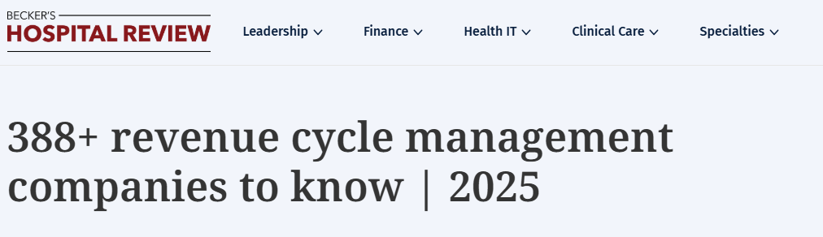

General AI Applications
Billing and Rev Cycle Management e.g.
https://www.beckershospitalreview.com/lists/388-revenue-cycle-management-companies-to-know-2025/
Notes:
Too voluminous a market to dissect
Capterra is a useful aggregator of software solutions that you can sort

Slide 60
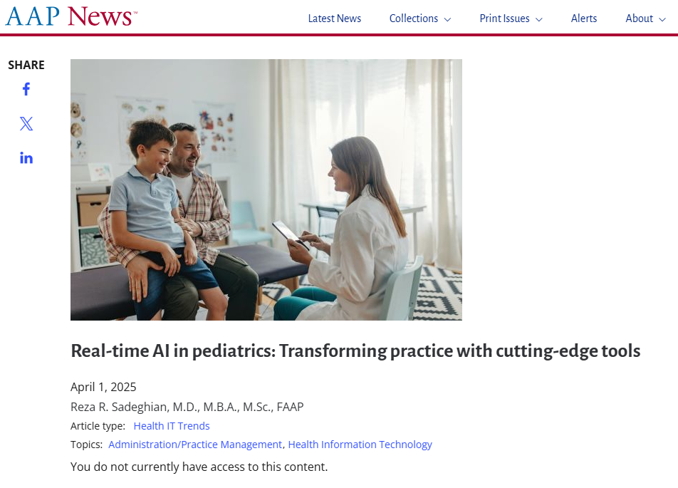
AI Billing Solutions
Notes:
This is behind a paywall but I understand from at least one manager it was useful

Slide 61
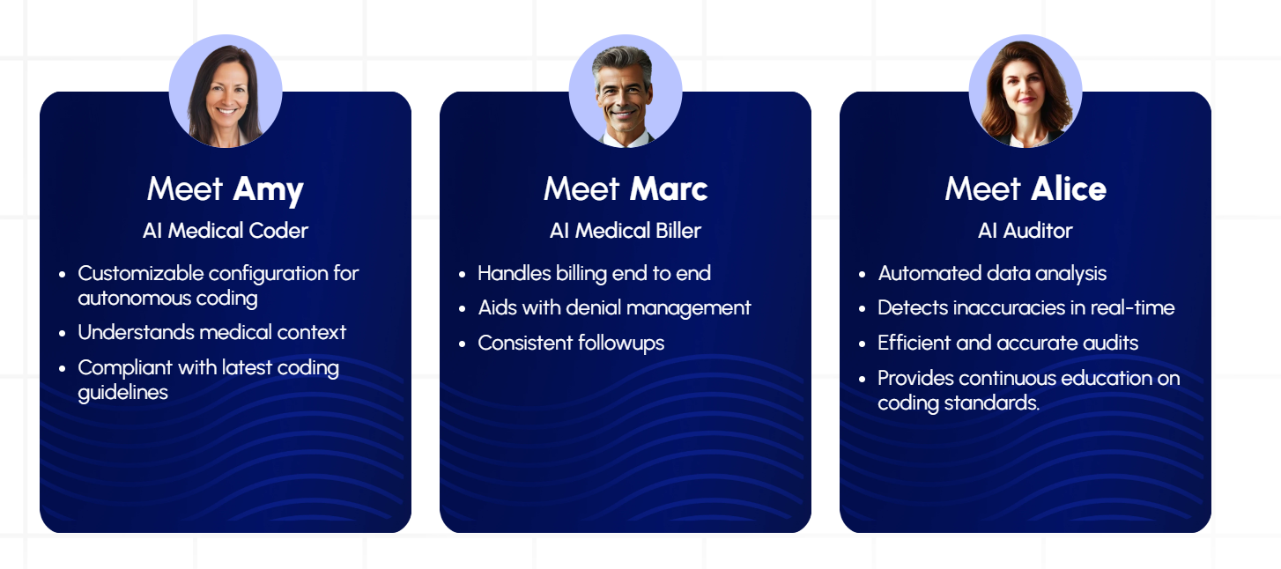
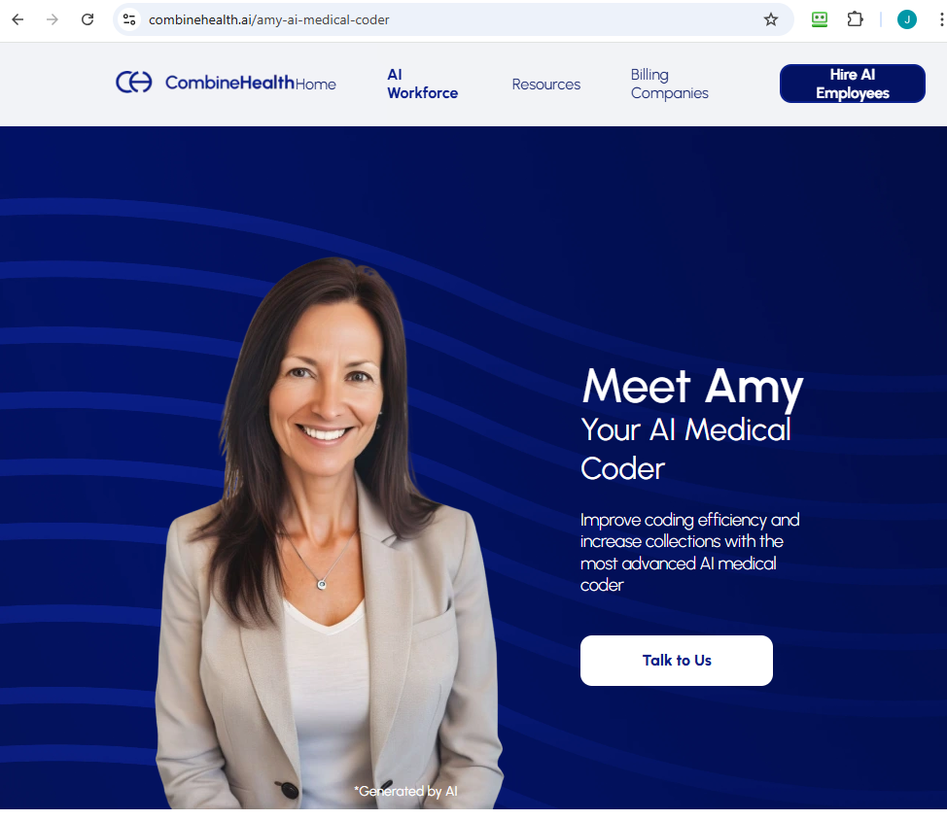
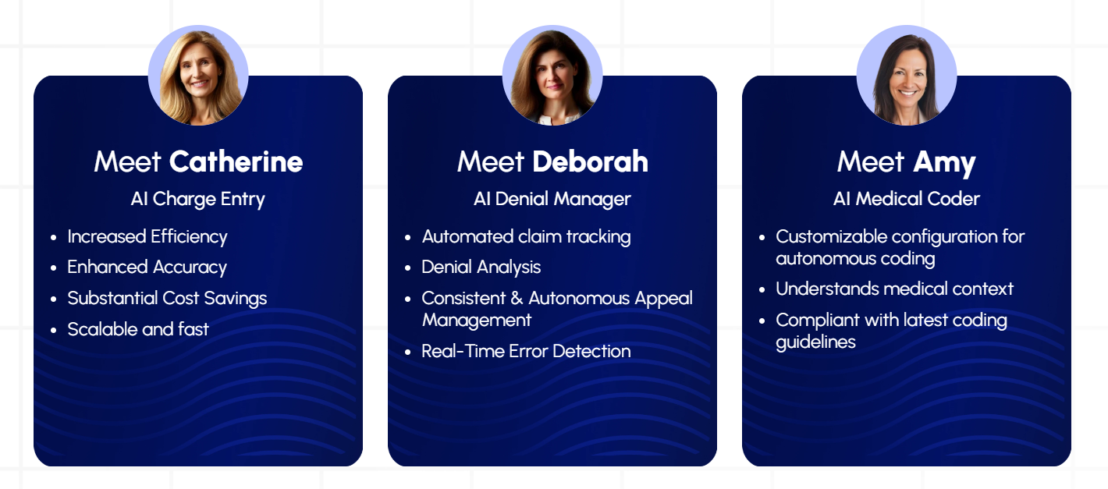
AI Billing Solutions

Slide 62

General AI Applications

Slide 63
Practical Implementation Considerations
Getting Started with AI:
Assessing practice needs: Begin with structured workflow analysis identifying time-intensive processes and clinical pain points - practices typically find that documentation (37%), screening/assessment (24%), and care coordination (18%) offer highest AI impact potential
Evaluating vendor claims: Request pediatric-specific validation studies, sensitivity/specificity metrics, and reference customers similar to your practice size and patient demographics
Focused applications: Start with single-purpose solutions addressing specific challenges - 86% of successful implementations began with narrow-scope projects before expanding
Staff training: Budget 3-5 hours per provider and 6-8 hours per support staff for initial training, with ongoing learning approaches showing 43% better adoption rates than one-time training
Success metrics: Establish baseline measurements before implementation and specific targets (time savings, quality improvements, patient/provider satisfaction) with 30/60/90 day checkpoints
Continuous evaluation: Plan for monthly review cycles during first 6 months with structured feedback loops from all user types - practices with formal review processes show 67% higher ROI
Legal compliance: Engage privacy officer and legal counsel early
Budgeting realistically: Calculate total cost of ownership including implementation (typically 30-45% of first-year costs), training (15-20%), and ongoing support/maintenance (23-28% annually)

Slide 64
Key Questions for Vendors
Pediatric training data: "What percentage of your training data comes from pediatric populations, and does it cover all developmental stages from neonatal through adolescence?" (Ideal response: >40% pediatric-specific data with stratified age representation)
Validation studies: "Can you provide validation studies specifically conducted in pediatric populations similar to my patient demographics?" (Request studies showing performance across different ages, ethnicities, and clinical settings)
Evidence of improvement: "What objective metrics improved in pediatric practices using your solution, and over what timeframe?" (Seek before/after comparisons with statistical significance)
Privacy protection: "What specific safeguards are in place for protecting pediatric data beyond standard HIPAA compliance?" (Look for compliance, age-appropriate consent mechanisms, and data minimization practices)
Implementation support: "What is your typical implementation timeline for a practice our size, and what resources will you provide?" (Typical pediatric implementations require 12-16 weeks; ensure pediatric-specific training materials)
EHR integration: "Do you have established integrations with [your EHR], and what functionality might be lost with integration?" (Request demonstration specific to your EHR environment)
Total cost breakdown: "What are all costs over a 3-year period including implementation, training, maintenance, and per-provider fees?" (Watch for escalating costs or upselling patterns)
Update processes: "How often are algorithms updated based on new pediatric evidence, and do updates require practice downtime?" (Best practices include quarterly algorithm reviews with minimal disruption)

Slide 65

08
The Perils of AI

Slide 66

The Perils of AI
Despite its potential, AI introduces significant risks that challenge its safe and equitable deployment. Its perils include:
Opaque "Black Box" Decision-Making
“It could be that the training set for a particular dermatology AI classifier contained a very high number of images of true, biopsy-confirmed melanomas that happened to appear on hairy skin, so the classifier has made an incorrect association between melanoma likelihood and hairiness,” says Daneshjou. “Bringing this kind of issue to light through our auditing framework would give developers the chance to correct the problem.”
Notes:
Sometimes it is hard for even the developers to determine how the AI is diagnosing
This study is an example of the AI assuming the hairiness impacted melanoma diagnosis…only through professional intervention were they able to determine this black box effect

Slide 67

The Perils of AI
Despite its potential, AI introduces significant risks that challenge its safe and equitable deployment. Its perils include:
Hallucination
Notes:
Self-Referential Learning Loop

Slide 68


The Perils of AI
Conclusions
It’s important to acknowledge that the performance of LLMs like ChatGPT (OpenAI) today does not guarantee their performance tomorrow. LLMs have the potential to be a substantial boon to the health care industry, offering to streamline workflows, enhance the accuracy of patient data processing, and even support diagnostic and treatment planning processes. Its value, however, is contingent upon a systematic and informed integration into health care systems. Recognizing that LLMs, like any technology, is fallible is crucial to its successful adoption. Its performance is temporal and will change as new data are fed to its algorithm. This acknowledgment underpins the necessity for robust oversight mechanisms, ongoing evaluation of AI-driven outputs for accuracy and relevance, and clear guidelines on its role as an assistive tool rather than a stand-alone decision-maker.
Despite its potential, AI introduces significant risks that challenge its safe and equitable deployment. Its perils include:
2. Over-Reliance and Deskilling
Notes:
Self-Referential Learning Loop

Slide 69

The Perils of AI
4 Conclusion
The physician’s decision-making autonomy is not a freedom to treat patients as he or she wishes, but is fundamentally rooted in the medical ethos to promote the patient’s health and well-being, thereby respecting the patient’s autonomy and rights. The role of a physician in ethical terms does not change due to AI. It is a tightrope to tread in order to meet the moral obligations toward the respective patient in the best possible way. The moral principles of medicine also apply unconditionally to the use of AI. The use of AI support must be assessed and weighed on the basis of these moral principles. AI support has the potential to better inform decision-making and thus indirectly promote the physician’s decision-making autonomy, and its use should be pursued where it succeeds. The functioning and information processing of AI support should be designed in a way that supports the decision-making autonomy of the physician; however, it should not be designed and implemented in such a way that, although it assumes the need for physician autonomy (e.g., in the form of a required medical review of the AI statement), the use of AI support actually exceeds the capabilities of the physician. Physicians also have a crucial role to play here: they should neither uncritically accept nor inappropriately resist the potentials of AI for healthcare, but actively engage in the discourse and development and critically examine whether the integration of AI tools in concrete fields of application has the potential to improve or impede the main goals of medical practice. Nonetheless, many stakeholders involved in design and development have a crucial role to play here, as is initially pursued in approaches such as user-centered design, HCD, participatory design, co-design, and value-sensitive design, all of which place more emphasis on the context-sensitivity of decision-making processes [c.f. (e.g., 38)]. The implementation and use of AI support, like any new standardization, measure and technology, will ultimately be judged from an ethical point of view against the main function of the physician’s decision-making autonomy: the best interest of the patient. If the physician should fulfill his or her moral obligation to promote the health and well-being of the patient, then the use of AI should be designed and implemented in such a way that it promotes or at least maintains the physician’s decision-making autonomy.
Despite its potential, AI introduces significant risks that challenge its safe and equitable deployment. Its perils include:
3. Has the Potential to Obviate Physician Autonomy
Notes:
If you want to do go really deep….

Slide 70

The Perils of AI
Notes:
Interesting commentary published in the Journal of Pediatrics this month….

Slide 71
The Perils of AI
Considerations for Pediatricians and Mental Health Practitioners
While there is hype around therapy chatbots, the issues we have identified draw attention to a host of open empirical questions and ethical considerations associated with their use in pediatrics. Here, we provide some ethical considerations for pediatricians and pediatric mental health practitioners to bear in mind before recommending these technologies to patients or families.
1.Avoid using therapy chatbots in a non-discerning, general way. This might be appropriate for some children, but others will need a targeted therapeutic approach, including dynamic, ongoing assessment of needs and progress. Part of this is clinicians familiarizing themselves with the design, features, and therapeutic strategy of different digital applications. Another part of this is working with app developers on the framing and messaging surrounding when, where, and how AI bots should be used. Clinicians have a crucial role to play in clarifying situations in which therapy chatbots are safe to use without the involvement of a mental health practitioner (either as a first port of call, or an unsupervised follow-up or ongoing form of support) vs situations when the bots should be used only in conjunction with in-person therapy or clinical management.
2.Partner with children, parents, and trusted or consenting adults, along with app developers, to ensure direct, reliable lines of support in the event of a mental health crisis/emergency. Part of this is working with application developers to incorporate crisis screening mechanisms into an application's programming, including prompts and responses that trigger alerting a trusted adult or emergency services. We acknowledge there are potential risks associated with sharing sensitive data with third parties that need to be addressed here.
3.Clarify to patients and families, in developmentally appropriate ways, that the chatbot is not a person, ie, that there is no one on the other end, and the application is not a “friend” or social platform. This should be made clear early on and revisited throughout the child's care. Framing therapy bots more like a game could be helpful. Part of this is also pursuing collaborative, interdisciplinary research on children's social understanding of AI chatbots and whether/how digital applications are influencing their perceptions of meaningful relationships and related social skills.
4.Use therapy bots as a scaffold, not a substitute, for in-person care or follow-up, regardless of an application's proclaimed capacity. Pediatricians should also encourage children to speak to a trusted adult about any issues the child is experiencing. This framing should be used when establishing a plan of care with the child. Importantly, the technologies should never be a child's sole source of support or monitoring.
5.There is a lack of data on the perspectives of not only mental health professionals, but also potential pediatric users, parents/families, and the general public on therapy chatbots. Pediatricians and pediatric mental health practitioners have a crucial role in multidisciplinary research aimed at better understanding these issues.

Slide 72
Risk Management - Identification & Assessment
Identifying AI-Specific Risks:
Algorithm bias: Conduct demographic subgroup analysis on all AI tools to identify performance disparities across race, ethnicity, age, gender, socioeconomic status, and rare conditions (most pediatric AI shows 12-27% lower accuracy for minority populations)
Data privacy: Map every data flow within AI systems using standardized Data Protection Impact Assessments (DPIAs) specific to minor protected information
Clinical reliability: Establish baseline "non-AI" performance metrics for each clinical task before implementation to quantify actual improvement and potential regression
Automation complacency: Measure provider reliance rates on AI recommendations and establish minimum override rates (recommended: ≥12% for diagnostic systems)
Workflow disruption: Conduct time-motion studies pre/post implementation to identify unintended workflow consequences
Legal/regulatory exposure: Perform quarterly compliance reviews against evolving FDA, HIPAA, and state-specific minor privacy regulations
Technical vulnerabilities: Implement pediatric-specific adversarial testing to identify edge cases where AI may fail (particularly vital in growth/development assessment)
Accountability gaps: Map decision authority between human providers and AI systems with clear escalation protocols for disagreements

Slide 73
Risk Management - Mitigation Strategies
Effective Risk Reduction:
Human oversight protocols: Implement mandatory pediatrician review thresholds for AI recommendations, with stricter oversight for high-risk areas (mandatory review for 100% of critical diagnostic suggestions, 75% of treatment recommendations, 50% of routine screening results)
Explainability requirements: Only deploy systems that can articulate reasoning in developmentally appropriate language for both providers and families (especially for behavioral health applications)
Gradual autonomy expansion: Begin with "AI as advisor" before progressing to "AI as actor" with staged autonomy increases only after predefined performance benchmarks are achieved
Continuous monitoring: Establish real-time monitoring dashboards tracking 12-15 key performance metrics with automated alerts for performance drift or unexpected patterns
Specialized testing: Subject all AI systems to pediatric-specific challenge cases including rare conditions, developmental edge cases, and demographic diversity
Backup systems: Maintain parallel conventional workflows for critical systems with <30-second failover capability
Informed consent: Develop age-stratified consent procedures for AI use, including simplified explanations for adolescents and assent procedures for school-age children
Regular retraining: Schedule quarterly algorithmic retraining incorporating local population data to prevent performance drift

Slide 74

09
AI in Litigation

Slide 75

Foreshadowing the future of claims associated with electronic medical record (EMR) systems enhanced by AI
In re Acclarent, 2024 WL 2873617 (Tex. App. 2024)

Slide 76
Foreshadowing the future of claims associated with electronic medical record (EMR) systems enhanced by AI
In re Acclarent, 2024 WL 2873617 (Tex. App. 2024)
In this case, the prospective plaintiff sought pre-complaint depositions of physicians and a medical device manufacturer surrounding an event involving a sinus surgery. The prospective plaintiff's intention was to learn more about an AI-enhanced feature of the product that was used during the surgical procedure at issue, which allegedly may have malfunctioned, causing injuries.
Among other things, the prospective plaintiff sought to learn the identity of the AI provider; how the device engineers interacted with the AI provider in enhancing the medical device; communications with and submissions by the device manufacturer, if any, to the Federal Drug Administration (FDA) about the AI enhancement; any product recalls due to faulty AI; all communications between the potential physician defendant and the product manufacturer on the use of the AI-enhanced device; and reports of other patient injuries due to errors by the AI-enhanced medical device.
Another reason for the prospective plaintiff's request to access the pre-complaint depositions was to vet whether she had a product liability case, a straightforward medical malpractice case, or a hybrid case involving the physicians and the medical device manufacturer. Her attorney argued that a product liability component could impact many aspects of the anticipated lawsuit, including the venue, jurisdiction, application of a preemptive defense by the device manufacturer, and timing of the filing of her case based on the applicable statute of limitations.
The Texas court of appeals ultimately denied the request for pre-complaint depositions of the device manufacturer, but the case illustrates the new issues to consider as AI becomes more integrated into health care decision making, diagnosis and treatment.

Slide 77


Foreshadowing the future of claims associated with electronic medical record (EMR) systems enhanced by AI
Lowe v. Cerner, 2022 WL 17269066 (6th Cir., Nov. 29, 2022)

Slide 78
Foreshadowing the future of claims associated with electronic medical record (EMR) systems enhanced by AI
Lowe v. Cerner, 2022 WL 17269066 (6th Cir., Nov. 29, 2022)
The trial court in Lowe v. Cerner held that an EMR system vendor can be sued after a patient was injured due to a charting error by the physician who admitted confusion in how to document the timing of an order. Given that EMRs are used almost universally with every patient, as opposed to the narrow use of traditional medical devices like defibrillators and orthopedic devices, the Lowe decision has set the precedent for a whole host of new medical device cases based upon medical provider user error due to a confusing EMR system. As the EMR becomes more complex and boosted by AI chatbots, clinical decision support (CDS) and computer assisted diagnosis (CAD), it should be anticipated that health care providers and EMR/AI vendors will be sued together more regularly.

Slide 79


Barrows et al v. Humana, Inc.
Estate of Gene B. Lokken et al. v. UnitedHealth Group, Inc. et al.
Kisting-Leung et al. v. Cigna Corporation et al.

Slide 80

10
Predicting the Future of AI in Litigation

Slide 81


Slide 82

Cite: https://illinoisjltp.com/file/149/Duffourc2023_Issue%201.pdf

Slide 83
“The Control Framework”
Consider the following scenario:
An Autonomous AI Physician, authorized by the Food and Drug Administration (FDA), is owned by a large healthcare organization which implemented the AI in its oncology department to improve treatment outcomes for cancer patients. The Autonomous AI Physician uses a vast amount of complex data to predict the previously unknown origin of a patient’s cancer. To reach this prediction, the AI engages in unpredictable and opaque but highly reliable algorithmic reasoning that humans cannot understand. A human oncologist then relies on the AI’s prediction to prescribe treatment. The prediction turns out to be wrong, and the prescribed treatment plan is ineffective, causing the patient to experience loss of chance for a better outcome. The patient then sues the AI developer, the healthcare organization, and the human oncologist for damages.

Slide 84
“The Control Framework”
Tort law would govern this case. However, existing tort liability can only compensate the patient for this injury if the injury can be sufficiently connected to human or organizational actions. Product liability law might compensate the patient if the injury was related to the creators’ design or manufacture of the AI
or if the creator failed to warn of reasonably foreseeable risks. Organizational liability might compensate the patient if the injury stemmed from the healthcare organization’s adoption and implementation of AI. Medical malpractice might compensate the patient if the human oncologist was negligent. In this case, let us assume the following: (1) the AI functioned as designed by creators and there was no known risk of a wrong prediction that required a warning under the applicable facts; (2) the healthcare organization was reasonable in its clinical implementation of the AI; and (3) the human oncologist neither knew nor should have known that the prediction was incorrect. In this scenario, the wrong prediction and resulting injury stem solely from the Autonomous AI Physician’s algorithmic medical decision-making process.

Slide 85
“The Control Framework”
Currently, there is no tort law cause of action that confronts injuries caused
by the AI’s autonomous medical decision-making process. This is because the
process through which the Autonomous AI Physician arrives at a medical
decision is often unpredictable, severing the connection between the AI’s
“thinking” and human actors involved in the creation and use of the Autonomous
AI Physician. Additionally, because AI is currently not considered a legal
person, it cannot be assigned direct liability as a human physician could.
As a result, medical injuries caused by the AI’s autonomous decision making
currently fall in a tort law gap—between products liability, organizational
liability, and medical negligence.

Slide 86
“The Control Framework”
In the case of the Autonomous AI Physician, several parties can exhibit control over its injury-causing behavior. Creators (designers, developers, and manufacturers) can exhibit control over the Autonomous AI Physician’s hardware and software components. Healthcare organizations can exhibit control over the AI’s implementation and continued use in clinical practice. Individual healthcare providers can exhibit control by providing human oversight for the AI’s medical decision making. Finally, the Autonomous AI Physician itself exhibits control over its own algorithmic decision making. Control over an injury-causing action by the Autonomous AI Physician is not necessarily mutually exclusive to one party. Instead, several parties can simultaneously exhibit control over the Autonomous AI Physician leading to potential liability for one or more parties. As a result, the control framework follows the functional approach proposed by Chung and Zink by allowing parties to “be identified and classified by the capacity and the authority they have to commit (or share responsibility for) the tort, whether they be human or AI.”

Slide 87
“The Control Framework”
Legal Personhood for the Autonomous AI Physician
Legal personhood for the Autonomous AI Physician is necessary to integrate it into the control framework for liability. Recognizing the Autonomous AI Physician as a legal person for the limited purposes of assigning liability for its malpractice allows it to both be directly liable under a theory of medical malpractice and serve as an agent under a theory of vicarious liability. It also enables the Autonomous AI Physician to participate in the procedural aspects of medical malpractice litigation as a litigant capable of asserting comparative fault and other defenses to malpractice and participating in the discovery process. Finally, because people, not products, are held to behavioral standards of care, personhood enables the law to assign a standard of care for the Autonomous AI Physician that corresponds to its unique ability to practice medicine.

Slide 88

11
Risk Management Approach to AI

Slide 89
How does a Risk Manager think about approaching vendor negotiations generally in healthcare?
Four Elements of Risk Whenever a Practice Engages with a Third Party Relative to Patient Care 1) Professional Liability (including Contractual Liability to Support Indemnification and Hold Harmless) 2) General Liability (Additional Insured/Waiver of Subrogation) 3) Cyberliability (Additional Insured/Waiver of Subrogation) 4) Workers Compensation (Waiver of Subrogation)

Slide 90
How does a Risk Manager think about approaching vendor negotiations involving AI?
Data Privacy and Security: Ensure compliance with HIPAA and other applicable regulations (e.g., GDPR if relevant). Specify how patient data is collected, stored, processed, and protected. Require encryption, access controls, and audit trails for data security. Clarify data ownership and rights to use/de-identify data for AI training. AI Transparency and Explainability: Demand clarity on how the AI system makes decisions (e.g., algorithms, inputs, outputs). Require explainability to ensure clinical decisions can be justified and audited. Include provisions for validating AI outputs for accuracy and bias. Performance and Reliability: Define performance metrics (e.g., accuracy, uptime, error rates) and service-level agreements (SLAs). Include clauses for regular testing and validation of AI models to prevent degradation. Specify processes for handling AI errors or failures, including escalation protocols.

Slide 91
How does a Risk Manager think about approaching vendor negotiations involving AI?
Liability and Indemnification: Clarify liability for AI-related errors (e.g., misdiagnosis, data breaches). Include indemnification clauses to protect the healthcare organization from vendor negligence. Address responsibility for adverse patient outcomes caused by AI recommendations. Regulatory Compliance: Ensure the vendor complies with FDA regulations if the AI is classified as a medical device (e.g., SaMD). Require the vendor to maintain certifications and report adverse events as needed. Include clauses for adapting to evolving AI regulations. Intellectual Property (IP): Define ownership of AI outputs, customizations, or derived insights. Clarify licensing terms for the AI system and any proprietary technology. Protect the healthcare organization’s IP if contributing data or expertise.

Slide 92
How does a Risk Manager think about approaching vendor negotiations involving AI?
Training and Support: Specify vendor responsibilities for training staff on AI system use. Require ongoing technical support, updates, and maintenance. Include provisions for retraining AI models to adapt to new data or clinical practices. Bias and Fairness: Require the vendor to assess and mitigate biases in AI algorithms (e.g., racial, gender). Include regular audits to ensure equitable outcomes across patient populations. Specify accountability for addressing biased outputs. Termination and Data Retrieval: Outline conditions for contract termination, including notice periods. Ensure the ability to retrieve all data (in a usable format) upon termination. Include provisions for secure data deletion by the vendor post-contract.

Slide 93
How does a Risk Manager think about approaching vendor negotiations involving AI?
Insurance and Financial Protections: Verify the vendor carries adequate cyber liability and professional liability insurance. Include clauses for financial remedies in case of breaches or downtime. Consider escrow for critical AI software to ensure continuity if the vendor fails. Change Management: Address how updates or changes to the AI system will be communicated and implemented. Require testing and approval of updates to prevent disruptions in care. Specify rollback procedures if updates negatively impact performance. Vendor Due Diligence: Include clauses requiring the vendor to disclose their AI development process, data sources, and third-party dependencies. Assess the vendor’s financial stability and reputation to ensure long-term reliability. Require subcontractors to meet the same contractual standards.

Slide 94
12
Additional Resources

Slide 95

Additional Resources
The Moffitt Cancer Center offers the FAIR Artificial Intelligence/Machine Learning Course, covering AI/ML concepts and FAIR data practices relevant to cancer research and clinical care.
https://www.moffitt.org/education/research-education-and-training/office-of-postdoctoral-affairs/integrated-program-in-cancer-and-data-science-icads/fair-artificial-intelligencemachine-learning-course/
The National Comprehensive Cancer Network (NCCN) provides a continuing education program, “Artificial Intelligence in Oncology,” designed for oncologists and related professionals to understand opportunities and ethical implications of AI in cancer care.
https://education.nccn.org/node/95535
PER® (Physicians’ Education Resource) has a CME activity, “Exploring the Benefits and Risks of AI in Oncology,” focusing on both the applications and risk considerations of AI in oncology.
https://www.gotoper.com/courses/exploring-the-benefits-and-risks-of-ai-in-oncology

Slide 96

Office: 678-424-6503
Cell: 404-307-4430
Email: jmiller@sspins.com

