Slide 1
The Price of Progress:
The Financial Impact of Precision Medicine
David Jackman, MD
Medical Director, Clinical Pathways and New Business Initiatives
Medical Director, DFCI Collaborative and Strategic Alliances
Senior Physician, Lowe Center for Thoracic Oncology
Dana-Farber Cancer Institute
Assistant Professor, Harvard Medical School

Slide 2

I have no conflicts of interest to disclose.
David Jackman, MD
Dana-Farber Cancer Institute, Boston, MA
Senior Physician, Lowe Center for Thoracic Oncology
Medical Director, Clinical Pathways and New Business Initiatives
Medical Director, DFCI Collaborative and Strategic Alliances
Assistant Professor, Harvard Medical School

Slide 3

The Cost of Care, Through a Lung Lens
 | Wholesale Adjusted Cost (WAC) for the first 12 weeks of therapy | Wholesale Adjusted Cost (WAC) for the first 48 weeks of therapy
Amivantamab + Lazertinib (MARIPOSA) | $133,458 | $ 488,204
Osimertinib + carboplatin + pemetrexed (FLAURA2) | $ 48,968 | $ 194,972
Osimertinib (FLAURA) | $ 47,928 | $ 191,712
Amivantamab + Lazertinib
Osimertinib
Amivantamab +
Lasertinib
Note: costs include anticancer drug costs only. Assumes a 70 year-old patient with a height of 70 inches and a weight of 70 kg.

Slide 4
Estimated Deaths for the 5 Leading Causes of Cancer Mortality, 2004 - 2024
Lung Cancer
Colorectal Cancer
Breast Cancer
Pancreatic Cancer
Prostate Cancer
Jemal et al, Cancer Statistics 2004. CA Cancer J Clin 2004
Siegel et al, Cancer Statistics 2014. CA Cancer J Clin 2014
Siegel et al, Cancer Statistics 2024. CA Cancer J Clin 2024

Slide 5
Initial FDA approvals for Targeted Therapies in non-small cell lung cancer (NSCLC)
 | MET exon 14
 | KRAS
 | RET
 | NTRK
BRAF
ROS1
ALK
EGFR
NRG
Zenocutuzumab
HER2
Fam-Trastuzumab deruxtecan
MET ex 14
Tepotinib
Capmatinib
KRAS
Adagrasib
Sotorasib
RET
Pralsetinib
Selpercatinib
NTRK
Entrectonib
Larotrectinib
BRAF V600E
Dabrafenib + trametinib
Encorafenib + binimetinib
ROS1
Entrectonib
Repotrectinib
ALK
Ceritinib
Brigatinib
Ensartinib
Crizotinib
Alectinib
Lorlatinib
EGFR
Erlotinib
Osimertinib
Amivantamab
Gefitinib
Afatinib
Dacomitinib
Lazertinib
2005
2010
2015
2020
2025

Slide 6
Hx
How Did We Get Here?
Results
What is the impact on patients and society?
Recs
What can we do?

Slide 7

The 5 P’s Propping Up Drug Prices in the US
High Drug Prices
Pharma
Pretending
Health Care Is A Free Market
This image was generated with the assistance of AI
PBMs
Policy
Physicians

Slide 8
The Cost of Care, Through a Lung Lens
Imatinib
Erlotinib
Bevacizumab
Crizotinib
Sotorasib
Amivantamab + Lazertinib
Larotrectinib

Slide 9
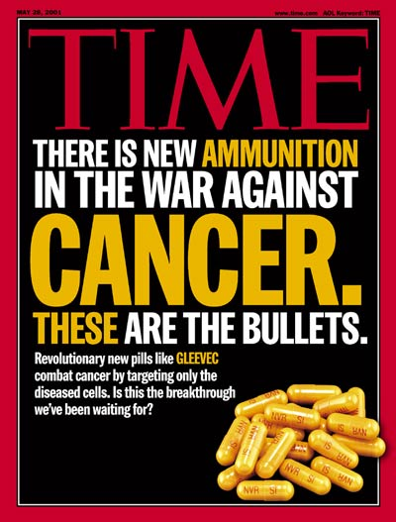
The Beginnings of Precision Medicine
1992: Prescription Drug User Fee Act (PDUFA) passed, authorizing the FDA to collect fees from pharma to fund the new drug approval process, expanding FDAs ability to review medications more rapidly.
Imatinib
1997: FDA relaxed restrictions on direct-to-consumer advertising of prescription drugs.
May 28, 2001

Slide 10
EGFR: The Lazarus Effect
Erlotinib
2003: Medicare Prescription Drug, Improvement, and Modernization Act. The federal government was prohibited from negotiating discounts or mandating a specific formulary.
Erlotinib
Erlotinib
2004: Initial approval for NSCLC patients who had progressed after 1 or more prior lines of therapy.
Cost for 1 month: $4,174
(from www.mskcc.org/sites/default/files/node/25097/documents/111516-drug-costs-table.pdf)

Slide 11
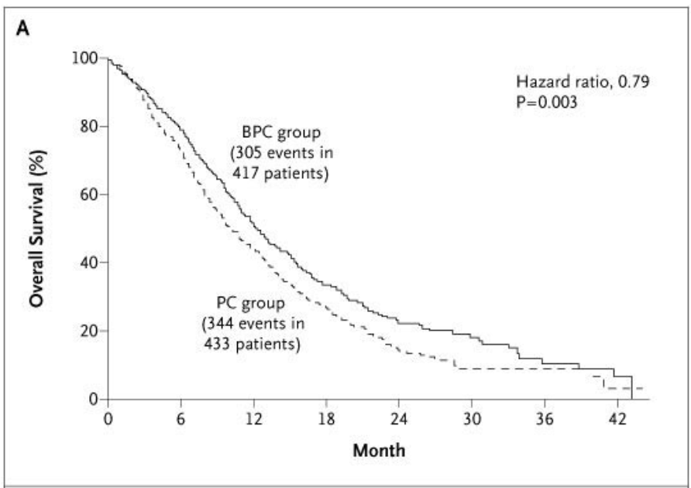
Bevacizumab: What the Market Will Bear
Overall Survival, ECOG4599
Carbo/Paclitaxel +/- Bevacizumab
Back of the envelope calculations at the time:
Median improvement in overall survival: 2 months
Number needed to gain 12 months of survival: 6
Median # of cycles: 7
6patients x 7 cycles each = 42 cycles
Cost per cycle of bevacizumab: $10,000
$ to gain 12 months of survival: $420,000
Bevacizumab
Bevacizumab
Bevacizumab
Impact of maintenance therapy?
Never addressed
From Sandler et al, NEJM 2006

Slide 12
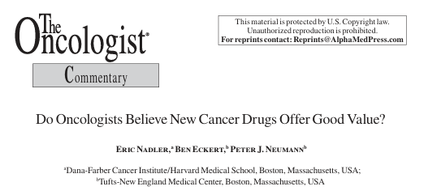
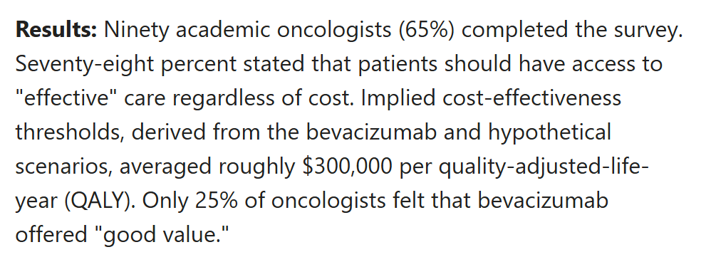
Bevacizumab: What the Market Will Bear
Bevacizumab
Back of the envelope calculations at the time:
Median improvement in overall survival: 2 months
Number needed to gain 12 months of survival: 6
Median # of cycles: 7
6patients x 7 cycles each = 42 cycles
Cost per cycle of bevacizumab: $10,000
$ to gain 12 months of survival: $420,000
Bevacizumab
Impact of maintenance therapy?
Never addressed
From Nadler et al, Oncologist 2006

Slide 13
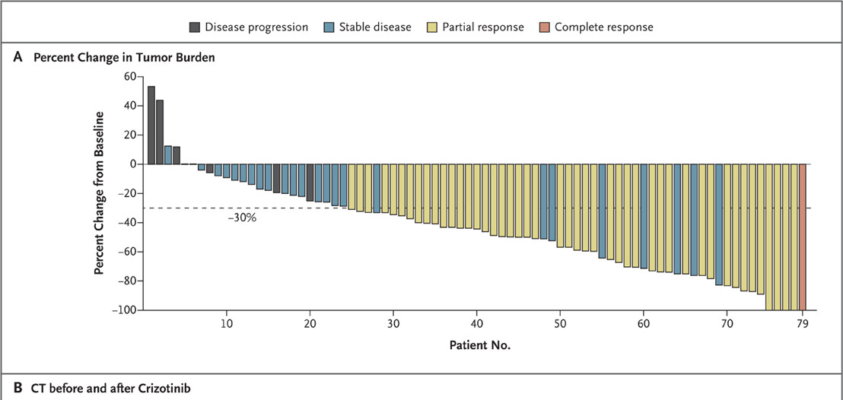

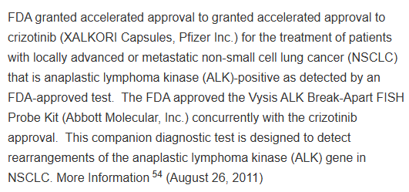
Crizotinib: “a sea change into something rich and strange”
Crizotinib
From Kwak et al, NEJM, Oct 2010
August 26, 2011

Slide 14
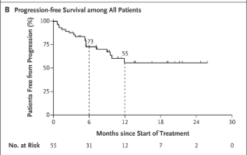
Larotrectinib: What the Market Will Bear, part 2
Erlotinib: Response rate in EGFR+: 60-80%
Crizotinib: Response rate in ALK+: 65%
2018: Accelerated Approval
Go-To-Market Price: $32,800 per month*
Larotrectinib: Response rate in NTRK+: 75%
Median duration of response: Not reached
Larotrectinib
$32,800 per month x 12 =
$ 393,600
*Business Insider: https://www.businessinsider.com/fda-approves-loxo-oncologys-larotrectinib-vitrakvi-2018-11
Drilon et al, NEJM 2018
Notes:
2019: Lilly buys Loxo for $8 billion

Slide 15
Sotorasib: What exactly are we paying for?
Erlotinib: Response rate in EGFR+: 60-80%
Crizotinib: Response rate in ALK+: 65%
Larotrectinib: Response rate in NTRK+: 75%
CodeBreaK200 (randomized phase III)
Sotorasib
 | Sotorasib | Docetaxel
Response Rate | 28% | 13% | p<0.001
Disease control rate | 82.5% | 60.3%
Median PFS, months | 5.6 | 4.5 months | HR 0.66 (0.51-0.86) p=0.0017
Median OS, months | 10.6 | 11.3 months | HR 1.01 p=0.53
2021: Why did this get an accelerated approval?
2023: ODAC voted against full approval
Despite this, monthly WAC = $ 21,750
de Langen et al, Lancet 2023
Notes:
Only 36% of the sotorasib group got any subsequent therapy (21% with chemo), while 42% of the docetaxel group got a subsequent therapy (34% got a KRAS inhibitor)

Slide 16
Amivantamab + Lazertinib: Full Circle
 | Wholesale Adjusted Cost (WAC) for the first 12 weeks of therapy | Wholesale Adjusted Cost (WAC) for the first 48 weeks of therapy
Amivantamab + Lazertinib (MARIPOSA) | $133,458 | $ 488,204
Osimertinib + carboplatin + pemetrexed (FLAURA2) | $ 48,968 | $ 194,972
Osimertinib (FLAURA) | $ 47,928 | $ 191,712
Amivantamab + Lazertinib
Osimertinib
Amivantamab +
Lasertinib
Note: costs include anticancer drug costs only. Assumes a 70 year-old patient with a height of 70 inches and a weight of 70 kg.

Slide 17
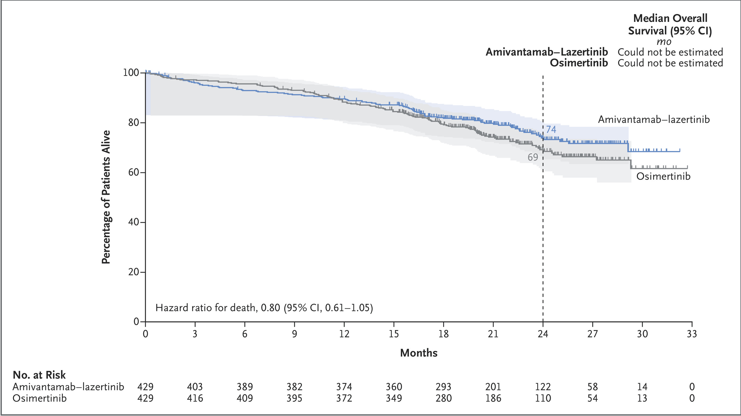
Amivantamab + Lazertinib: Full Circle
 | Wholesale Adjusted Cost (WAC) for the first 12 weeks of therapy | Wholesale Adjusted Cost (WAC) for the first 48 weeks of therapy
Amivantamab + Lazertinib (MARIPOSA) | $133,458 | $ 488,204
Osimertinib + carboplatin + pemetrexed (FLAURA2) | $ 48,968 | $ 194,972
Osimertinib (FLAURA) | $ 47,928 | $ 191,712
Amivantamab + Lazertinib
From Yang et al, European Lung Cancer Conference 2025
Note: costs include anticancer drug costs only. Assumes a 70 year-old patient with a height of 70 inches and a weight of 70 kg.

Slide 18
What Have We Learned?
The causes of our drug pricing dilemma is multifactorial:
Overhauled FDA approval process grew faster and, arguably, less stringent
Medicare reform handcuffed itself from negotiating on price/formulary
Govt agencies don’t just avoid price discussions. They aren’t consistently demanding studies that would clarify value (e.g., maintenance bevacizumab).
Market forces are really only on the seller/supply side.
  Monopolies in increasingly niche indications without perceived alternatives
  Limited insight into costs and benefits for consumers.
High Drug Prices
Pharma
Pretending
Health Care Is A Free Market
This image was generated with the assistance of AI
PBMs
Policy
Physicians

Slide 19
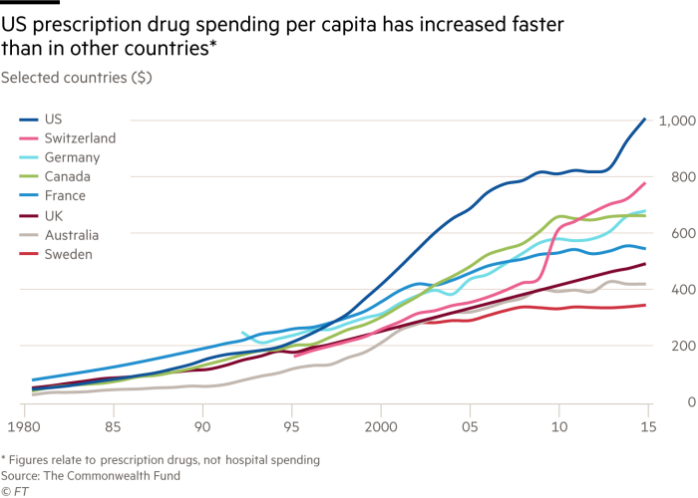
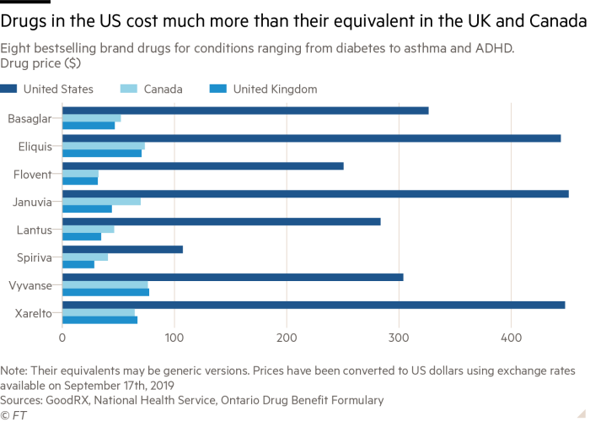
Where Has This Left Us?
The US outspends all other nations on prescription drugs, paying far higher prices on brand-name drugs.
Papanicolas et al, JAMA 2018

Slide 20
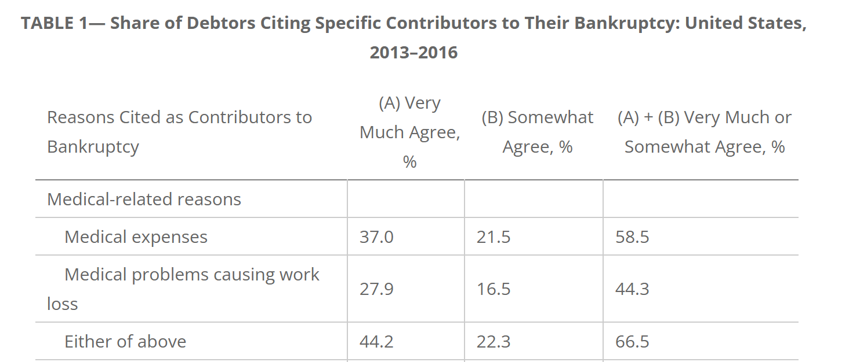
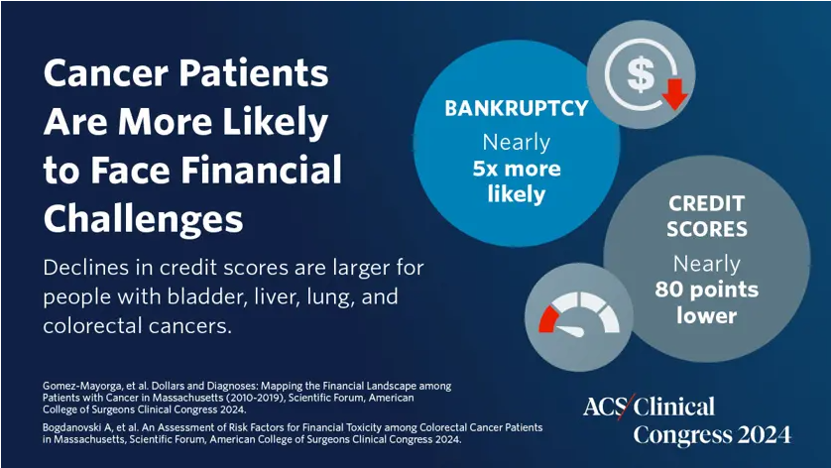

Where Has This Left Us?
Medical-related issues are the highest cause of personal bankruptcy in the United States.
Himmelstein et al, AJPH 2019
Since the site launched in 2010, campaigns for medical expenses have accounted for 1/3 of all campaigns and raised over $3 billion.
From : GoFundMe Statistics By Campaign, Funding and Facts

Slide 21
Where Has This Left Us?
High costs threaten businesses’ ability to survive and thrive
2024 Health Care Strategy Survey,
Business Group on Health
One in two employers said cancer was the No. 1 driver of health care costs, and 86% said it ranked among the top three, likely due to late-stage cancer diagnoses from the pandemic. Last year, cancer overtook musculoskeletal conditions as the top driver of large companies’ health care costs, for the first time.
Pharmacy costs continue to affect trend and affordability. While 92% of employers are concerned about high-cost drugs in the pipeline, 91% reported concern about pharmacy cost trend overall. This comes as employers experienced an increase in the median percentage of health care dollars spent on pharmacy, from 21% in 2021 to 24% in 2022. For 2024, employers said they planned to deploy various pharmacy management strategies.
https://www.businessgrouphealth.org/en/newsroom/news-and-press-releases/press-releases/2024-lehcss

Slide 22
What Can We Do at a Policy Level?
Recent Actions Initiated
Inflation Reduction Act’s Medicare Drug Price Negotiation Program
Recently signed executive order re: Most Favored Nation status on drug price
Need to find a way to engage on value-based pricing
Approval Process
Reserve accelerated approval process for its original intention: life-threatening conditions without meaningful alternative treatments.
Maintain appropriately high standards:
  Caution with surrogate endpoints
  Requiring clinical endpoints for full approval
  Demand a clear and timely plan for confirmatory trials
  Action when confirmatory trials are negative.

Slide 23
What Can We Do at a Policy Level?
Transparency
Transparency in lobbying spending
Transparency in funds to providers, professional organizations/institutions, and patient organizations
Transparency on arrangements between pharma and pharmacy-benefit managers

Slide 24
What Can We Do?
Engaging with Cost:
Consider efficacy, toxicity, and cost
Move past guidelines that don’t meaningfully consider cost
Learn to discuss cost with patients and families.
Using Precision Medicine appropriately
Efficient, comprehensive biomarker testing strategies
Avoiding unsupported use of targeted therapies.
When appropriate, consider early restaging to minimize continuing ineffective therapy
Strongly advocate for appropriate use.

Slide 25
Questions? Please reach out.
David M. Jackman, MD
Medical Director, Clinical Pathways and New Business Initiatives
Senior Physician, Thoracic Oncology
Assistant Professor, Harvard Medical School
david_jackman@dfci.harvard.edu

