Slide 1



Clinical Utility of Liquid Biopsy in the Management and Treatment of Lung Cancer
Bruna Pellini, MD
Assistant Member, Department of Thoracic Oncology, H. Lee Moffitt Cancer Center and Research Institute
Assistant Professor, Department of Oncologic Sciences, University of South Florida
Co-Chair, Liquid Biopsies Scientific Interest Group, National Institute of Health
@BrunaPellini

Slide 2
Disclosures
Research support: George Edgecomb Society at Moffitt Cancer Center, Bristol Myers Squibb Foundation/the Robert A. Winn Diversity in Clinical Trials Awards Program (institution), NIH/NCI 1R21CA259215-01A1 (institution), Bristol Myers Squibb (institution)
Advisory Board/Consultant: AstraZeneca, Bayer, Merus, BMS, Foundation Medicine, Guardant Health, Illumina, Regeneron, Gilead
Speaker Honoraria: Foundation Medicine, Merck, AstraZeneca

Slide 3
Outline
ctDNA definition
Tumor-informed vs. tumor-naïve assays
ctDNA applications in oncology:
Molecular Profiling
Treatment Monitoring
Minimal residual disease (MRD) detection

Slide 4
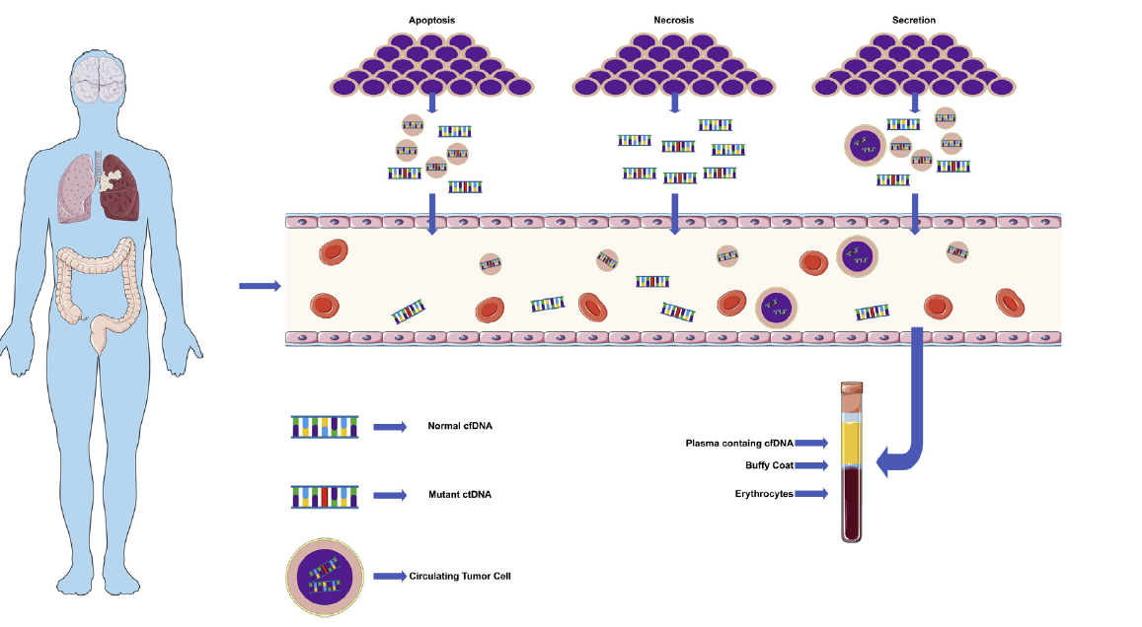
Tumor-derived fragments of nucleic acids identified in the blood are called circulating tumor DNA (ctDNA) )
Pellini B et al. Thorac Surg Clin. 2020
Notes:
cfDNA explanation, explain that the remaining 90%+ comes from blood cells
Circulating tumor DNA (ctDNA) is under-represented in plasma
Typically <1% of total cfDNA in localized cancer & <10% in advanced cancer patients

Slide 5
Tumor-informed vs. tumor-naïve assays
Tumor-Informed | Tumor-naïve
Requires tissue biopsy | No need for biopsy
Personalized assay | Off the shelf assay
Longer turnaround time | Shorter turnaround time
Does not account for tumor heterogeneity | Can detect clonal variants that emerge during follow-up
Potential for better sensitivity and specificity | Variable sensitivity and specificity
Pellini B and Chaudhuri A. J Clin Oncol. 2022

Slide 6
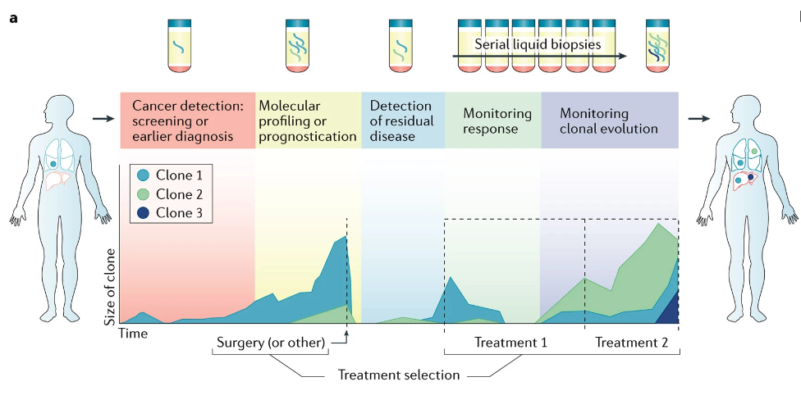
ctDNA applications in thoracic oncology
Wan J et al. Nat Rev Cancer. 2017

Slide 7
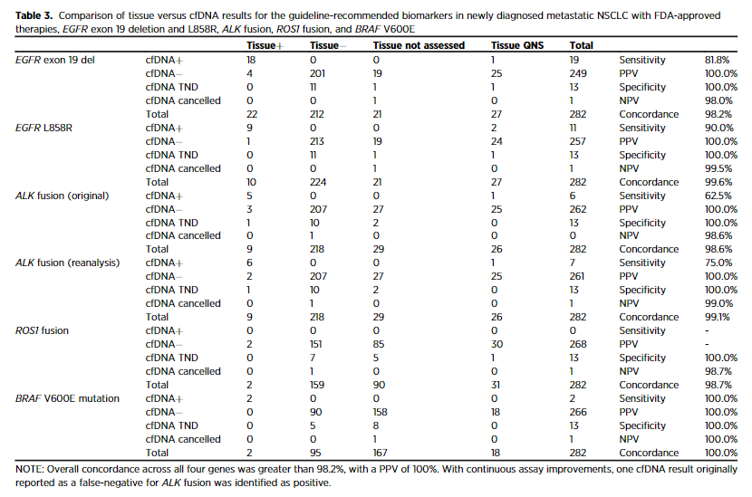
ctDNA sequencing has high sensitivity and specificity to identify actionable genomic alterations
Stage IV NSCLC
Tumor-naïve assay (Guardant 360)
Leighl N et al. Clin Cancer Res. 2019

Slide 8
Outline
ctDNA definition
Tumor-informed vs. tumor-naïve assays
ctDNA applications in oncology:
Molecular Profiling
Treatment Monitoring
Minimal residual disease (MRD) detection

Slide 9
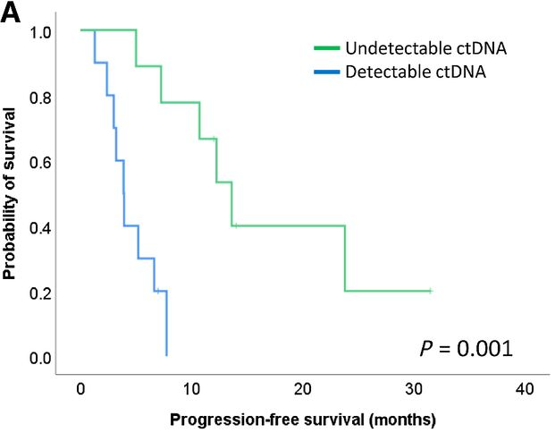
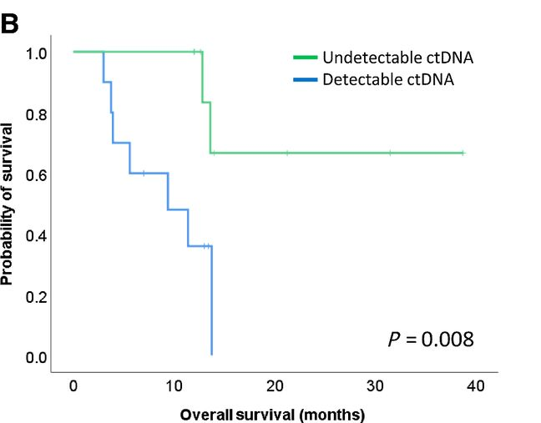
ctDNA monitoring can predict outcomes in patients with NSCLC receiving immune checkpoint inhibitors
Stage IV NSCLC
Tumor-naïve assay (TEC-Seq)
Anagnostou V et al. Cancer Res. 2019
Notes:
Hopkins- 4 to 8 weeks (average 9 weeks from tx start)

Slide 10
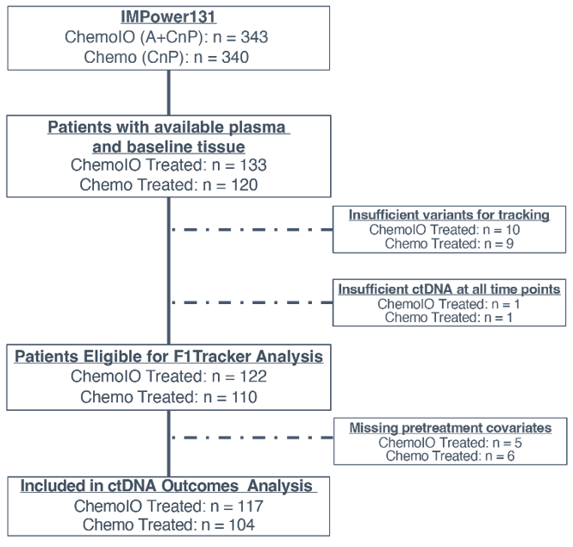
Can ctDNA monitoring risk stratify advanced SCC prior to the start of maintenance atezolizumab in patients receiving carboplatin + nab-paclitaxel + atezolizumab (IMpower 131)?
Only 8% did not have enough variants for the development of their unique multiplex PCR
Tumor-informed assay (FoundationOne
Tracker)
Only 1% did not have enough ctDNA for the analysis
Pellini B, et al. Clin Cancer Res.2023
Notes:
253 patients with tissue NGS results and plasma available
232 (91%) were eligible for analysis using FoundationOne Tracker
221 (87%) were included in ctDNA outcomes analysis

Slide 11
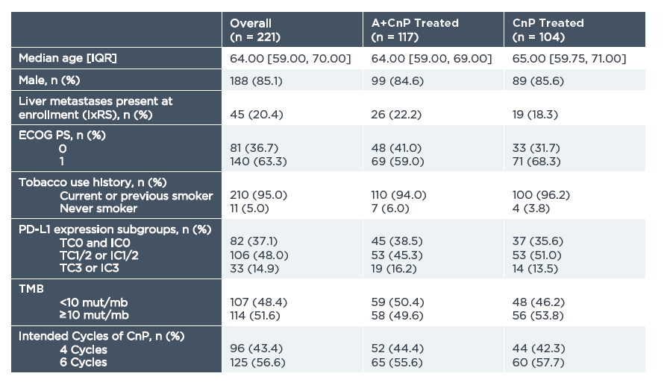
Can ctDNA monitoring inform outcomes in advanced NSCLC prior to the start of maintenance therapy in patients receiving chemotherapy + immunotherapy?
Notes:
253 patients with tissue NGS results and plasma available
232 (91%) were eligible for analysis using FoundationOne Tracker
221 (87%) were included in ctDNA outcomes analysis

Slide 12
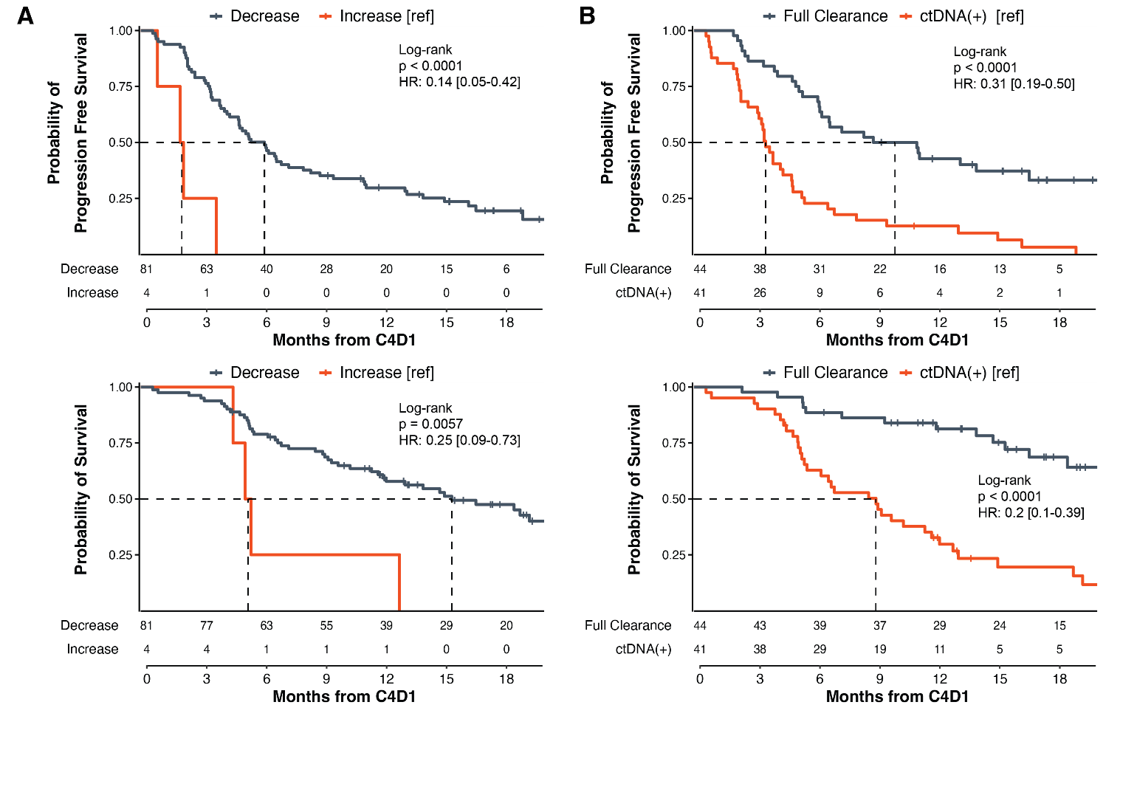
ctDNA Monitoring on Atezolizumab + Carboplatin + Nab-Paclitaxel (A +CnP) identifies patients with SCC with higher risk for poorer outcomes
Analysis limited to the 85 patients with detectable ctDNA pre-treatment
mPFS=6.1 mo
mPFS=9.9 mo
mPFS=3.5 mo
mPFS=2.0 mo
PFS and OS are landmarked from C4D1
(i.e., 9 weeks into induction therapy)
Decrease is defined as any decrease
mOS=NR
mOS=15.3 mo
mOS=8.9 mo
mOS=5.3 mo
Pellini B, et al. Clin Cancer Res.2023
Notes:
50% decrease mPFS 6.1 vs 1.9; mOS=15.3 vs 5.1 mo
>/= 90% DECREASE mPFS comparable with full clearance
When adjusting for covariates, including PD-L1, any ctDNA decrease and full ctDNA clearance at C4D1 from baseline remained statistically significant as independent prognostic factors for clinical outcomes
of 38 chemoIO patients with ctDNA clearance at C4D1, only 21 (55%) had early clearance at C2D1; and of the 23 patients with early
clearance at C2D1, two developed detectable ctDNA by C4D1.

Slide 13
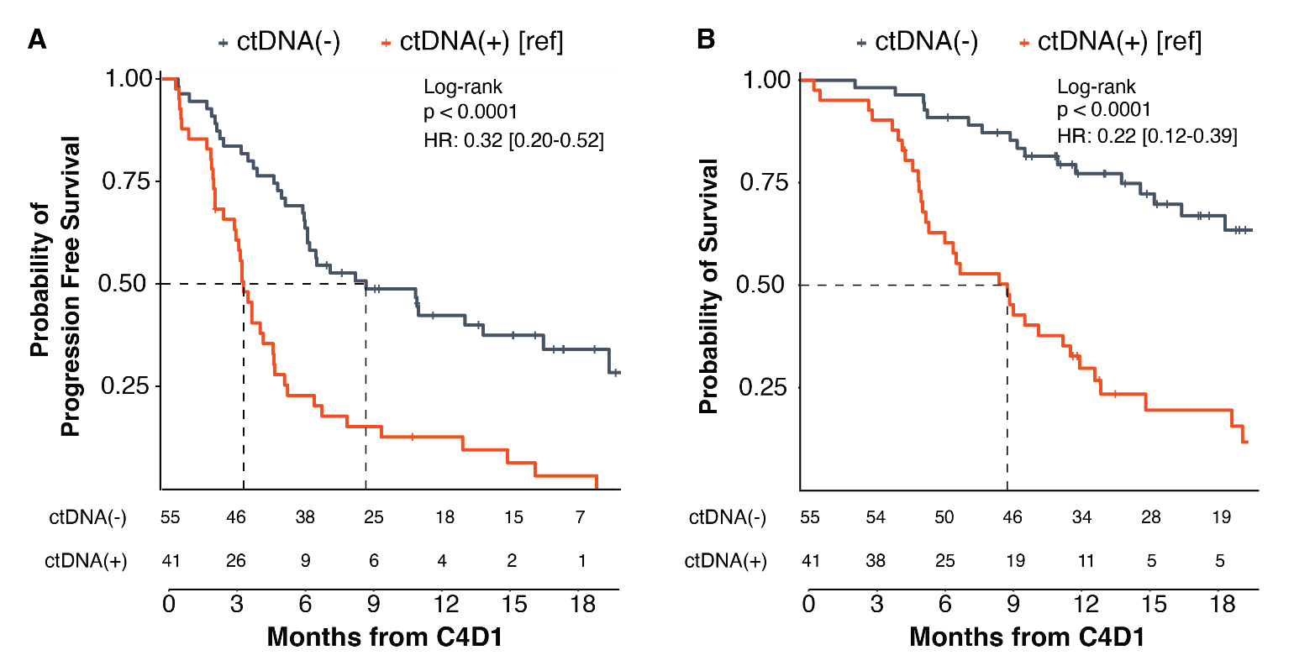
ctDNA detection at C4D1 on Atezolizumab + Carboplatin + Nab-Paclitaxel (A +CnP) can risk stratify patients with SCC before maintenance therapy start
ctDNA + at C4D1
PFS and OS are landmarked from C4D1
(i.e., 9 weeks into induction therapy)
mOS=NR
mPFS=8.8 mo
mOS=8.9 mo
mPFS=3.5 mo
Analysis in 96 patients with available samples at C4D1 regardless of baseline sample availability
Pellini B, et al. Clin Cancer Res.2023
Notes:
43% were ctDNA+→(median: 14.6 MTM/mL, range 0.3-787.3),
ctDNA + lower objective response rate (43%) compared to those with undetectable ctDNA at the same timepoint (ctDNA-: 78%; p<0.001).
Adjustments for clinical and genomic characteristics did not diminish the independent prognostic value of ctDNA detection at C4D1

Slide 14
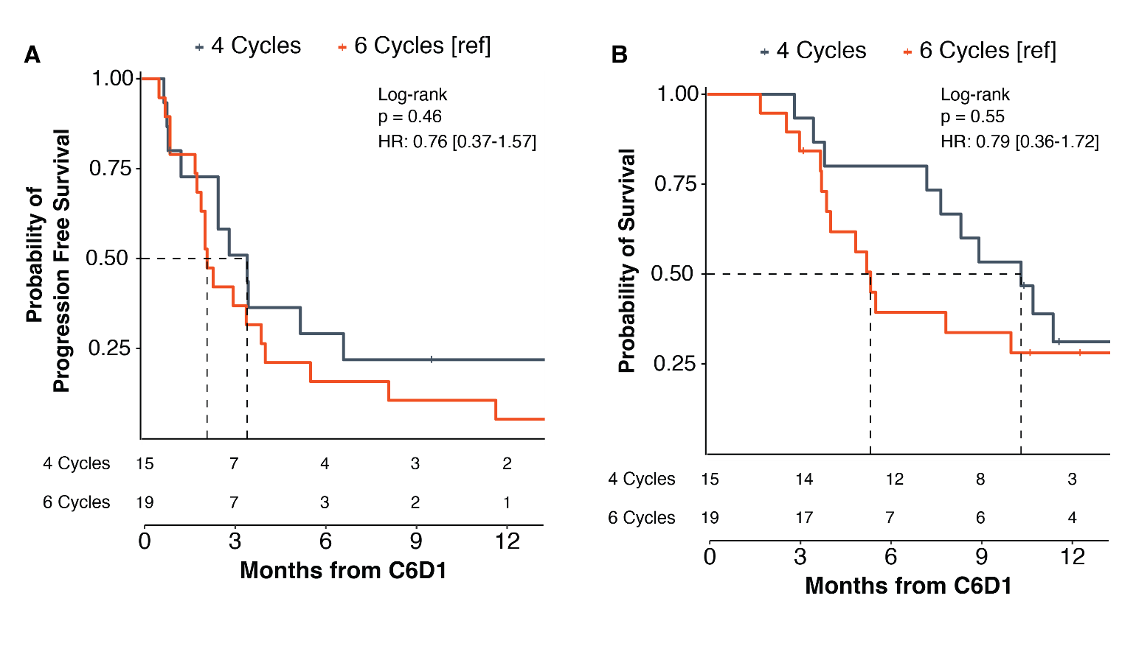
Additional cycles of induction Atezolizumab + Carboplatin + Nab-Paclitaxel (A +CnP) are not associated with improved outcomes in patients with ctDNA + at C4D1
mOS=10.3 mo
mPFS=3.5 mo
mOS=5.3 mo
mPFS=2.1 mo
Pellini B, et al. Clin Cancer Res.2023

Slide 15
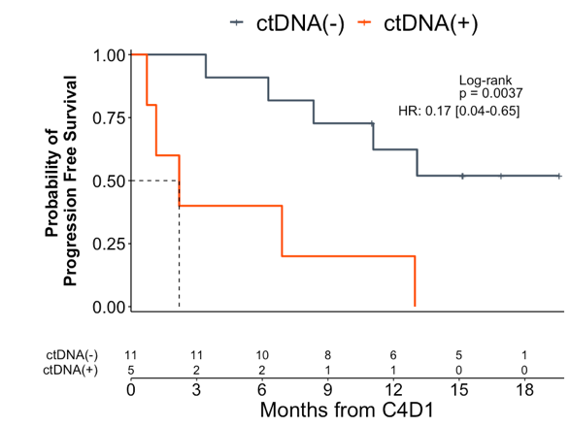
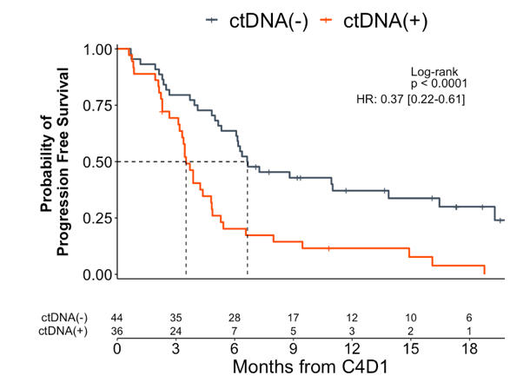
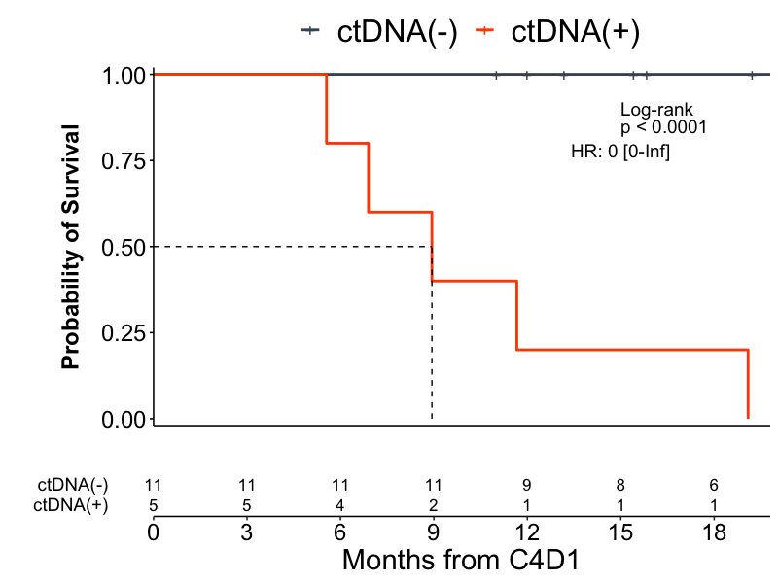
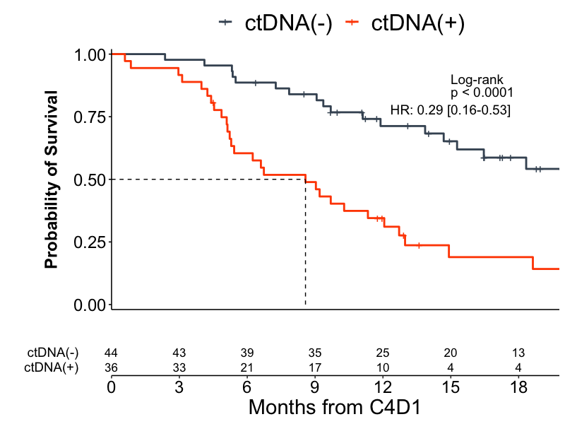
Full clearance of ctDNA at C4D1 on chemoIO identifies patients with poorer outcomes on IO maintenance, independent of PD-L1 status
PD-L1 High
PD-L1 Low
Pellini B, et al. Clin Cancer Res.2023

Slide 16
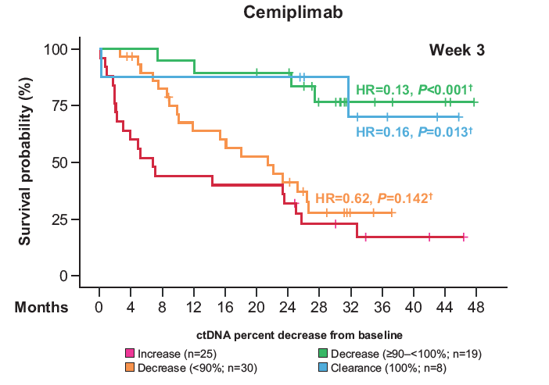
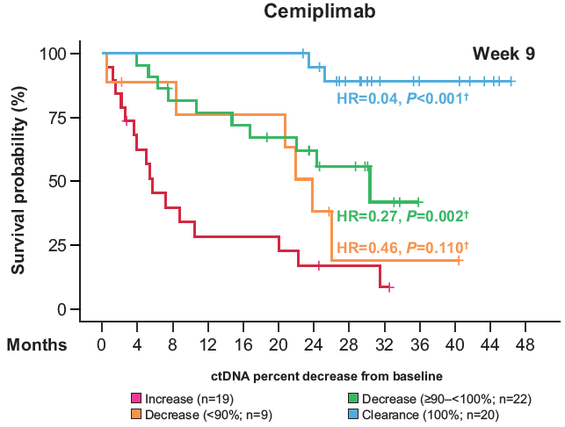
ctDNA decrease ≥90% at week 3 or 9 during cemiplimab treatment is associated with improved OS
Advanced NSCLC
Tumor-informed assay (Signatera™ & FoundationOne Tracker)
N=82
N=70
Vokes N et al. 2023 ASCO Annual Meeting.
Notes:
There are limited data from prospective, randomized, phase 3 studies to establish clear criteria for the application of ctDNA monitoring as a biomarker in clinical practice.
personalized tumor-specific analysis of ctDNA from patients treated in the EMPOWER-Lung 1 study to evaluate the magnitude of ctDNA variation that is associated with clinical outcomes
33% of pts achieved a deep response by week 3
composite of deep ctDNA and radiographic response at 9 weeks in cemiplimab-treated patients:
Allows identification of patients with Response Evaluation Criteria in Solid Tumours (RECIST) stable disease who have a favorable outcome.
Allows prediction of which patients with RECIST partial response have poor outcomes.
The correlation is not as clear in chemotherapy-treated patients.
composite of deep ctDNA reduction and radiographic response may represent a useful tool to guide treatment intensification in patients treated with cemiplimab monotherapy.

Slide 17
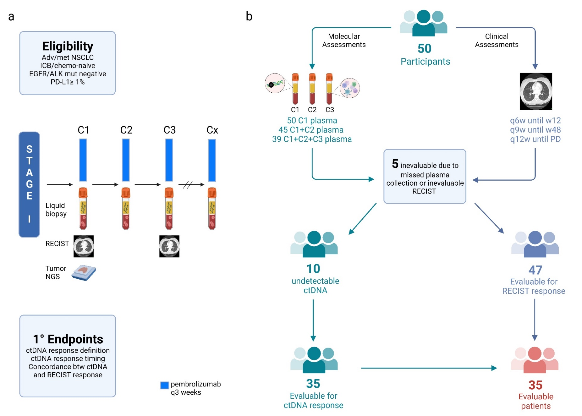
BR.36: A ctDNA-directed phase II study of molecular response adaptive immunotherapy in NSCLC
Tumor-uninformed assay
(PGDx elio™ plasma resolve)
NGS with 33-gene panel
WBC-informed
TAT 1 week
20% not evaluable for molecular response due to ctDNA (-) at baseline
Slide courtesy from Dr. Valsamo Anagnoustou
NCT04093167, Anagnostou et al., Nat Med, 2023

Slide 18
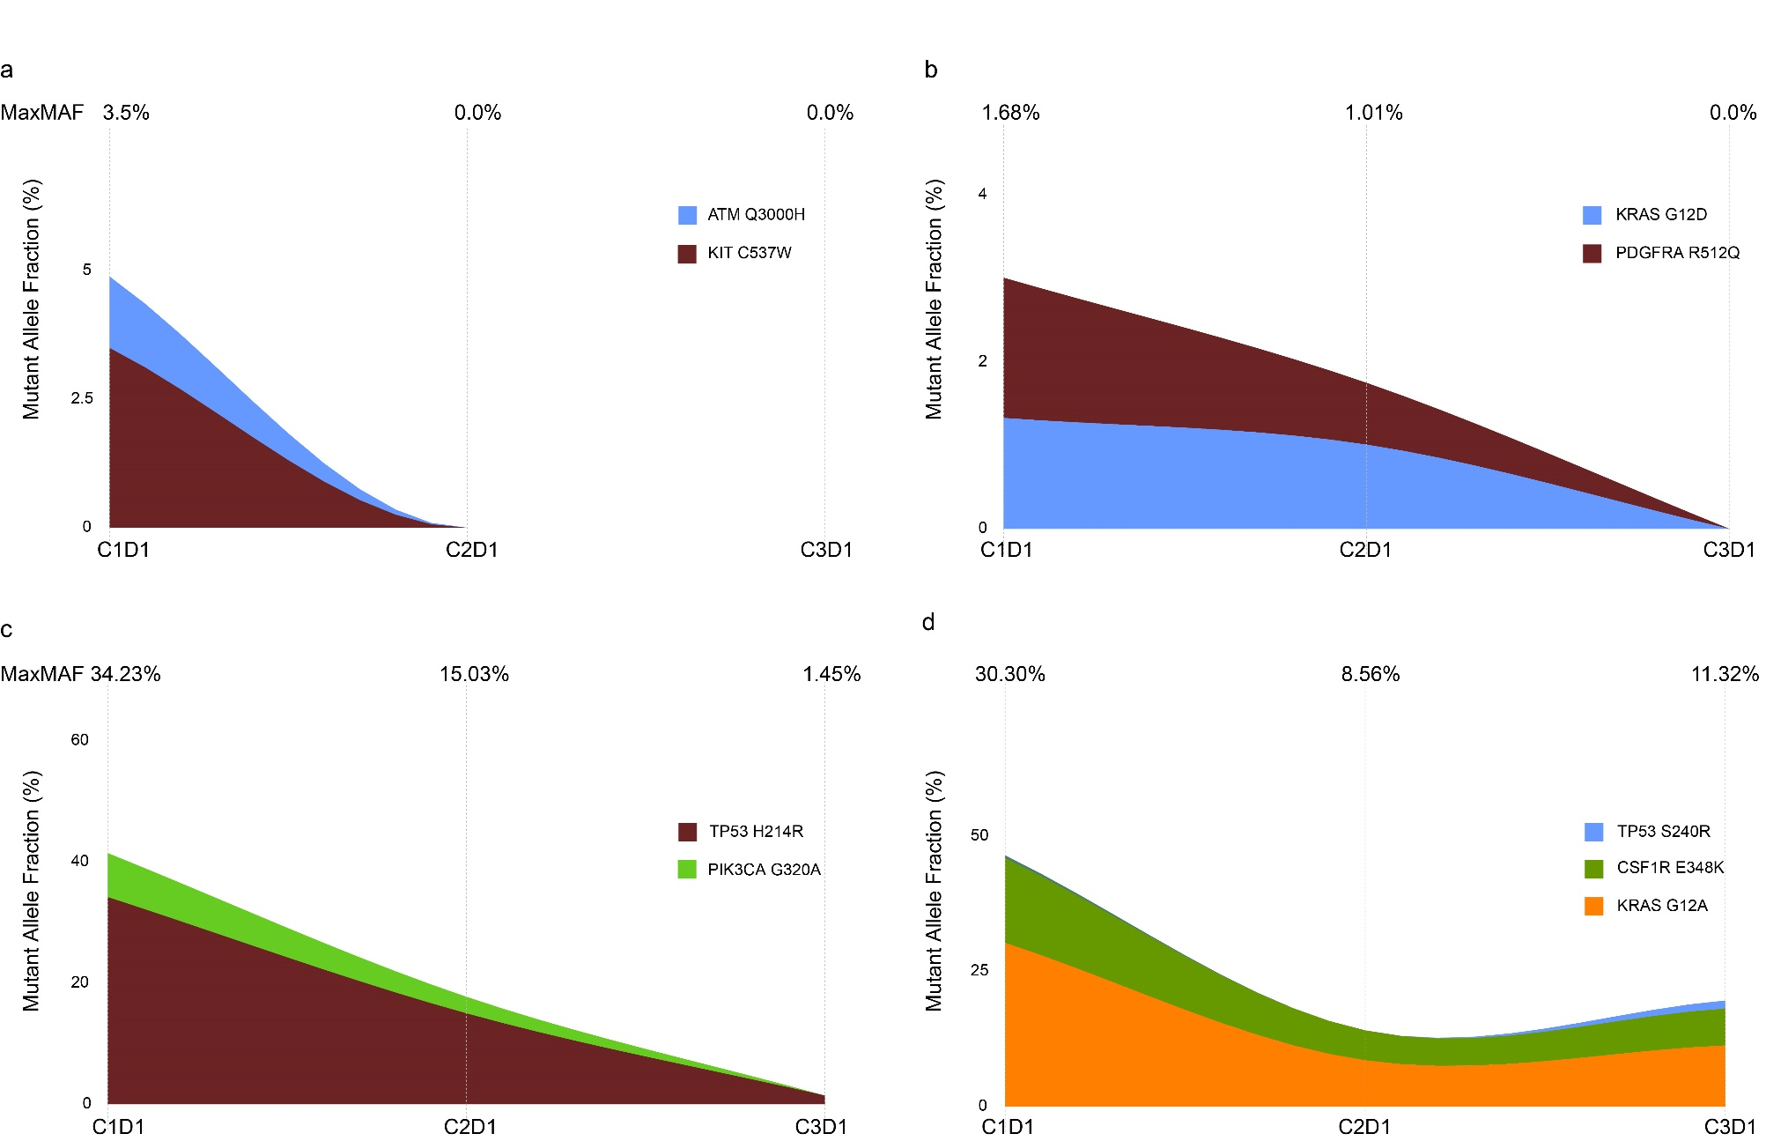
Patterns of ctDNA kinetics
ctDNA clearance at C2
ctDNA clearance at C3
Only 2 patients
ctDNA reduction >85% but <100%
ctDNA persistence at C3
Only 2 patients
Slide courtesy from Dr. Valsamo Anagnoustou
NCT04093167, Anagnostou et al., Nat Med, 2023

Slide 19
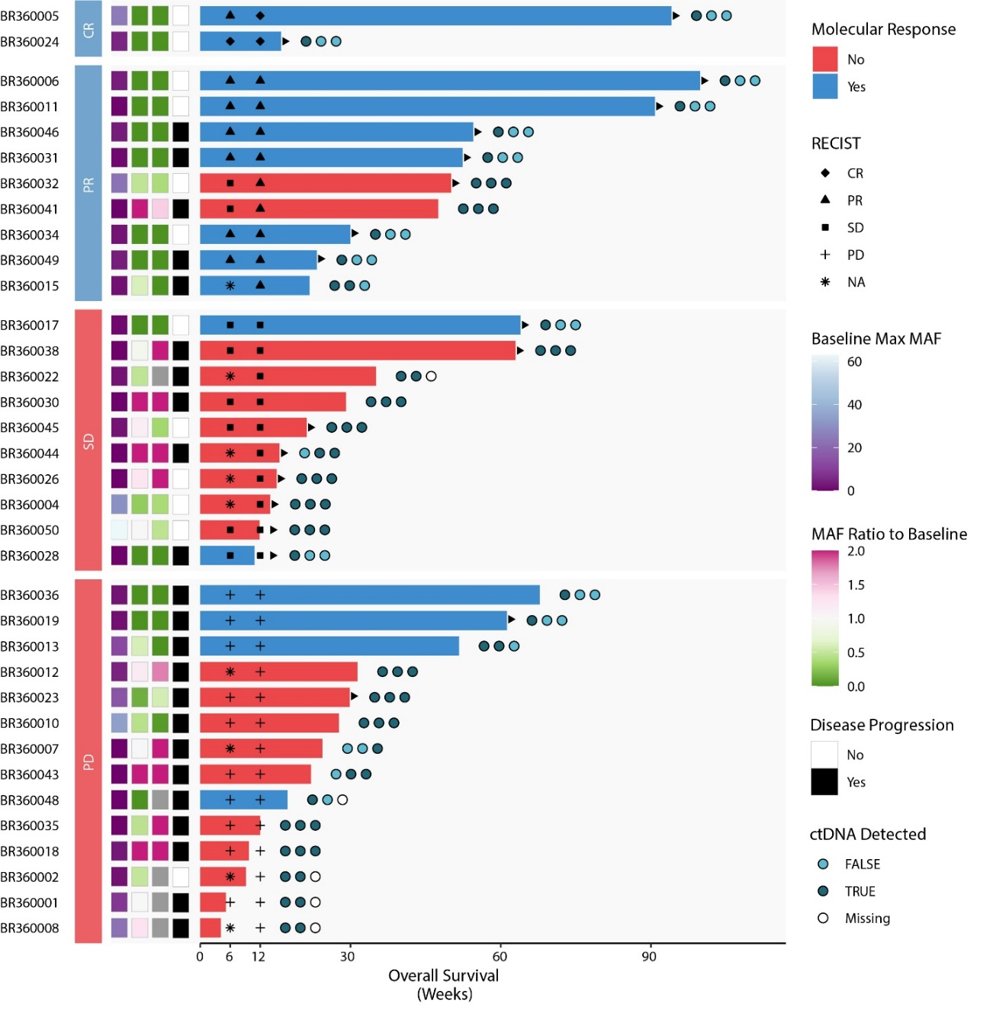
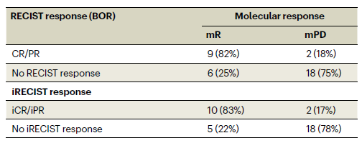
ctDNA-RECIST response concordance
BR.36 stage 1 met its primary endpoint.
The sensitivity of molecular response for RECIST best overall response was 82%, (90% CI: 52% - 97%), specificity was 75% (90% CI: 56.5% - 88.5%).
Slide courtesy from Dr. Valsamo Anagnoustou
NCT04093167, Anagnostou et al., Nat Med, 2023

Slide 20
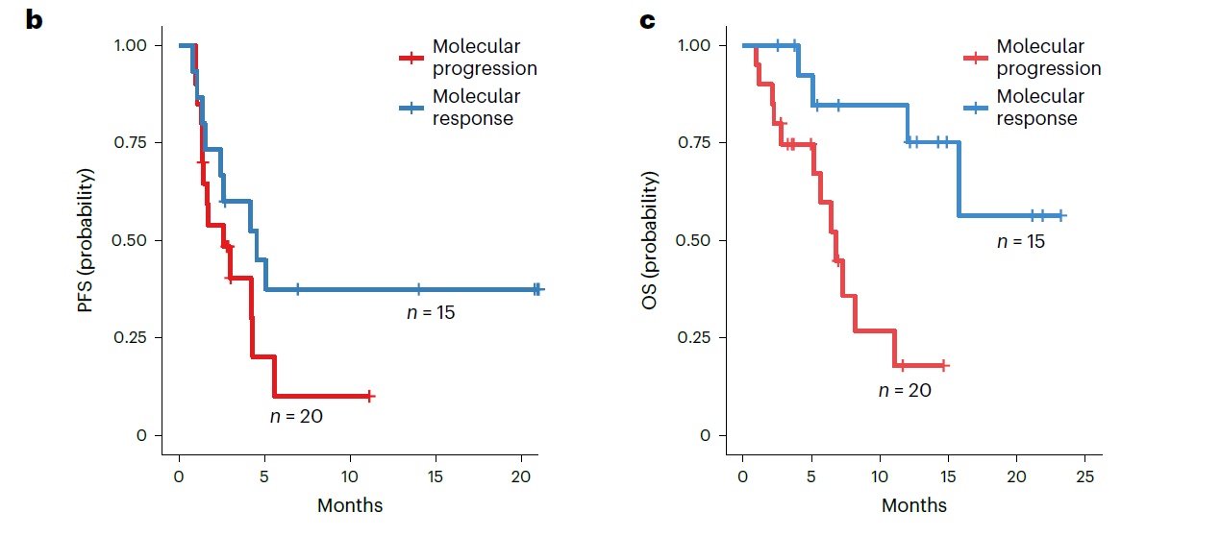
ctDNA molecular response risk stratifies patients with mNSCLC with PD-L1≥ 1%
mOS= NR
mPFS=5.0 mo
mOS=7.2 mo
mPFS=2.6 mo
Median time to ctDNA response was 2.1 months
NCT04093167, Anagnostou et al., Nat Med, 2023

Slide 21
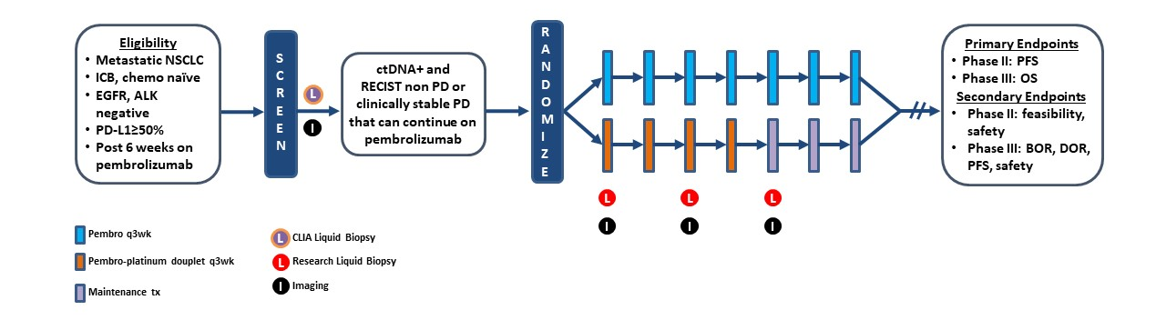
BR.36 stage 2-A Biomarker-Directed, Open Label, Multi-Center Phase II/III Study of Molecular Response Adaptive Immuno-Chemotherapy in Patients with NSCLC
Slide courtesy from Dr. Valsamo Anagnoustou
NCT04093167, Anagnostou et al., Nat Med, 2023

Slide 22
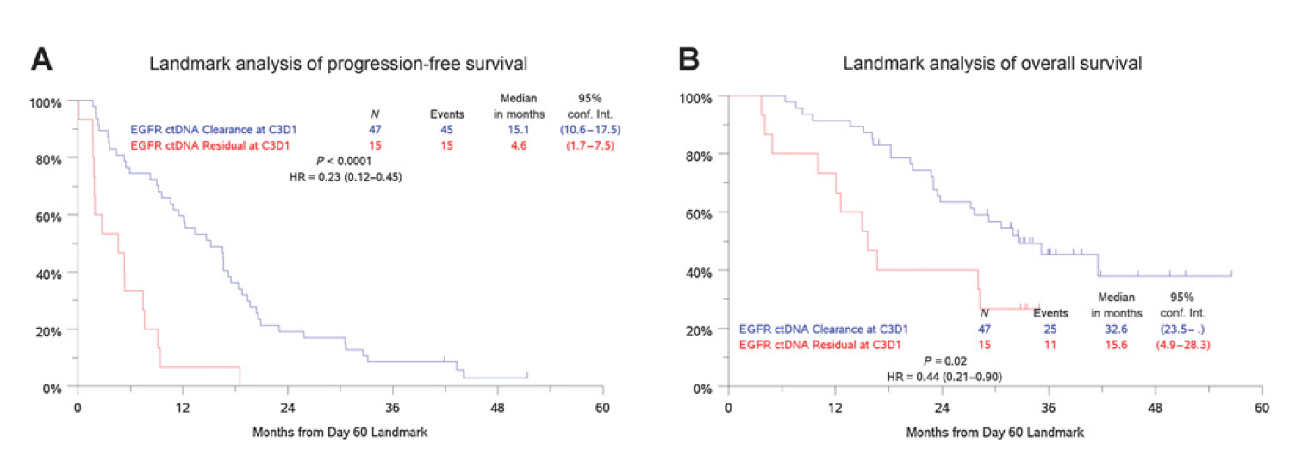
Patients with undetectable EGFR 8 weeks after treatment start had better PFS and OS
Stage IV NSCLC
Tumor-naïve assay (Guardant 360)
Mack PC et al. Clin Cancer Res. 2022

Slide 23
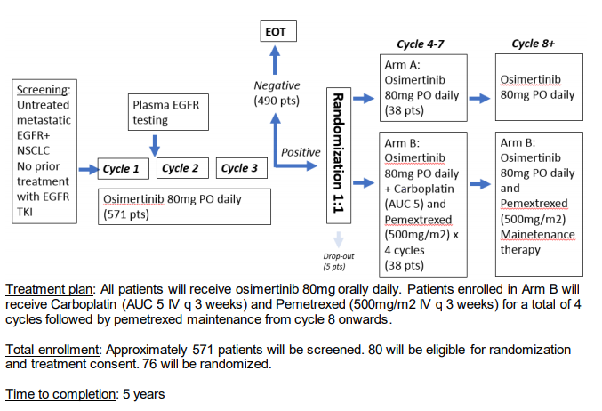
Treatment escalation based on ctDNA detection is under investigation for patients with EGFR mutations
3 weeks into therapy
NCT04410796
National Study PI: Helena Yu, MD (MSKCC); Moffitt PI: Bruna Pellini, MD

Slide 24
Outline
ctDNA definition
Tumor-informed vs. tumor-naïve assays
ctDNA applications in oncology:
Molecular Profiling
Treatment Monitoring
Minimal residual disease (MRD) detection

Slide 25
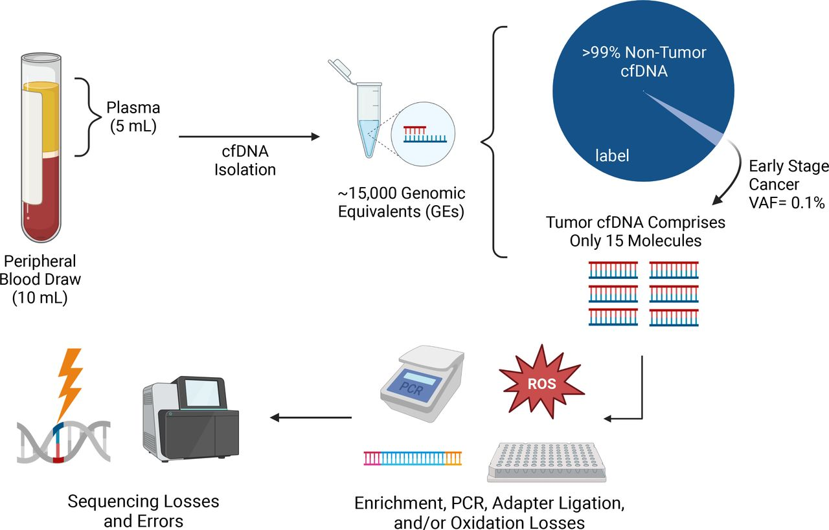
Challenges of ctDNA detection in MRD settings
Semenkovich N et al. J Immunother Cancer. 2023
Notes:
The numbers presented here are estimates for illustrative purposes. From a single 10 mL blood draw, one could potentially recover 15,000 haploid genomic equivalents, which at a VAF of 0.1% equates to only 15 molecules of tumor DNA—with further losses and potential errors during isolation, adapter ligation, enrichment, and sequencing processes

Slide 26
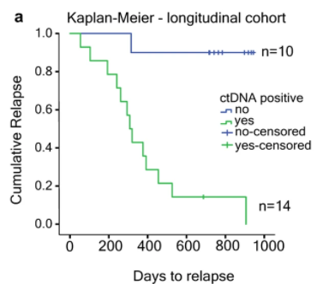
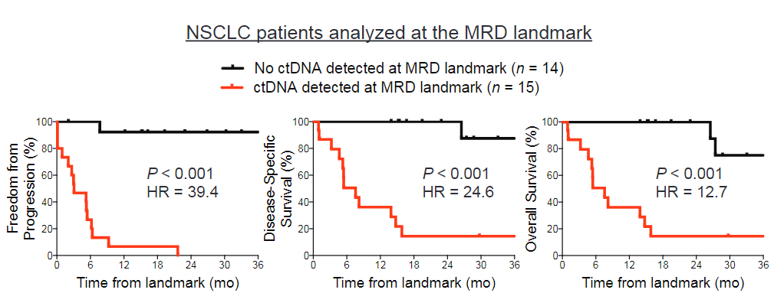

Multiple studies have shown that ctDNA can be used to detect minimal residual disease (MRD) and it is a powerful prognostic biomarker
Stages I-III NSCLC
Tumor-informed assay
(Signatera™)
Stages I-III NSCLC
Tumor-naïve assay (CAPP-Seq)
LOD= 0.002%
(0.1%)
LOD= 0.01%
Abbosh C et al. Nature. 2017
Chaudhuri A et al. Cancer Discov. 2017

Slide 27
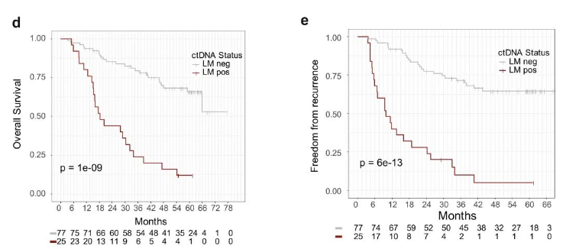
TRACERx
2023 updates
Stages I-III NSCLC
Invitae PCM™
(Tumor-informed assay)
LOD= 0.008%
(0.05%)
Stage I – 50%, stage II – 31%, stage III – 19%
25% pts had + ctDNA on post-operative samples (49% of these patients developed disease recurrence)
51/108 patients (47%) developed disease recurrence
Sensitivity = 49% and Specificity = 96% to detect disease recurrence
Abbosh C et al. Nature. 2023

Slide 28
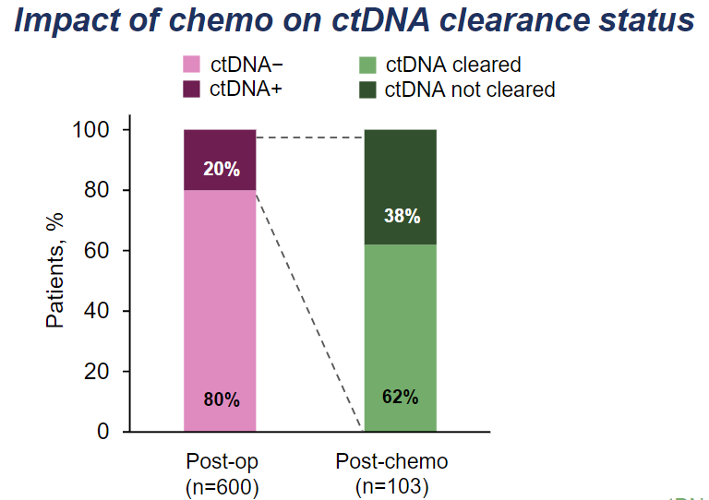
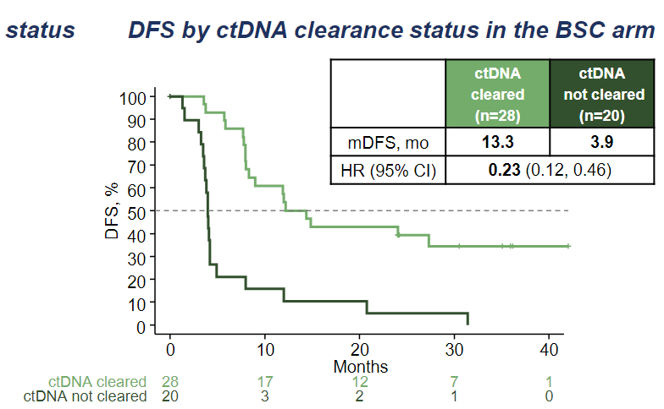
IMpower-010: patients with detectable ctDNA MRD after adjuvant chemotherapy have worse prognosis
Presented by Enriquera Felip. ESMO Immuno-Oncology Congress 2022, Abstract 1O (https://bit.ly/3sZVgye)

Slide 29
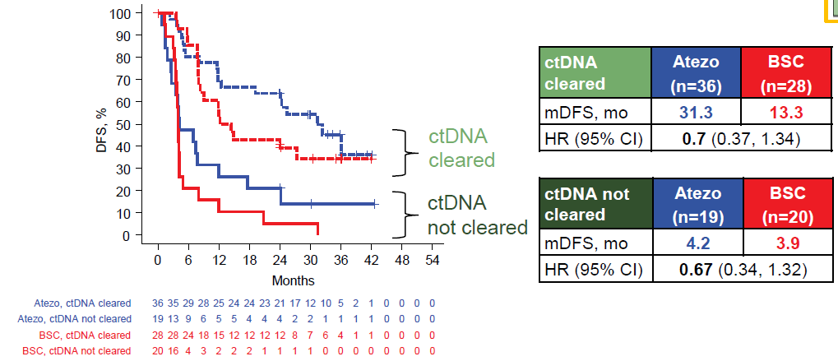
IMpower-010: data suggests adjuvant atezolizumab delays conversion to ctDNA +
Stages I-III NSCLC
Tumor-informed assay
(Signatera™)
ctDNA status post- adjuvant chemotherapy
Presented by Enriquera Felip. ESMO Immuno-Oncology Congress 2022, Abstract 1O (https://bit.ly/3sZVgye)

Slide 30
The sensitivity to detect disease recurrence is heterogenous across different platforms and may be too low
Author & Year | No.ª | Clinical Stage | Treatment | ctDNA Assay | Sensitivity (%)^{b} | Specificity (%)^{b}
Chaudhuri et al (2017)^{c} | 32 | IB-IIIB | CRT or RT and/or surgery +/- chemo | CAPP-Seq | 94 | 100
Abbosh et al (2017)^{d} | 24 | IA-IIIB | Surgery +/- chemo +/- PORT | Signatera | 36 | 90
Chen et al (2019)^{e} | 25 | IIB-IIIB | Surgery +/- chemo | cSMART | 44 | 88
Zviran et al (2020)^{f} | 22 | IA-III | Surgery +/- chemo and RT | MRDetect | 100 | 71
Pellini B & Chaudhuri A. J Clin Oncol. 2022

Slide 31
Interrogating ctDNA in multiple timepoints after curative-intent treatment improves the sensitivity to detect disease recurrence
Author & Year | No.ª | Clinical Stage | Treatment | ctDNA Assay | Sensitivity (%)^{b} | Specificity (%)^{b}
Chaudhuri et al (2017)^{c} | 37 | IB-IIIB | CRT or RT and/or surgery +/- chemo | CAPP-Seq | 100 | 100
Abbosh et al (2017)^{d} | 24 | IA-IIIB | Surgery +/- chemo | Signatera | 93 | 70
Abbosh et al (2020)^{e} | 78 | I-III | Surgery +/- chemo | ArcherDx | 82 | 96
ctDNA post-treatment surveillance studies in NSCLC
Pellini B & Chaudhuri A. J Clin Oncol. 2022

Slide 32
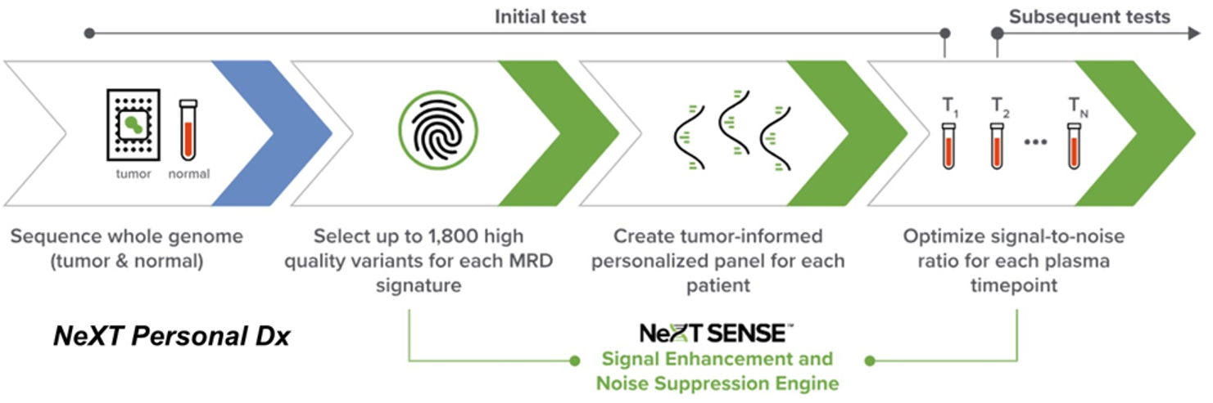
Will WGS solve the issue of clinical sensitivity?
Stages I-III NSCLC
Tumor-informed assay
(NeXT Personal®)
LOD = 0.00037%
(4ppm)
Garcia-Murillas, I. ASCO 2024. JCO 42, 1010-1010(2024).
DOI:10.1200/JCO.2024.42.16_suppl.1010
Notes:
ESMO 2023-Black et al—Prelim data cohort—54% clinical sensitivity in predicting recurrence 10-120 days after surgery vs 85% clinical sensitivity with surveillance/96% specificity– lead time 173 days
n= 170

Slide 33
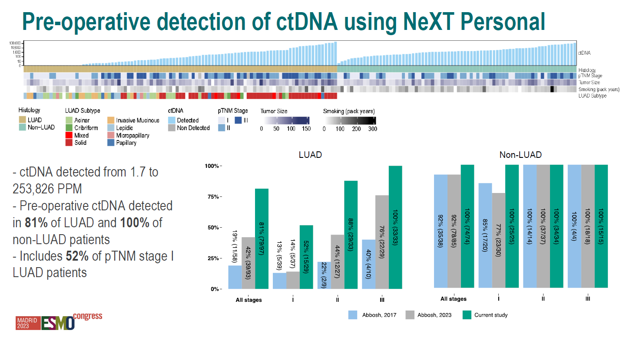
Slide courtesy from Black JRM. 2023 ESMO
Notes:
Detection of ctDNA for adenocas 81% vs 42% with Invitae’s PCM and 19% for Natera; SCC 100% vs. 92% for Invitae and Natera
Pre-surgery
Stage I- 52% ctDNA +
Stage II- 88% ctDNA +
Stage III- 100% ctDNA +

Slide 34
Current treatment landscape for resectable NSCLC
IMpower-010
KEYNOTE-091
Surgery
Adjuvant Chemotherapy
Adjuvant Immunotherapy
Neoadjuvant Chemoimmunotherapy
Surgery
NADIM
CheckMate-816
Neoadjuvant Chemoimmunotherapy
Surgery
Adjuvant Immunotherapy
AEGEAN
KEYNOTE-671
Neotorch
CM77T

Slide 35
Current treatment landscape for resectable NSCLC
IMpower-010
KEYNOTE-091
Surgery
Adjuvant Chemotherapy
Adjuvant Immunotherapy
Neoadjuvant Chemoimmunotherapy
Surgery
NADIM
CheckMate-816
pCR rates= 17.2-24.9%
MPR rates= 30.2-48.5%
Neoadjuvant Chemoimmunotherapy
Surgery
Adjuvant Immunotherapy
AEGEAN
KEYNOTE-671
Neotorch
CM77T

Slide 36
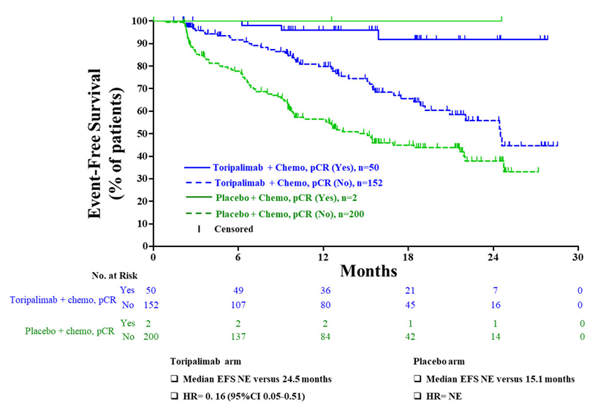
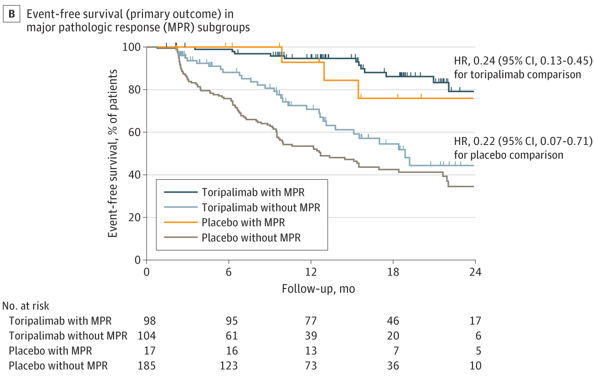
Neotorch: EFS based on pCR and MPR
pCR
MPR
Lu S et al. JAMA. 2024

Slide 37
Unanswered questions
Tumor-informed vs. tumor-naïve assays– which one is better?
How many timepoints should we use to guide treatment escalation or de-escalation in trials and clinical practice?
Will treatment de-escalation based on MRD status be equal to SOC?
Will treatment escalation based MRD status improve DFS and OS?
Notes:
Detection of ctDNA in non-adenocarcinomas was relatively high for both prior assays at 92 percent. NeXT Personal detected ctDNA in 100 percent. The difference in adenocarcinomas was more striking with an overall ctDNA detection rate of 81 percent for Personalis compared to 42 percent and 19 percent in the studies involving Invitae's and Natera's assays, respectively.

Slide 38
How do I treat ctDNA positive after a complete resection?
I do not order ctDNA in the MRD setting given assay limitations and lack of proven clinical utility
If you choose to order ctDNA in the post-op setting, what would I recommend?
Obtain a pre-neoadjuvant or pre-surgical blood specimen for ctDNA analysis→ ctDNA dynamics matter for risk stratification
Assess ctDNA after surgery if you have given neoadjuvant therapy or after chemotherapy if you have opted for the surgery first approach→ your MRD timepoint should be prior to adjuvant immunotherapy selection
If clinically feasible, obtain blood samples in 2 MRD timepoints→ 2 weeks post-op & 4 weeks post-op
Analyze your ctDNA MRD results together with your pathological response findings
You need to analyze ctDNA in at least 3 timepoints to increase the odds of obtaining clinically meaningful information

Slide 39
We need clinical trials that will investigate escalation and de-escalation based on MRD status to then change our clinical practice
Enrollment
Stage II-IIIb NSCLC (EGFR and ALK wt locally)
3-4 Cycles of Histology Specific Chemotherapy
+
Anti-PD-1/L1
Durvalumab
SWOG
Randomize
PathCR
Surveillance
Defintive resection
ECOG
Treatment Escalation
Non-path CR
S2414, “A Randomized Phase III Trial INcorporating Pathologic Complete ReSponse in Participants with Early StaGe Non Small Cell Lung Cancer to Optimize ImmunotHerapy in the AdjuvanT Setting (INSIGHT)”
Durvalumab

Slide 40
Take home points
ctDNA detection during induction chemoIO may offer an opportunity to identify patients at high-risk for disease progression and inform selection of novel personalized maintenance treatment strategies
Tumor-uninformed (agnostic) ctDNA molecular response at 6-8 weeks into IO monotherapy in advanced PD-L1(+) NSCLC is can identify patients with improved clinical outcomes
ctDNA can detect MRD and it is a strong prognostic biomarker
One timepoint MRD status may not be enough to inform clinical-decision making
Tumor-informed MRD assays will not be feasible for patients with pCR and MPR
Ongoing trials will inform if clinical decision-making can be guided by ctDNA and if that improves patients’ outcomes

Slide 41


Thank you!
www.moffitt.org
Bruna.Pellini@moffitt.org
@BrunaPellini

