Slide 1
The Impact of Precision Medicine in Lung Cancer Care
Ticiana Leal, MD
Associate Professor
Director, Thoracic Oncology Program
Medical Director, Clinical Trials Office
Winship Cancer Institute
Emory University
Vice President/President-Elect, GASCO

Slide 2
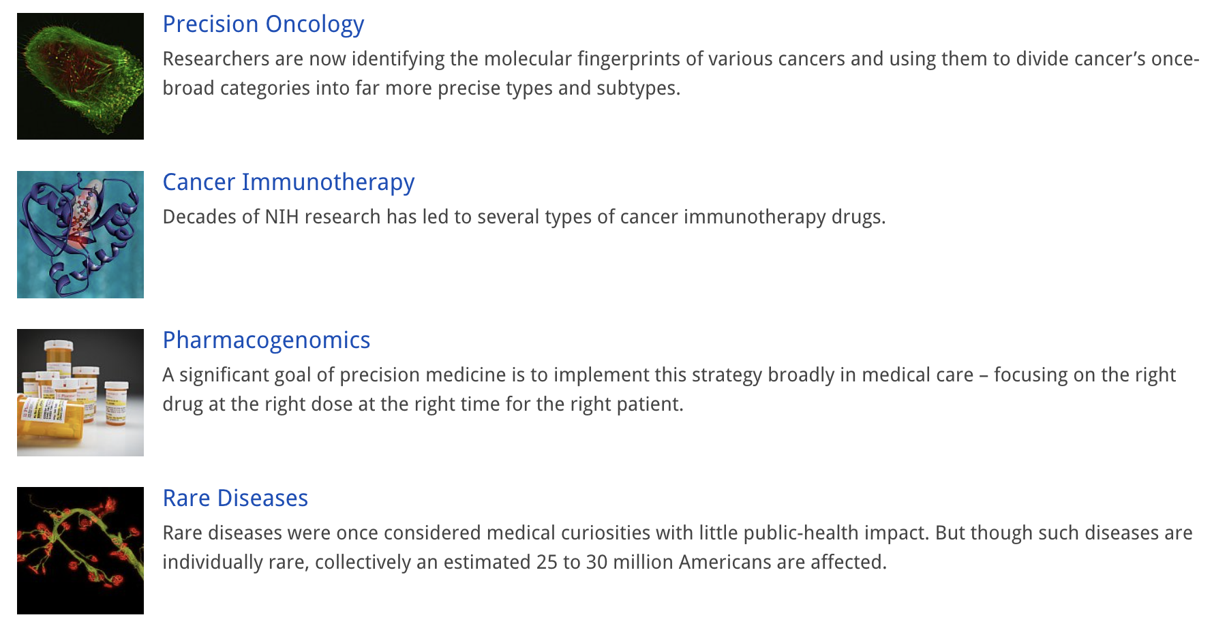
Precision Medicine
Precision medicine is an innovative approach that takes into account individual differences in patients’ genes, environments, and lifestyles.
https://www.nih.gov/about-nih/what-we-do/nih-turning-discovery-into-health/promise-precision-medicine

Slide 3
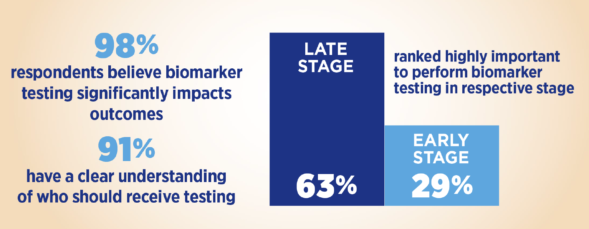
IASLC Global Molecular Testing Survey - 2024
Smeltzer M et al. WCLC 2024.

Slide 4
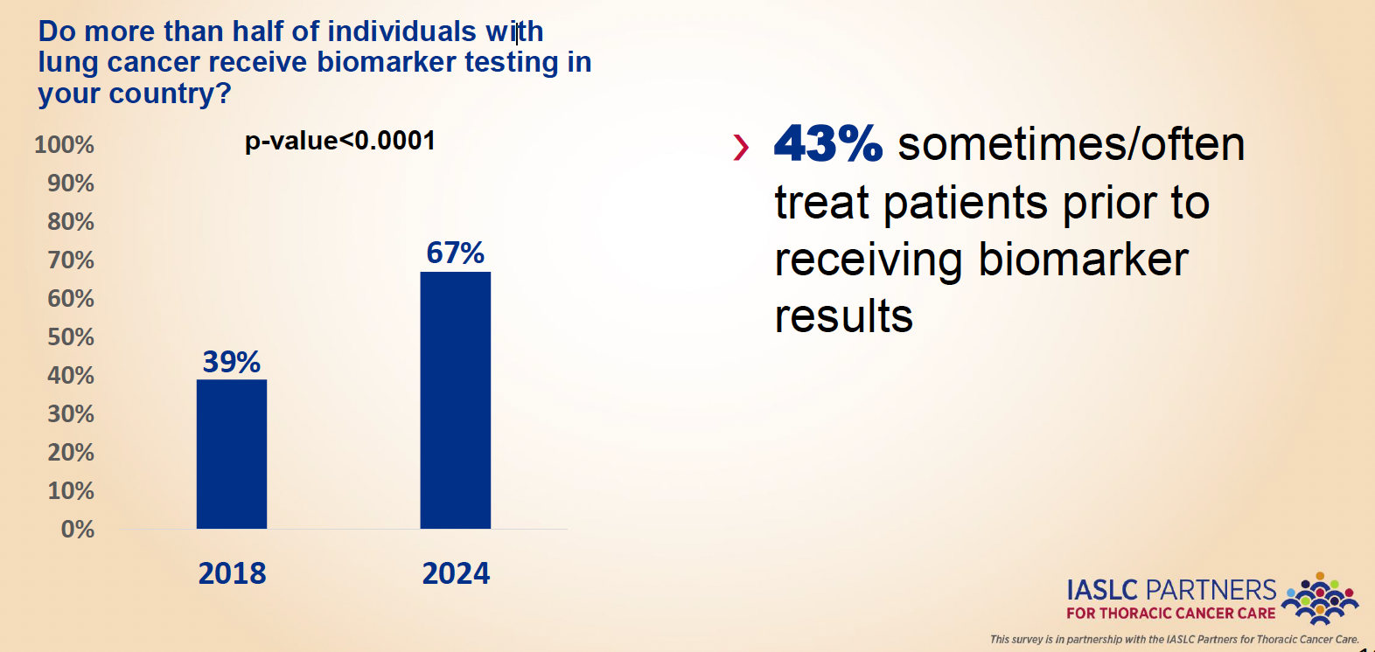
IASLC Global Molecular Testing Survey - 2024
Smeltzer M et al. WCLC 2024.

Slide 5
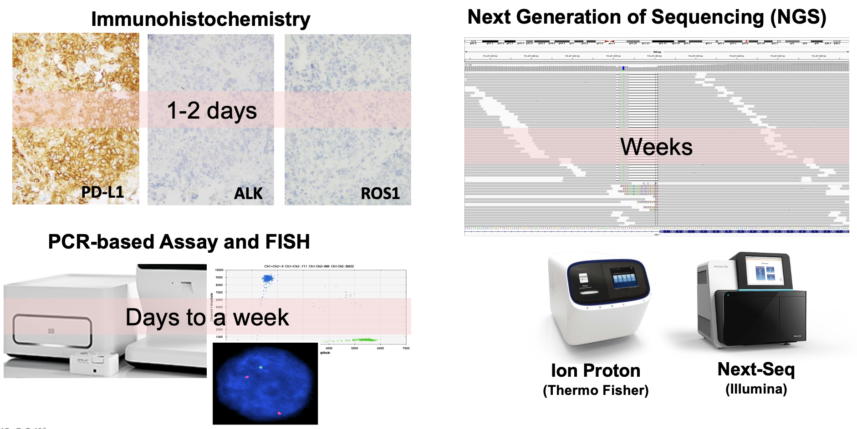
NSCLC Biomarker Testing → Tricky Timing
Slide (modified) Courtesy of Lynette Sholl, MD, Harvard Medical School and Brigham And Women’s Hospital

Slide 6
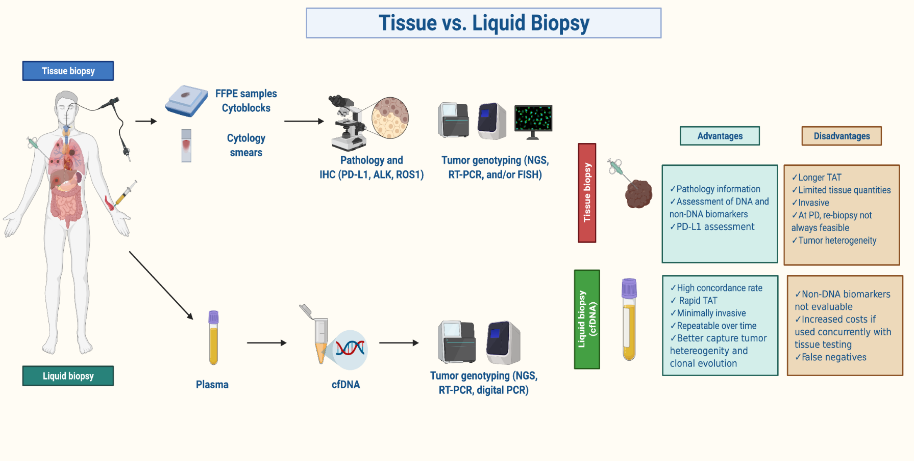
Tissue + Liquid Biopsy for Molecular Profiling
C. Rolfo et al, J Thorac Oncol, 2021

Slide 7
Molecular results inform use of targeted therapy in all stages of disease in NSCLC
In early-stage disease:
-Determining who to offer targeted therapy to; who to not give neoadjuvant or adjuvant immunotherapy to
-Potentially in determining assays for MRD
In unresectable stage III disease:
-Avoiding immunotherapy; Using targeted therapy
In advanced disease:
-Where targeted agent likely SoC first line; Potential to combine or use with other modalities; To investigate resistance mechanisms
Clinical trial options at all stages

Slide 8
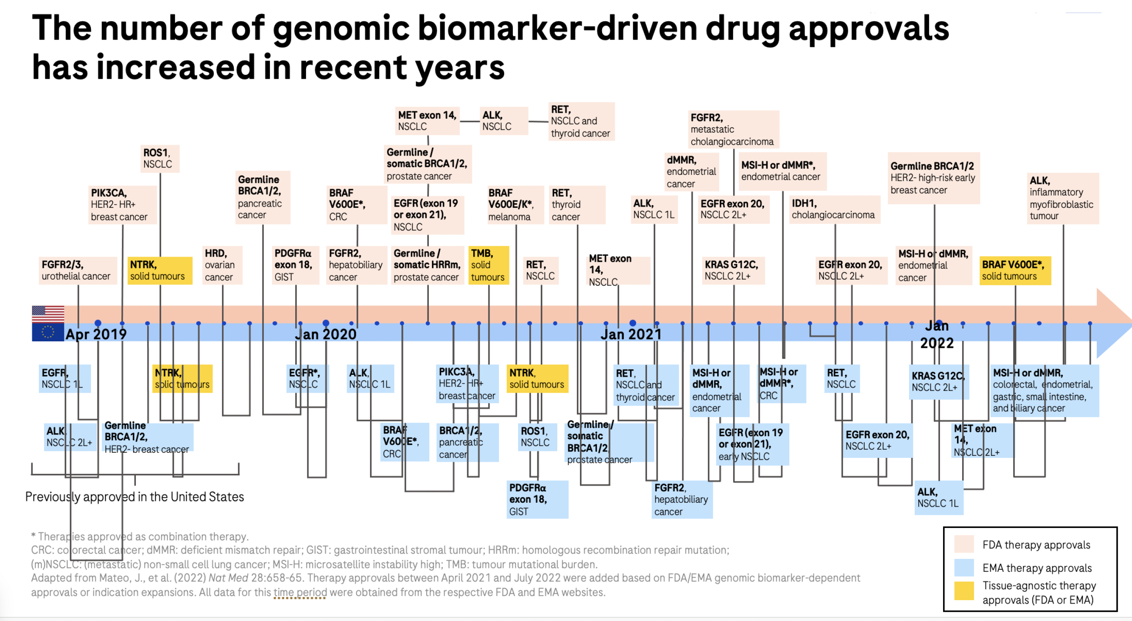
Molecular results inform use of targeted therapy in tumor agnostic indications
Adapted from John T, WCLC 2024.

Slide 9
In early-stage NSCLC:
MRD could be used to determine duration of therapy
-MRD negative after stopping
Molecular abnormalities can be predictive for lack of immunotherapy benefit
-EGFR (ADAURA)
-ALK (ALINA)
Tsuboi et al. N Engl J Med 2023;389:137-147; Wu et al. N Engl J Med 2024;390:1265-1276

Slide 10
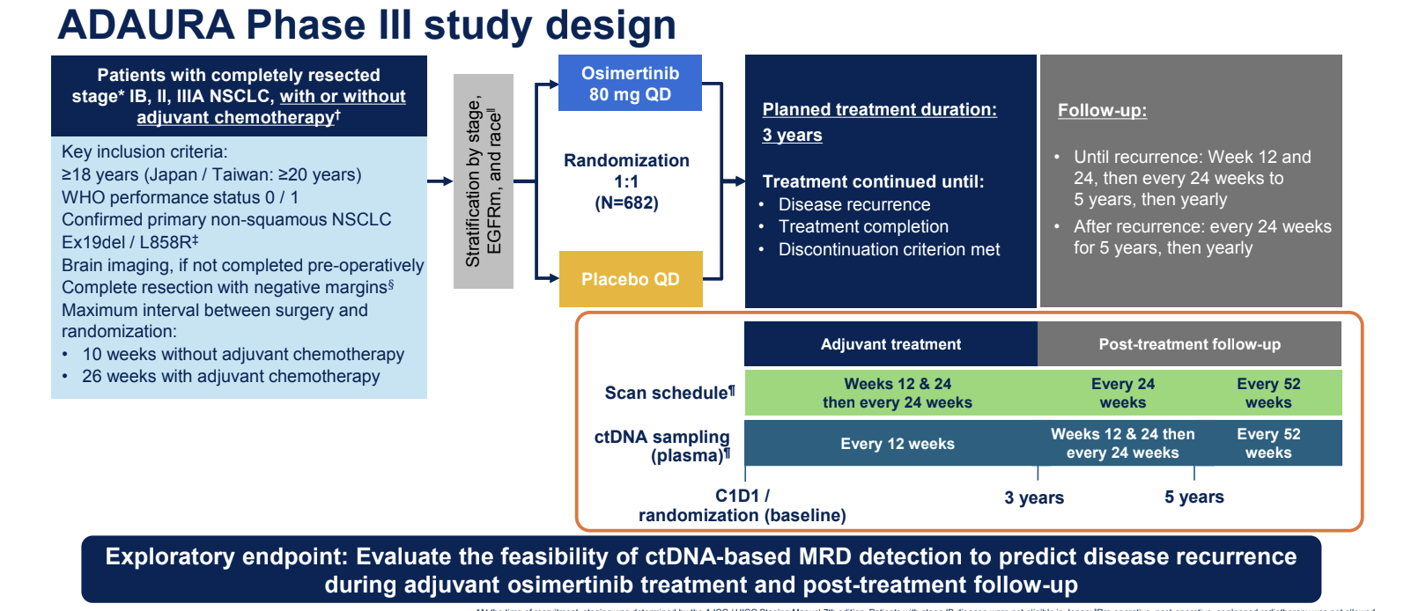
John T, ASCO 2024.

Slide 11
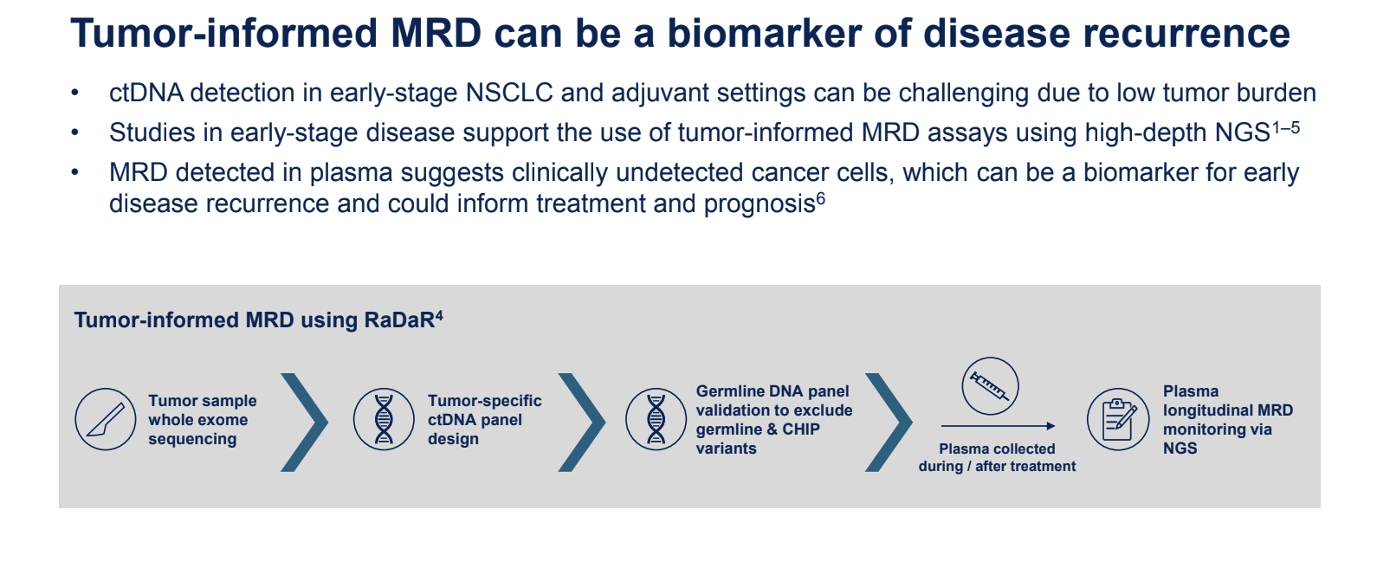
John T, ASCO 2024.

Slide 12
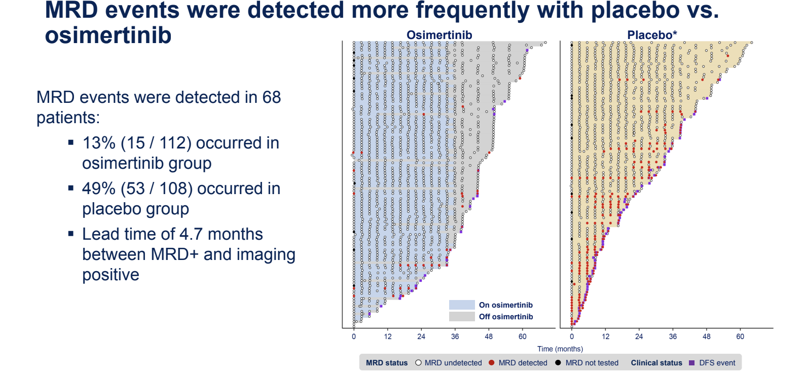
John T, ASCO 2024.

Slide 13
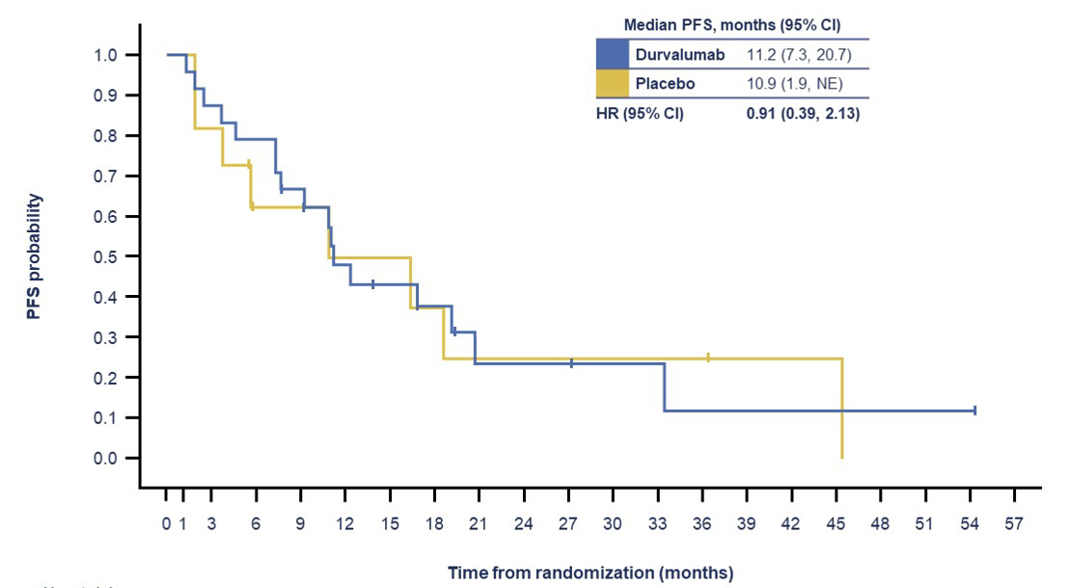
In Stage III: Lack of benefit with immunotherapy in EGFR NSCLC
A post-hoc analysis of PACIFIC included 35 patients with NSCLC with EGFR mutations (69% common and 31% other EGFR alterations or combinations) revealed similar PFS between the durvalumab and placebo groups (11.2 vs. 10.9 mos)
Naidoo et al. JTO 2023.

Slide 14
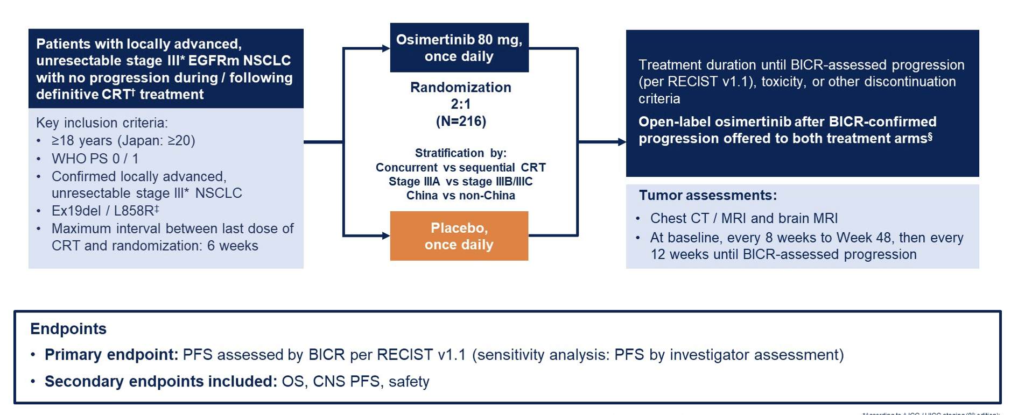
LAURA trial
Ramalingam et al. ASCO 2024. Lu S et al. NEJM, 2024

Slide 15
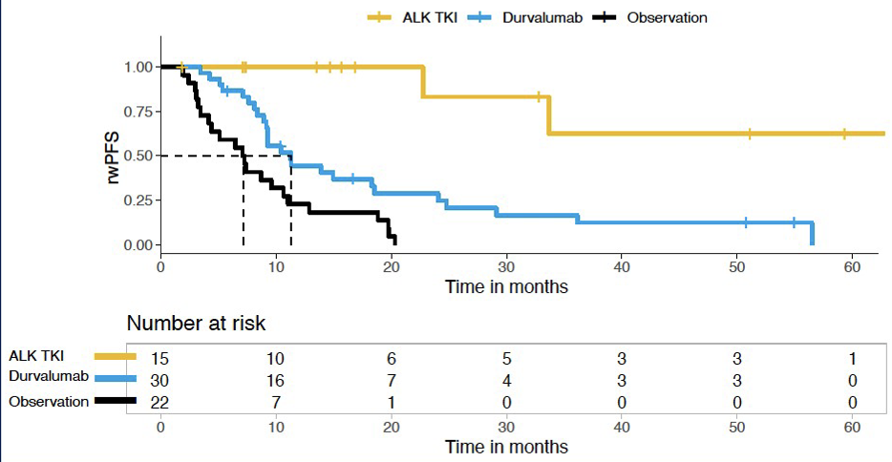
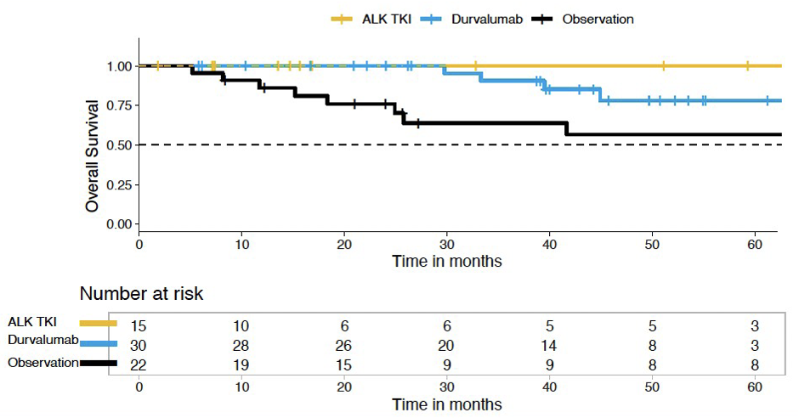
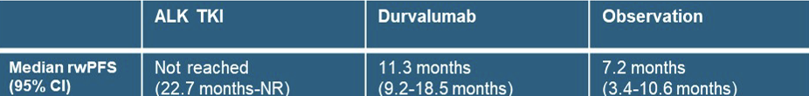

Consolidation ALK Tyrosine Kinase Inhibitors Versus Durvalumab or Observation
After Chemoradiation in Unresectable Stage III ALK-Positive NSCLC
Nassar et al. J Thorac Oncol. 2024 Sep 10:S1556-0864(24)02265-2.

Slide 16
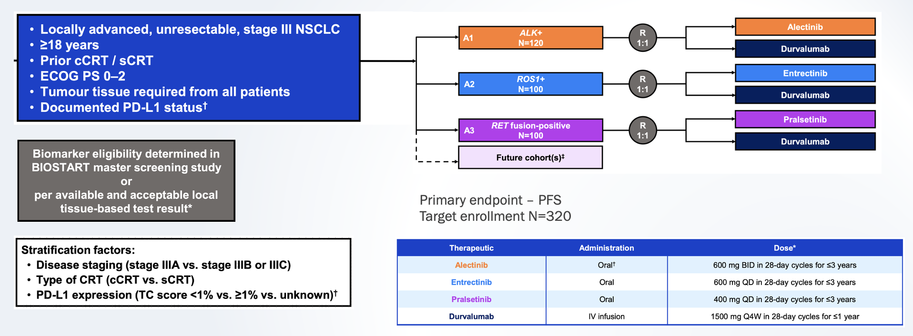
HORIZON-01
A phase I–III platform study evaluating the safety and efficacy of multiple therapies in patients with biomarker-defined locally advanced, unresectable, stage III non-small cell lung cancer (NSCLC)
Nassar et al. J Thorac Oncol. 2024 Sep 10:S1556-0864(24)02265-2.

Slide 17
In advanced disease:
Molecular testing personalizes treatment in front-line and is the preferred 1L treatment in NSCLC
May assist in deciding role of combination therapies if presence of high-risk co-mutations
May inform on mechanisms of resistance and assist in optimizing second-line strategies

Slide 18

Barriers to Precision Oncology
In 2024, perceived testing rates improved over 2018 but that substantial barriers to testing persist and are similar regardless of tumor stage.
The IASLC conducted a survey in 2024 to assess current practices. The survey revealed the barriers to adoption of biomarker testing:
The IASLC conducted a survey in 2018 to assess current practices. The survey revealed the barriers to adoption of biomarker testing:
❯Cost
❯Lack of quality and standards
❯Access
❯Awareness
❯Long turnaround times
Smeltzer M et al. WCLC 2024.

Slide 19
Opportunities in Precision Oncology
Key solutions focused on (2024 IASLC survey respondents):
-Education
-Clinical processes
-Eliminating bureaucracy in government and payer organizations
-Increasing funding
Smeltzer M et al. WCLC 2024.

Slide 20
Opportunities in Precision Oncology
Collaboration across institutions
Telemedicine
Virtual Tumor Boards/Molecular Tumor Boards
Training Programs

Slide 21
Emory Precision Medicine Preceptorship in Breast & Lung Cancer for Latin American Oncologists
Medical oncologists within 6 years of final oncology training
Funded 2-week immersion involving didactics, clinical exposures, and research meetings focused on breast and lung cancer genomics
All completed:
-Baseline needs assessment
-Pre-program survey: assess goals and confidence in skills
-Post-program interview: evaluate program and reassess confidence in skills
Gogineni K, Leal T, Dixon MD, Rana SA, Pentz R. JCO 42, (suppl 16; abstr 9040)

Slide 22
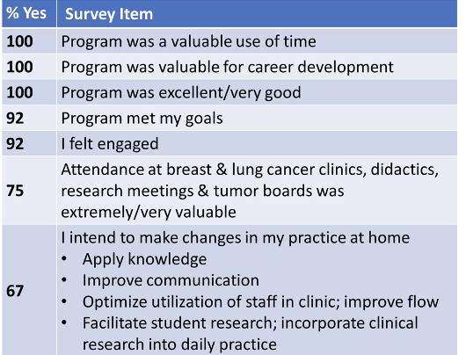
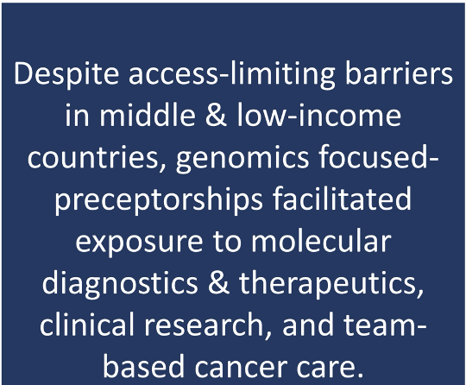
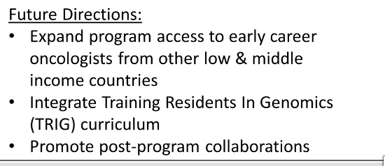
Emory Precision Medicine Preceptorship in Breast & Lung Cancer for Latin American Oncologists
Results: From 2020-23, Twelve Latin American Oncologists participated at Winship
Gogineni K, Leal T, Dixon MD, Rana SA, Pentz R. JCO 42, (suppl 16; abstr 9040)

Slide 23
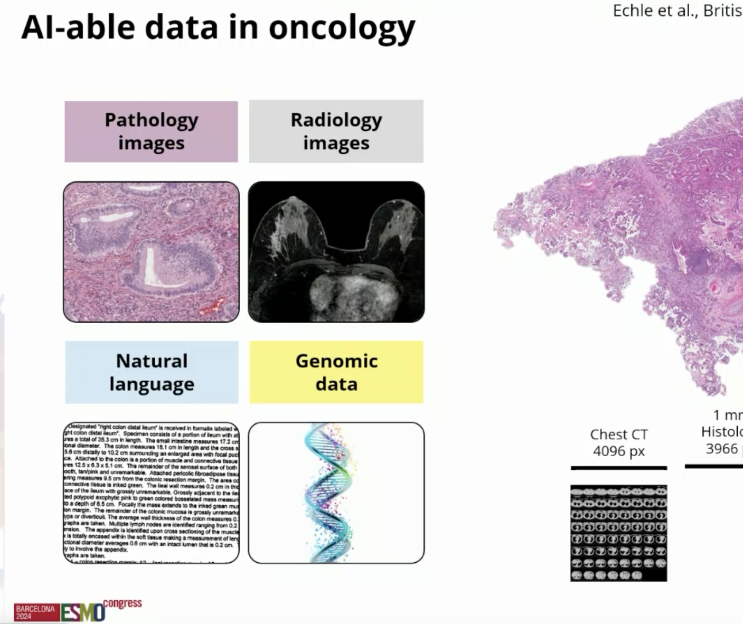
Artificial intelligence has the potential to transform precision oncology
Large language models (LLMs) are a type of AI that can process large and diverse volumes of text at human-level competency to deal with the rapidly expanding amount of patient-specific data in oncology, and then generate outcome text from the processed information.
Truhn D et al. NPJ Prec Oncol. 2024;8:72; Rosler et al. J Cancer Res Clin Oncol 2023 Aug;149(10):7997-8006; Kather J. ESMO 2024.

Slide 24
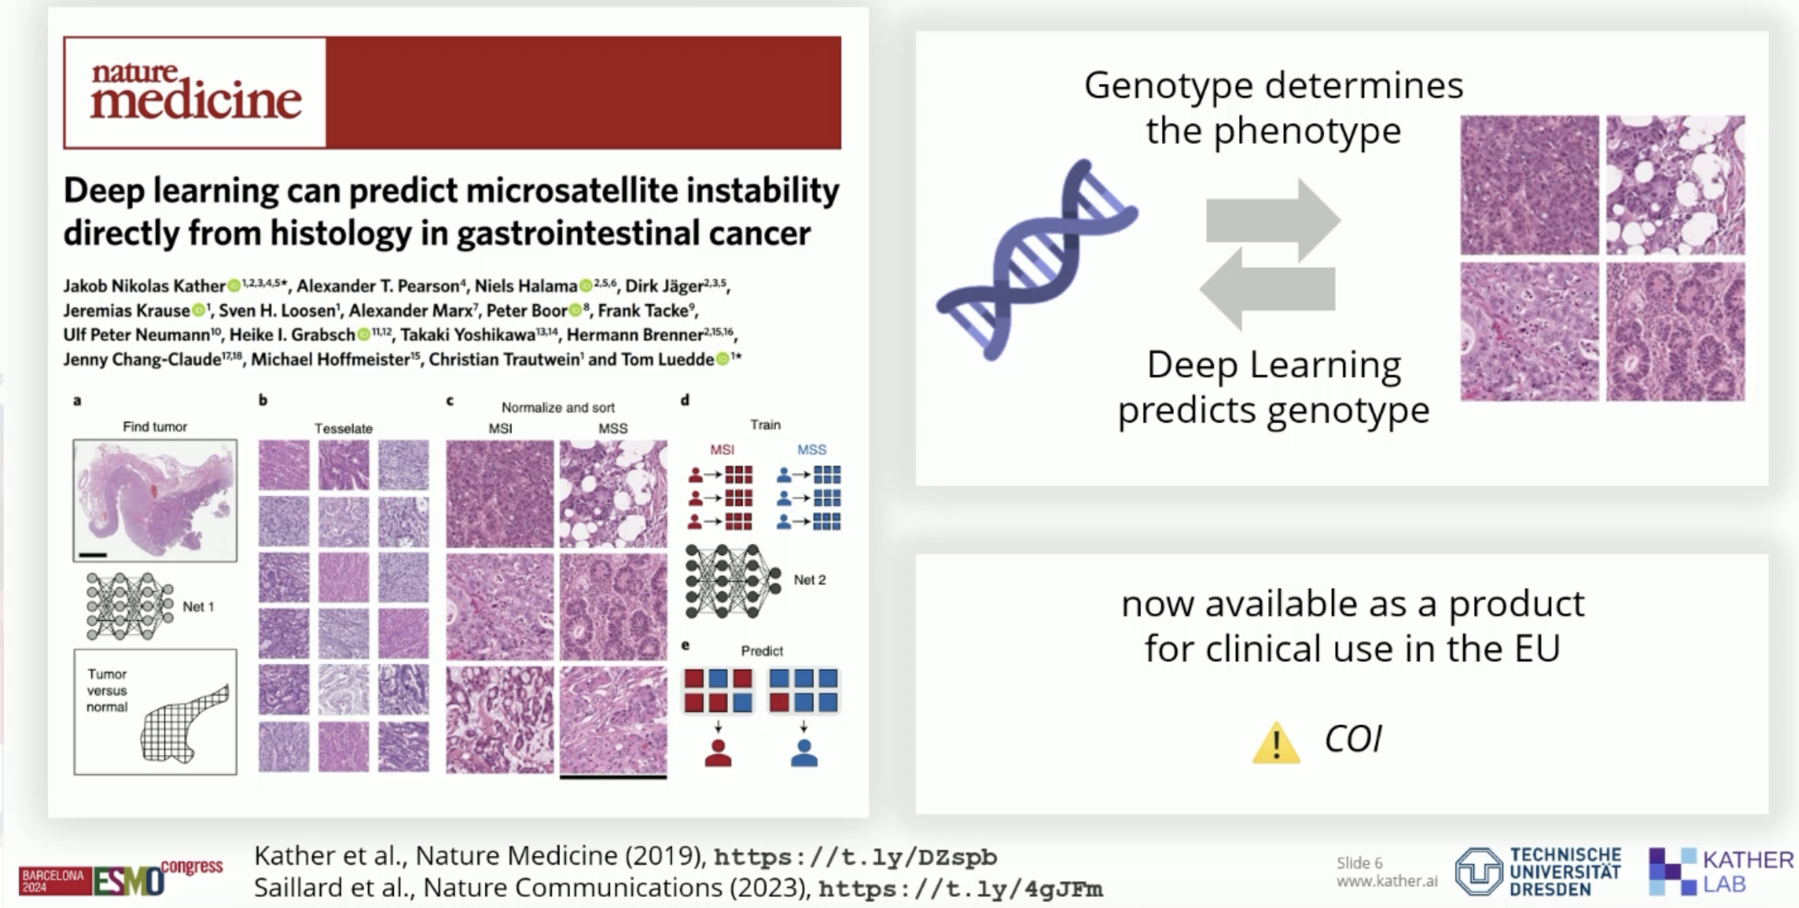
Predicting biomarkers with AI
Kather J. ESMO 2024.

Slide 25
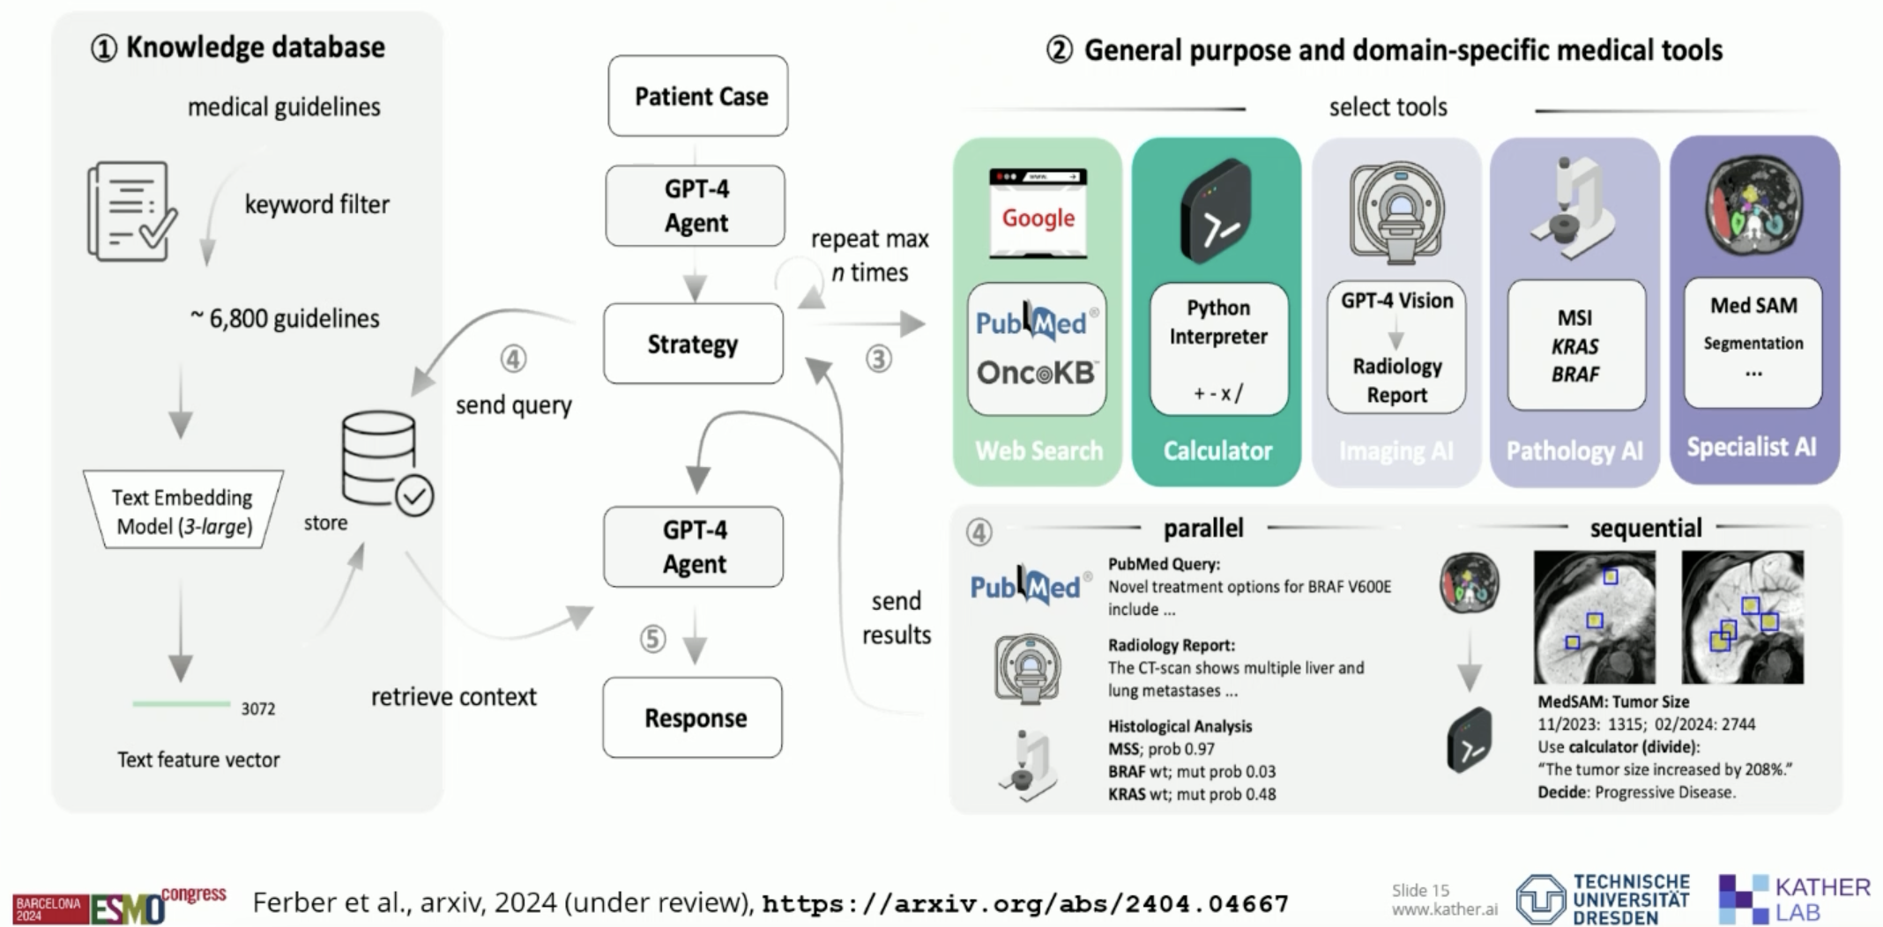
Decision-making support with AI
Kather J. ESMO 2024.

Slide 26
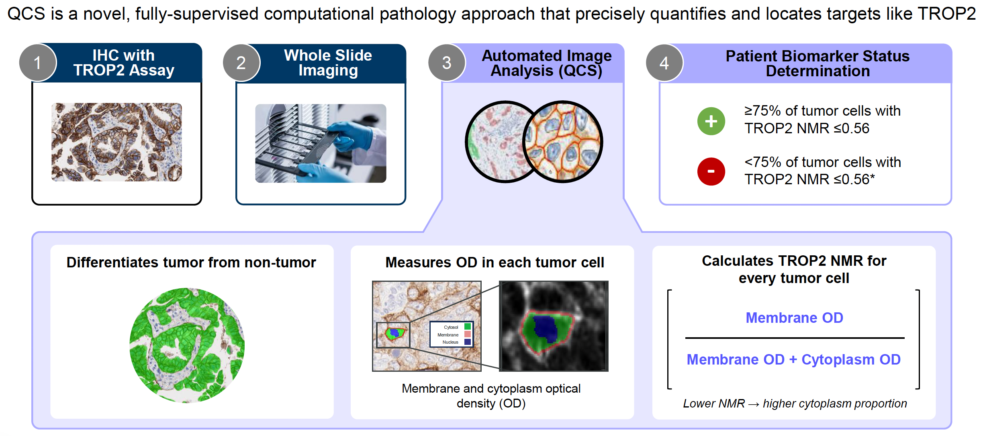
TROP2 Normalized Membrane Ratio (NMR) measured by Quantitative
Continuous Scoring (QCS)
Garassino M et al. WCLC 2024.

Slide 27
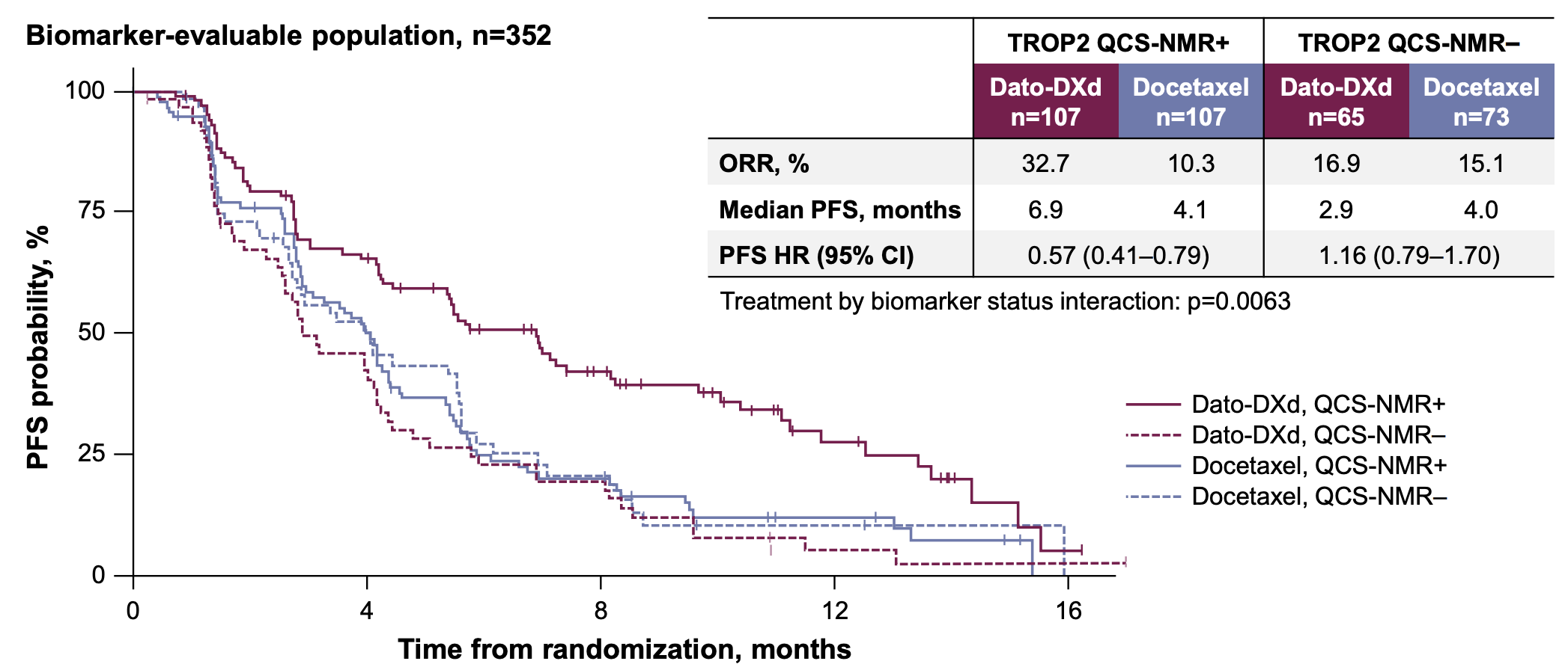
TROP2 QCS-NMR positivity is predictive for longer PFS with Dato-DXd in the biomarker-evaluable population
Further investigation of this promising biomarker is ongoing in the first-line advanced/metastatic NSCLC trials AVANZAR (NCT05687266) and TROPION-Lung 10 (NCT06357533)
Garassino M et al. WCLC 2024.

Slide 28
Take Home Points
Molecular results inform use of targeted therapy in all stages of disease in NSCLC and may predict lack of benefit from immunotherapy or need to escalate/de-escalate therapies; however, costs and time are still barriers
Precision medicine has led to approval with tumor agnostic approaches and the number of therapies is rapidly increasing
Use of MRD can be useful for detecting risk of early recurrence and may inform therapeutic decisions
Use of AI has the potential to transform Precision Medicine

Slide 29


Thank you! Questions?

